Slide 1
Action Learning Sets
Housing & Mental Health
Set 3: Service User Involvement
Somoud Saqfelhait &
Jon Beech
www.touchstone-leeds.co.uk

Slide 2
Intro and Recap
Outcomes of Day 1
Getting to know one another
Principles of Action Learning
Outcomes of Day 2
Finalizing Project
Practice of Action Learning

Slide 3
Outcomes of Set 3
By the end of the day we will have
Practiced Action Learning more
Shared our Projects with the wider group
Explored the various forms of Service User involvement/participation
Learned why it’s important to choose the right kind of participation
Identified opportunities for greater service user participation in our Projects
Produced a project plan (including measurable outcomes)

Slide 4
Morning Outline : Set 3
9.30 Coffee, Homework
10.00 Welcome: Recap, Overview
10.10 Exercise: With a little help from my friends
10.25 Action Learning in Triads: Project Updates
11.15 Break
11.30 Service User Involvement: Examples
11.45 Service User Involvement: Why do it & who benefits?
12.15 Guest Speaker: Chris Essen, Leeds University & Leeds Partnerships Foundation Trust
12.45 Lunch

Slide 5
Afternoon Outline: Set 3
13.30 A working model of participation: with examples
13.45
14.45 Break
15.00 Action Planning
15.45 Feedback & reflection
16.00 Finish

Slide 6
Our Groundrules
Mobile Phones on silent
Listen to one another
Time to talk socially
Honesty and openness
Respecting different cultures, diversity and opinions
Confidentiality and anonymity
Empathy and understanding
No JARGON. Keep it simple, and don’t patronise
Be brave - Take some risks
Be positive, and challenge respectfully

Slide 7
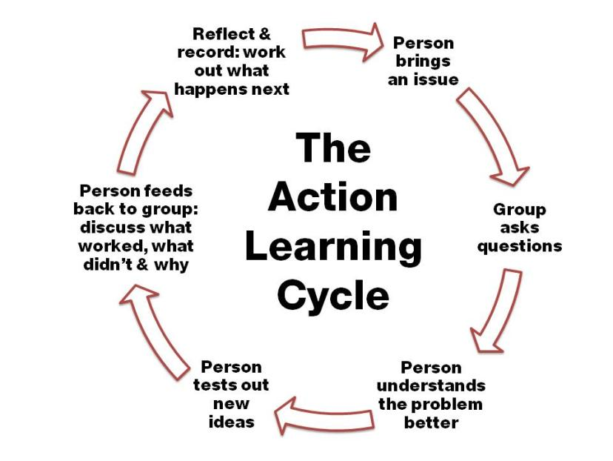

Slide 8
With a little help from my friends
Tell us about something important you’ve done, with a friend, or with someone you know
  What did you do?
  What did they do?
  What makes it important to you?

Slide 9
Learning Triads
Purpose
Experience action learning process in small groups
Understand the different skills required for action learning to succeed
Practice these skills

Slide 10
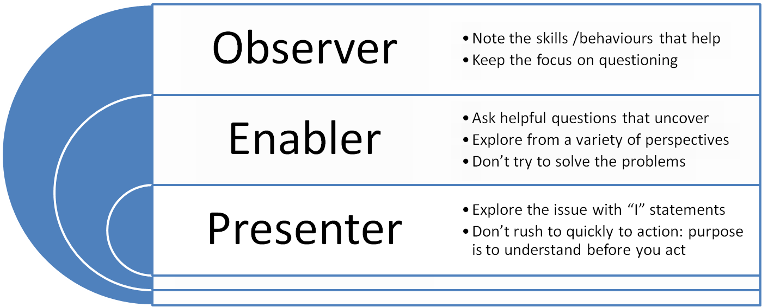
Learning Triad Rules
Presenters have 10 minutes max
Observers give 5 minutes of feedback max
Everyone plays the role of Presenter, Enabler, Observer

Slide 11
What is your Project?
On a piece of paper tell us:
What is your project trying to do? (30 words max)
Who is involved?
What have you done so far? (30 words max)
How will you know when you’ve done what you set out to do? (30 words max)

Slide 12
Break (15 mins)

Slide 13

Examples of Service User Participation/Involvement
Get into three groups, each with 5 people in
Write a real example of Service User participation on a Post It
One post it per idea, please
Front

Slide 14
Why bother with Service User Involvement?
On the back of each Post It note, write why this piece of user involvement is important
Back

Slide 15
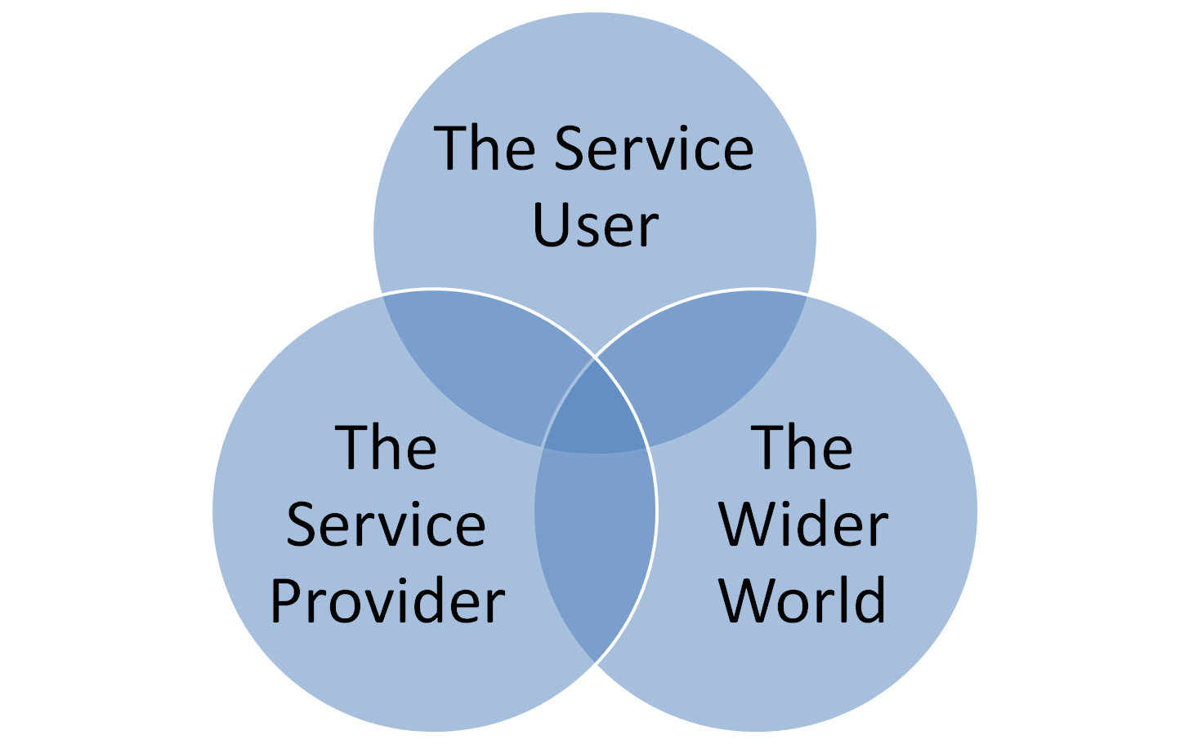
Cui Bono? – Who Benefits?

Slide 16
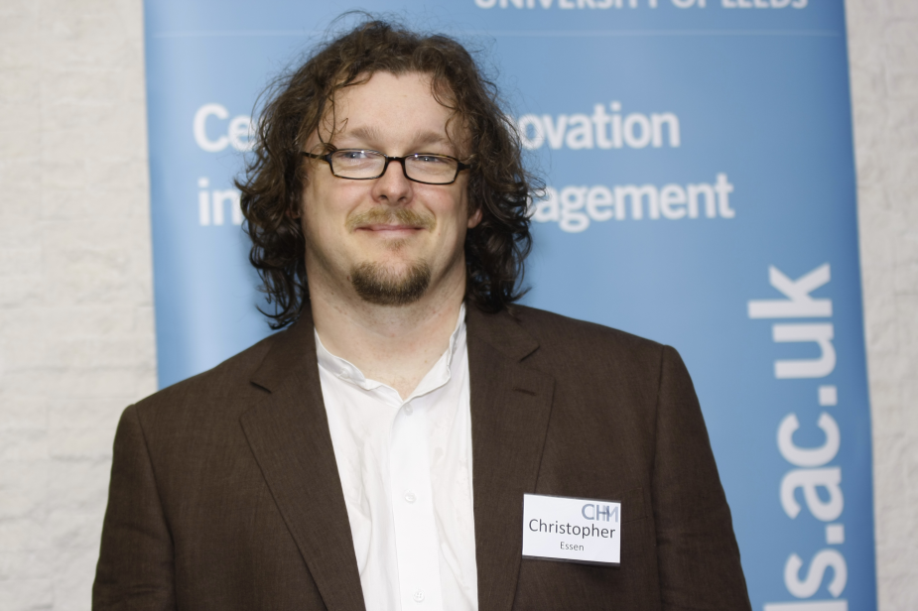
Guest Speaker: Chris Essen
Leeds University
Leeds Partnerships Foundation Trust Hospital
Other stuff

Slide 17
Lunch
(45 mins)

Slide 18
A working Model of Participation
Purpose
To think about the meaning of Participation
To become aware of and understand Arnstein’s Ladder of Participation
Recognise the role of different styles of participation at different times
Reflect on the potential benefits of greater service user involvement/participation in own Project

Slide 19
What do we mean by....
  Participation? – if someone participates in something
  Authority? – if someone has authority to do something
  Empowerment? – if someone is empowered?
  5 Mins: Split into 3 groups of 5; each group comes up with a definition

Slide 20
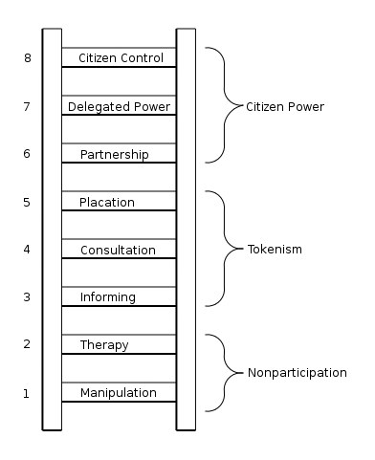

Arnstein’s Ladder of Participation
Where would we put this morning’s examples?

Slide 21
Participation: A Personal Journey
Citizen Control: “Let’s play to our strengths & let’s do it together”
Delegated Power: “You can do this , on our behalf”
Partnership: “You do this, we’ll do that”
Placation: “Tell us your ideas - we’ll choose the best of them”
Consultation: “Tell us your ideas”
Informing: “These are your rights”
Therapy: “The problem is really a symptom of your own problems”
Manipulation: “Other people have said it’s ok”

Slide 22
Choosing the ‘right’ way
Not all of these levels can be used for everything
What are the issues involved?

Slide 23
Time/Effort in Participation
Placation
Partnership
Citizen Control
Effort
Manipulation
Consultation
Delegated Decision
Making
Informing
Therapy
Time

Slide 24

Increasing Participation: Ideas Shower
Place your Project Post It on a piece of paper
Stick your piece of paper on a wall
Ask others to write ideas for increased Service User Participation around the outside of the idea
Write your ideas here
This is
someone’s
project
...or here
Or here

Slide 25
Break (15 mins)

Slide 26
Action Planning for SU involvement
What are the participation/involvement opportunities in your project?
How will it be different?
Get back into 3s
Use Action learning Skills of talking, listening, & observing
10 minutes each
Clarify definite actions
Note these down on learning logs

Slide 27
Outcomes of Set 3
By the end of the day have
Practiced Action Learning more
Shared our Projects with the wider group
Explored the various forms of Service User involvement/participation
Learned why it’s important to choose the right kind of participation
Identified opportunities for greater service user participation in our Projects
Produced a project plan (including measurable outcomes)

Slide 28

Next Session: 7th January 2011

