Slide 1
Action Learning Sets Housing and Mental Health Session 4
Somoud Saqfelhait &
Jon Beech
www.touchstone-leeds.co.uk

Slide 2
Session 4 Outline: AM
9.30 Coffee, Homework
10.00 Welcome, Recap, Overview
10.15 Ladder of Participation, reflections & feedback
10.45 Asking the right Questions
11.15 Break
11.30 Action Learning Triads – Project Updates
12.15 Participation: What really Matters
13.00 Lunch

Slide 3
Session 4 Outline: PM
13.45 SMART Planning
15.00 Sharing our learning: YHIP and beyond
15.15 Feedback & reflection
15.30 Finish

Slide 4
Intro and Recap
Outcomes of Day 1
Getting to know one another
Principles of Action Learning
Outcomes of Day 2
Finalizing Project
Practice of Action Learning
Outcomes of Day 3
Understanding Levels of Participation
Sharing Projects
Identify Opportunities for greater service User involvement

Slide 5
Our Groundrules
Mobile Phones on silent
Listen to one another
Time to talk socially
Honesty and openness
Respecting different cultures, diversity and opinions
Confidentiality and anonymity
Empathy and understanding
No JARGON. Keep it simple, and don’t patronise
Be brave - Take some risks
Be positive, and challenge respectfully

Slide 6
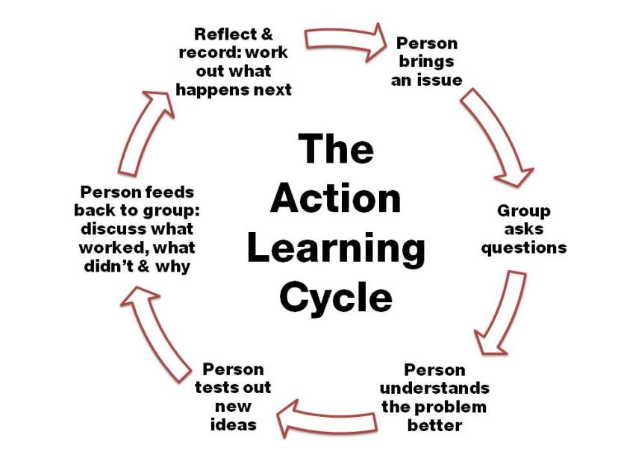

Slide 7
Outcomes of Day 4
By the end of the day participants will
Be more skilled in asking questions
Reflected more on the ladder of involvement
Understand the how to do participation well
Understand the principles of SMART planning
Produce a SMART project plan, to be shared with their manager
Agreed action points for the next 3 weeks

Slide 8
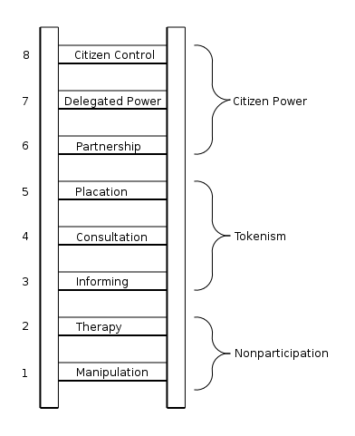
Reflections on Ladder of Participation
Any further thoughts on last time?
How does this fit with the services you use or where you work?

Slide 9
A revised ladder of Participation
10. Service users decide - workers participate if they are invited to
9. Service users decide, supported by workers
service users initiate decisions
8. Common decisions - Staff and service users decide together on basis of equality
7. Consultation – Staff consult service users and make decisions that take their concerns into account
6. Invitation – Service users invited to express their opinions but Staff ultimately decide
5. Symbolic Staff decide, service users make less important decisions
4. Ornament – Staff decide, service users participate in various ways (telling stories, sharing experiences)
3. Manipulation Staff decide, service users asked if they agree but given other options
2. Mild control Staff make all decisions, service users told what to do and why
1. Control by Staff Staff take all decisions, service users told what to do, with no other info

Slide 10
Reflections on Suggestions for Participation
Look at the feedback you were given
What are the suggestions?
Were these surprising?
Do you have any questions?
Do you want people to explain what they wrote more?
Have they generated new ideas?

Slide 11
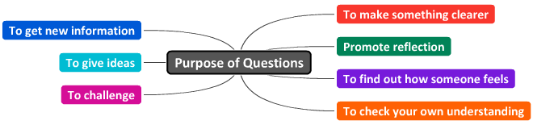
Questions in Action Learning
Questions are there to help the presenter think things through,
not just explain what happened but to understand why and how

Slide 12
Effective Questions in Action learning
Signs your questions may not be working
If you find you are giving ideas
If you are trying to ‘lead’ a person to your way of thinking
If you are doing most of the talking
Things you can do
Don’t share your ideas, or what you have done
Don’t try to solve the problem
Help the presenter think through why things happen, or how/where they can find their own solutions

Slide 13
Break (15 mins)

Slide 14
Learning Triad Rules
Presenters have 10 minutes max
Observers give 5 minutes of feedback max
Everyone plays the role of Presenter, Enabler, Observer
Observer
Note the skills /behaviours that help
Keep the focus on questioning
Enabler
Ask helpful questions that uncover
Don’t try to solve the problems
Presenter
Explore the issue with “I” statements
Don’t rush to quickly to action: purpose is to understand before you act
Explore from a variety of perspectives

Slide 15
Participation: what really matters
What are the things that really help service users to get involved?
What are the things that stop it from working?
Look at our ground rules
Write one DO and one DON’T that does NOT appear on the ground rules

Slide 16
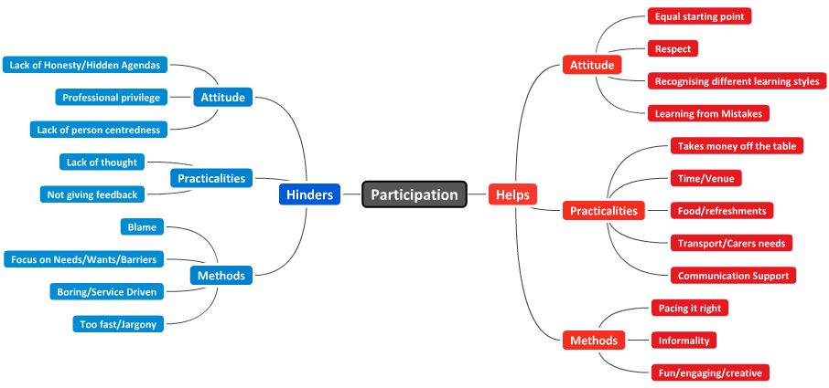
Some Dos & Don’ts of Service User Participation

Slide 17
Participation: what really matters
Get into 2 groups: Service users and staff
Choose your top 10 DOs top 10 DON’Ts to share with the other group
DOs | DON’Ts
1 | 1
2 | 2
3 | 3
4 | 4
5 | 5
6 | 6
7 etc | 7 etc

Slide 18
Lunch (45 mins)

Slide 19
Making your projects SMART
Aim
To make all projects SMART
To share these with the group
To share these with your organisational sponsors
To help evaluate the effectiveness of the Action Learning Set

Slide 20
SMART Planning
Specific
Exactly what are you going to do?
Measurable
How will you know when you have done it or not?
Will there be something to show for it? How can you measure it?
Achievable
When must it be done by?
Realistic
Time Limited
Can it be done?
Is it possible in these circumstances? Here/Now

Slide 21
Examples of SMART planning
Specific
Measurable
Achievable
Realistic
Time Limited
Getting home
Eating your tea
Watching a film
Participating in the London Olympics

Slide 22
SMART planning exercise
Into Groups of 3
Think about your project
What has been done so far?
What is left to do?
Spend 10 minutes per person working through plans

Slide 23
Sharing what we have learned
Evidence so far
Questionnaires
Learning Logs
SMART plans
Session outlines
Session Feedback Sheets
Remaining Evidence
Final Project Feedback

Slide 24
YHIP Homes and Jobs Event
17th February, Sheffield Megacentre 10.00 -3.30
Sharing Good Practice from across the region
0113 262 6409
danny@inclusionnorth.org

