Slide 1
11-06-2026
ML project discussion

Slide 2
Observations
Encounters
Examples: 1
Body Height, BMI, Heart Rate, Systolic Blood Pressure, Triglycerides, Total Cholesterol, Heart Rate, etc.
Examples: Encounter for 'check-up’, Outpatient procedure, Follow-up visit (procedure), Telephone encounter (procedure) , etc.
Total: 1480409 rows. Avg 418 encounters per patient. Median 242 encounters per patient.
Total: 285,339 rows. Avg 80.6 encounters per patient. Median 48 encounters per patient

Slide 3
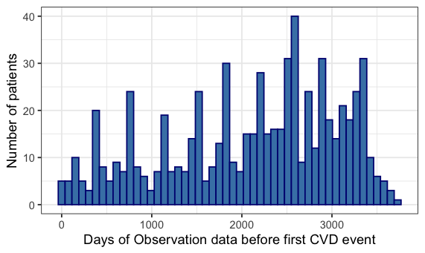
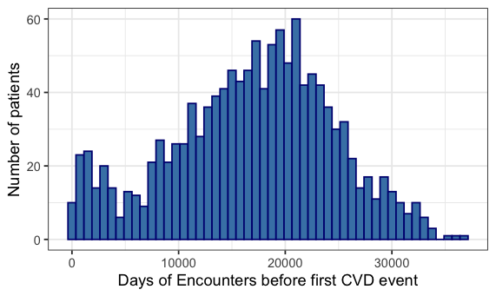
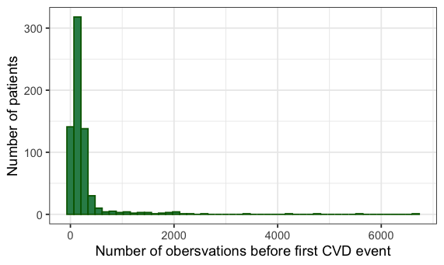
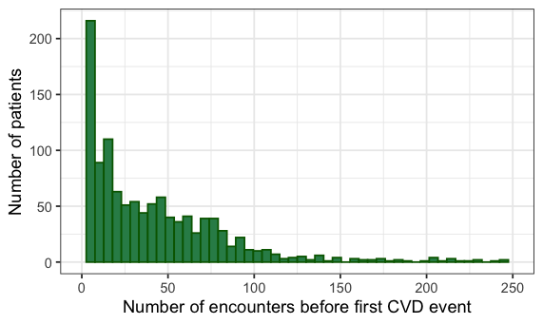
Observations
Encounters
Mean: 2100
Median: 2283
Mean: 16883
Median: 17570
Mean: 257
Median: 138
Mean: 50
Median: 27

Slide 4
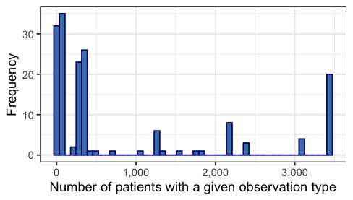
Not all patients will have every observation – should we make a cutoff of patient coverage for an observation to be included?

