Slide 1
LH
Lakehouse
Pipeline.
Production-Style Demo
Postgres → Kafka → Spark → MinIO → Trino → Metabase → DataHub
lakehouse-stack · 2026-05-13

Slide 2
What's in the box
Every service wired in docker-compose, healthchecked, ready on first boot
Postgres
Kafka + UI
Debezium
5432
9092 / 8082
8083
OLTP source of truth
Event spine
CDC from Postgres → Kafka
Spark
MinIO + Hive
Trino
4040
9001 / 9083
8181
Batch + streaming ETL
S3 lake + Iceberg metastore
Federated SQL across lake + PG
Airflow
Metabase
DataHub
8085
3001
9002
Orchestration & lineage push
BI dashboards
Catalog · governance · lineage

Slide 3
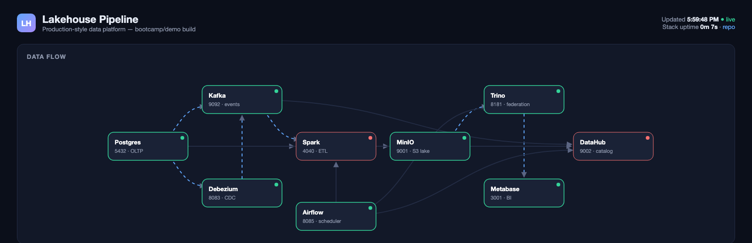
Mock control plane · pipeline diagram
Real-time service map; every node pings its container every 5 s

Slide 4
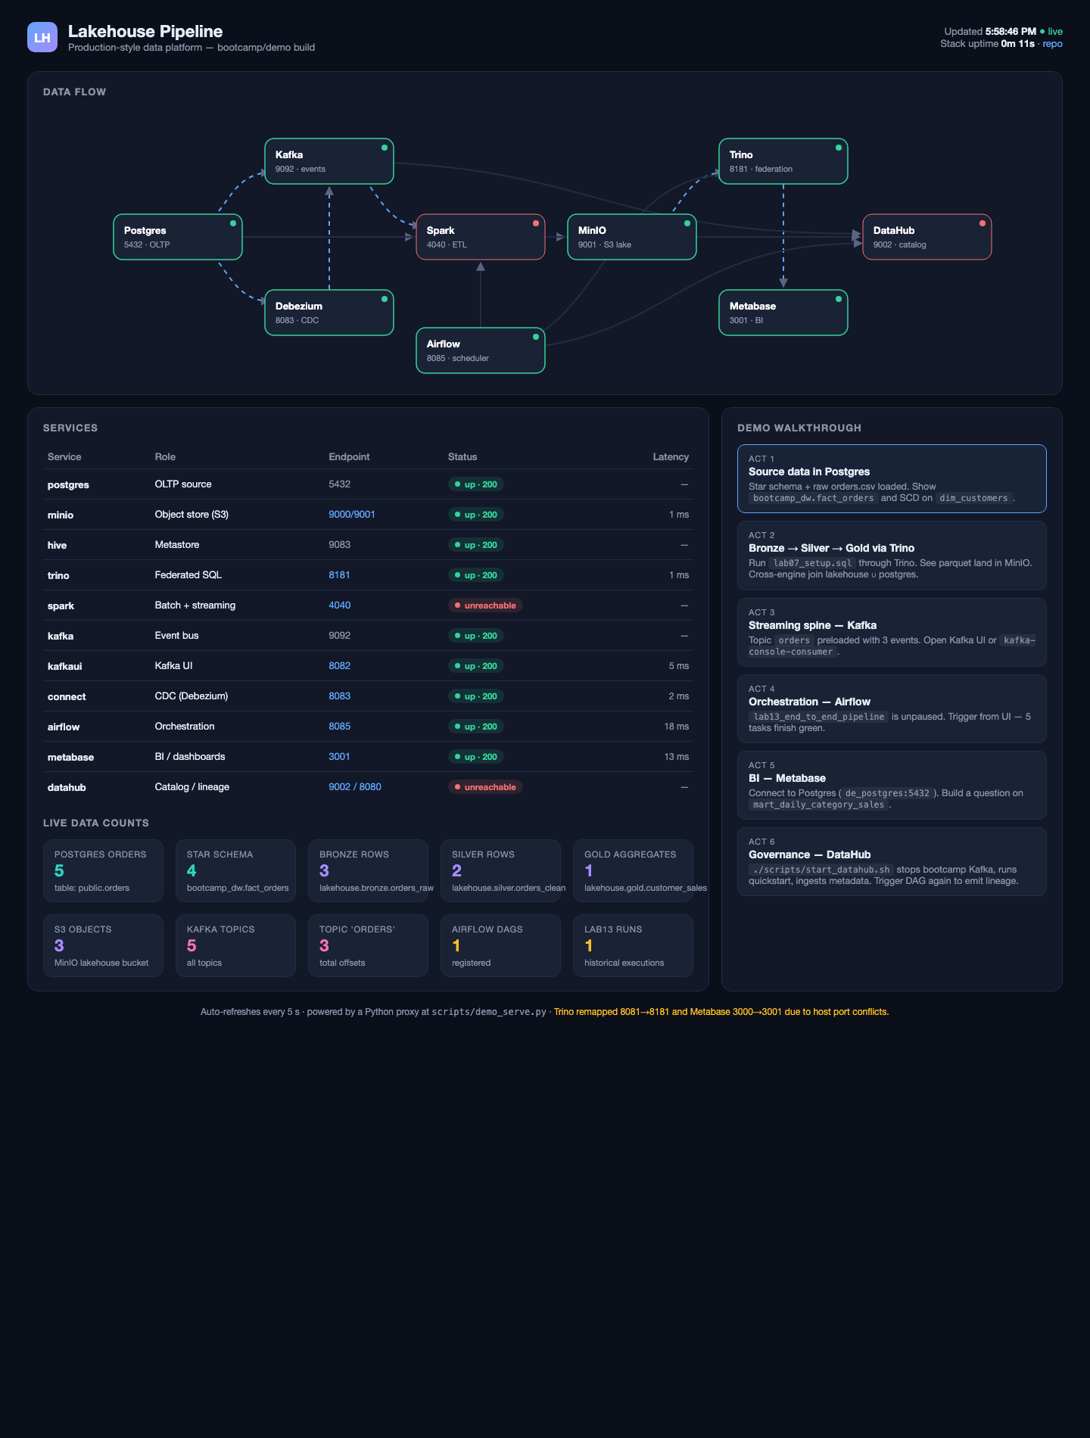
Mock control plane · full dashboard
Status, latency, live row / object / offset counts on one page

Slide 5
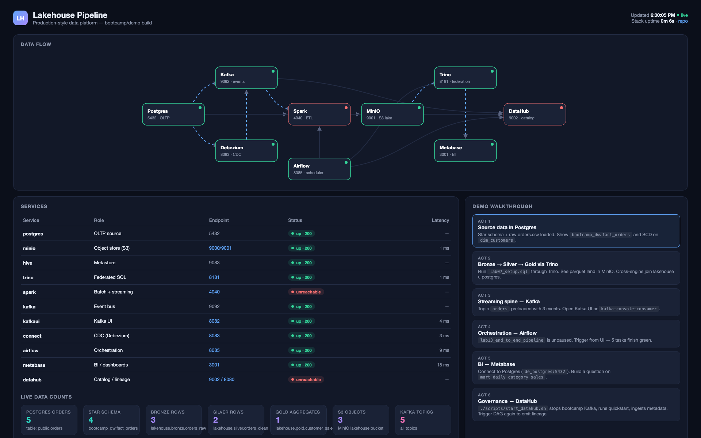
Mock control plane · wide layout
1920×1200 capture suitable for a projector / second screen

Slide 6
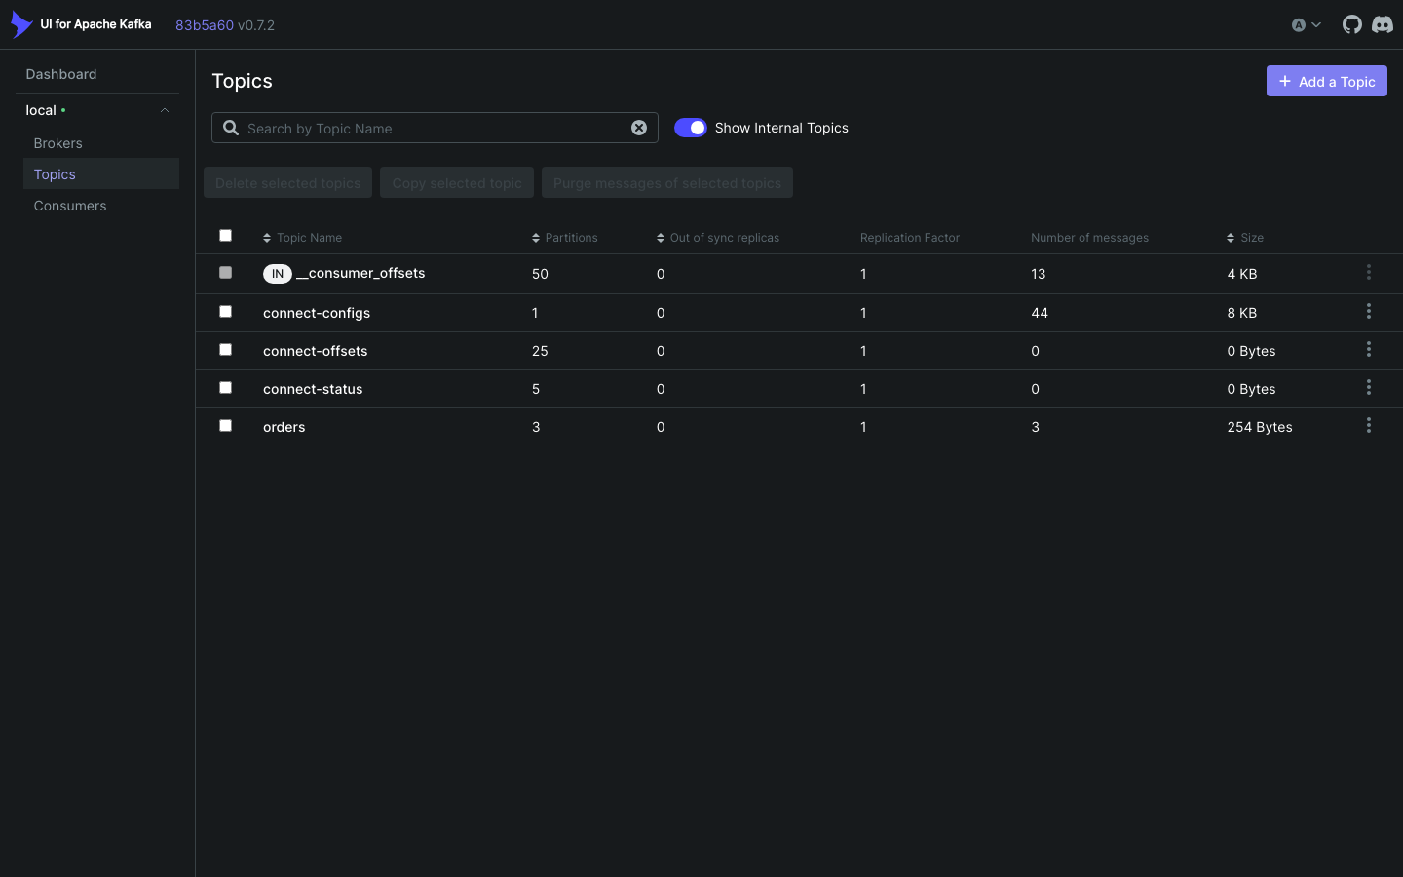
Kafka UI · topics
5 topics — 4 internal + 'orders' with 3 partitions, 254 bytes

Slide 7
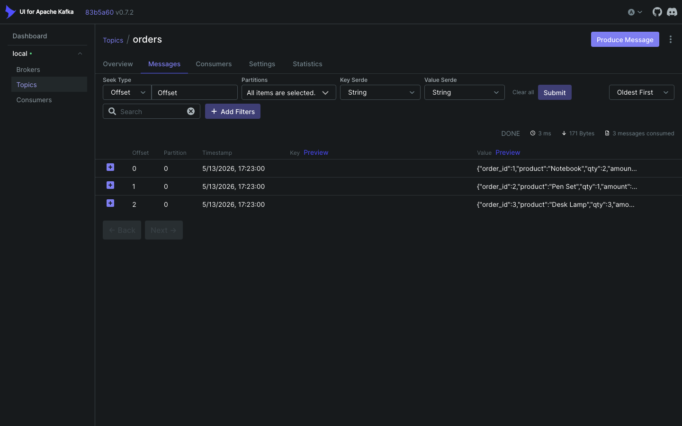
Kafka UI · topic 'orders' messages
3 JSON events preloaded — Notebook, Pen Set, Desk Lamp

Slide 8
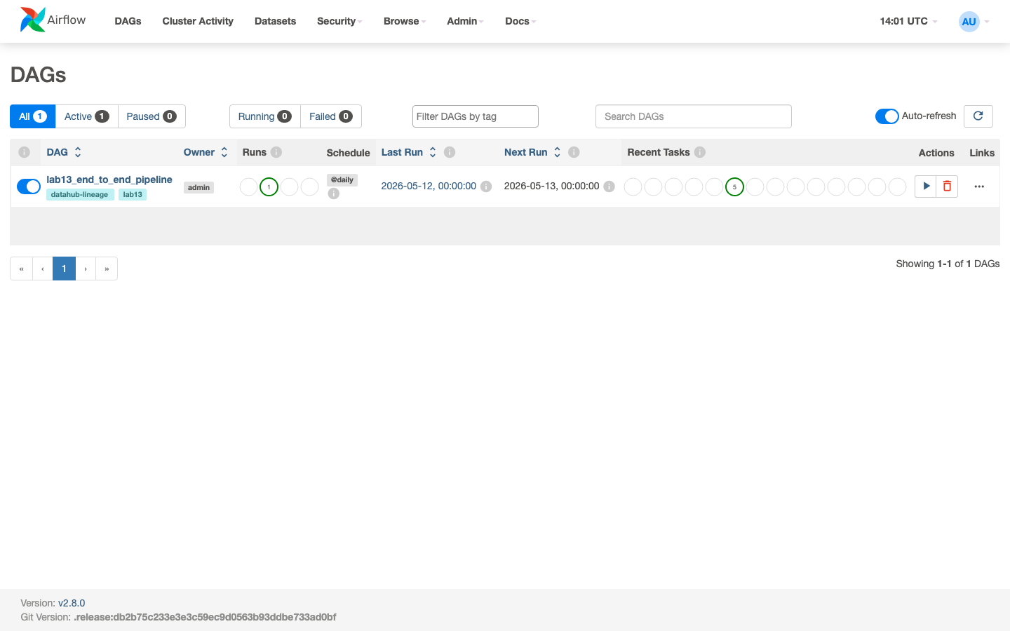
Airflow · DAGs list
lab13_end_to_end_pipeline · @daily · tags: datahub-lineage, lab13

Slide 9
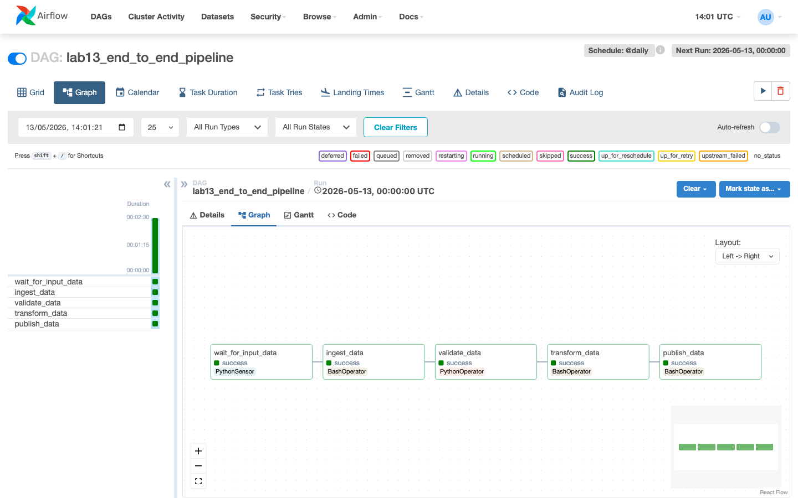
Airflow · lab13 DAG graph
Five tasks · all success · DataHub plugin emits dataset lineage at each step
wait_for_input_data
ingest_data
validate_data
transform_data
publish_data

Slide 10
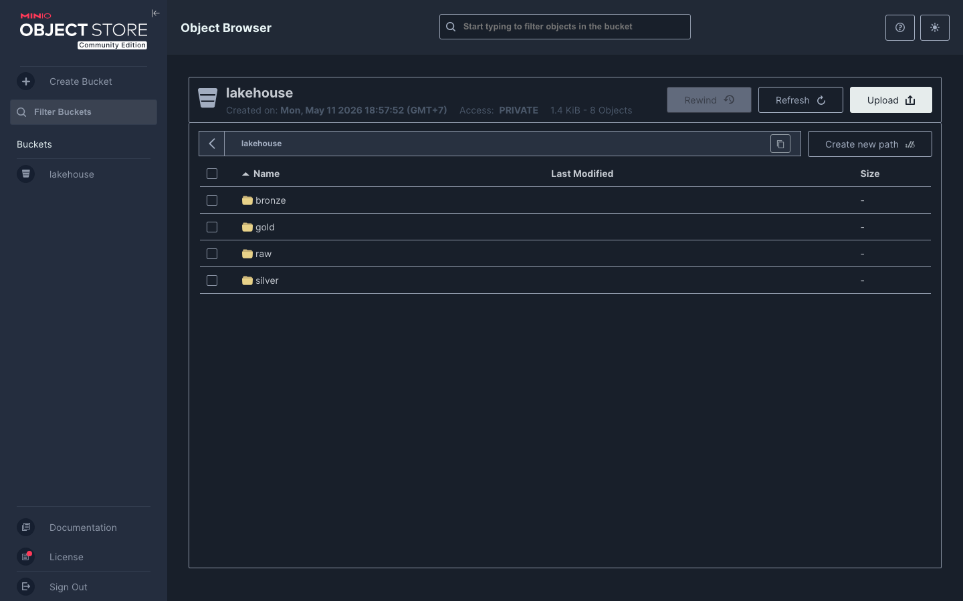
MinIO · lakehouse bucket
bronze / silver / gold / raw — 8 objects, 1.4 KiB, private bucket

Slide 11
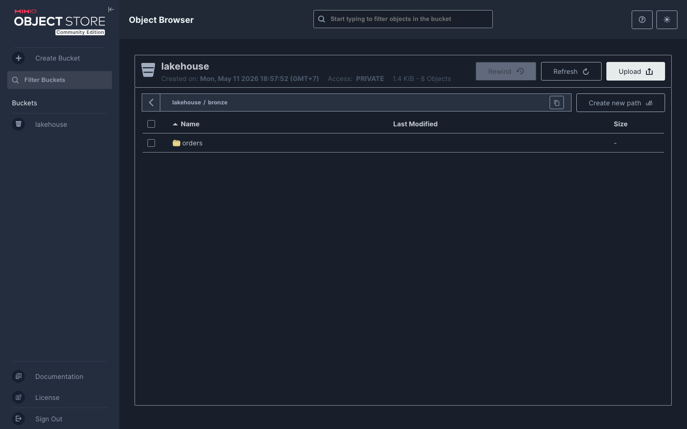
MinIO · bronze layer
Trino-written orders text data lives under lakehouse/bronze/orders/

Slide 12
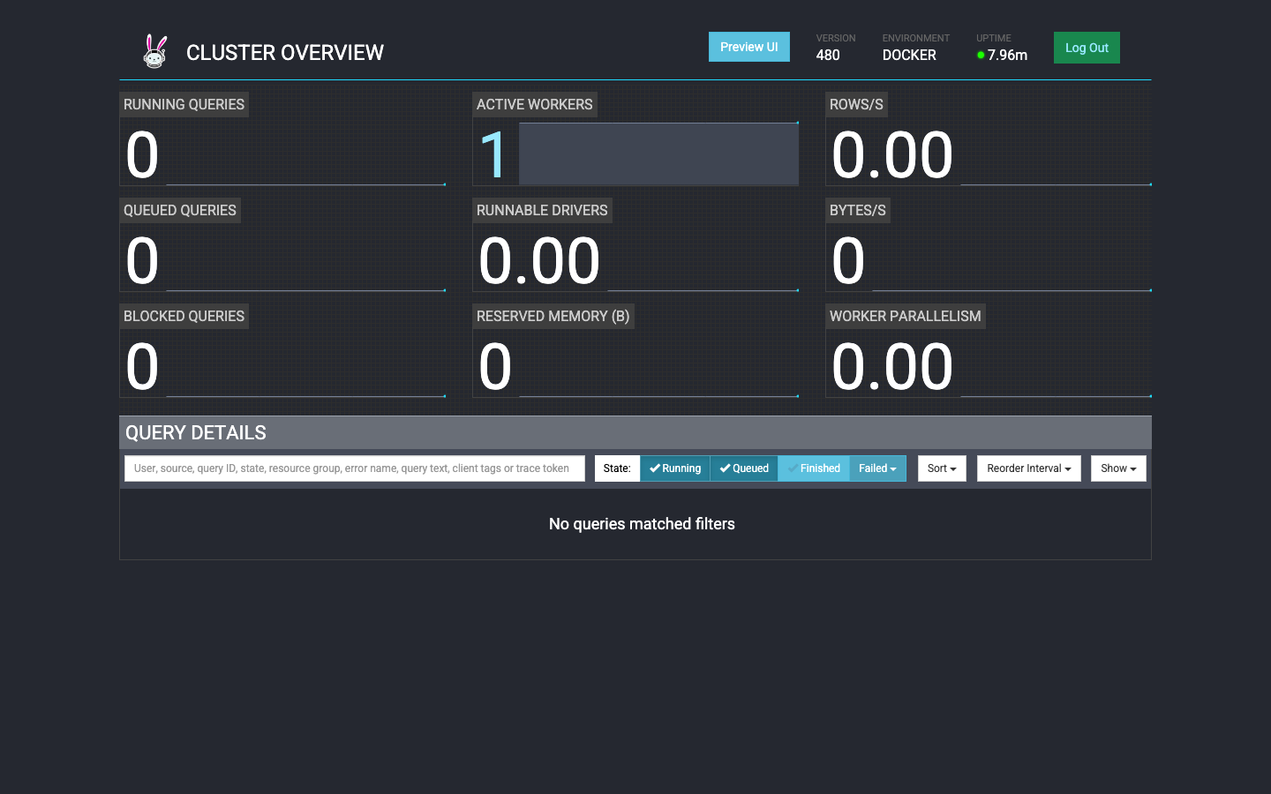
Trino · cluster overview
Version 480 · 1 active worker · ready to federate lakehouse ∪ postgres

Slide 13
6-Act demo walkthrough
Each act answers a different 'how do you do X' question
Act 1
Act 2
Source — Postgres
Bronze → Silver → Gold
Star schema (bootcamp_dw) + raw orders.csv on de_postgres:5432.
Run lab07_setup.sql through Trino; parquet lands in MinIO.
Act 3
Act 4
Streaming spine — Kafka
Orchestration — Airflow
Topic 'orders' preloaded with 3 events; Kafka UI on 8082.
DAG lab13_end_to_end_pipeline triggers 5 tasks green.
Act 5
Act 6
BI — Metabase
Governance — DataHub
Question on bootcamp_dw.mart_daily_category_sales.
./scripts/start_datahub.sh — catalog + Airflow lineage.

Slide 14
Cross-engine SQL — one query, two systems
Same engine reads parquet from MinIO and live tables from Postgres
SELECT 'gold' AS src, customer_id::VARCHAR AS k, total_revenue::VARCHAR AS v
FROM lakehouse.gold.customer_sales
UNION ALL
SELECT 'pg', order_id::VARCHAR, (quantity*unit_price)::VARCHAR
FROM postgres.public.orders;
Result (6 rows): gold | 101 | 400.5 pg | 1 | 77.50 pg | 2 | 50.00 pg | 3 | 120.00 pg | 4 | 100.00 pg | 5 | 136.50

Slide 15
Lab 15 — DataHub governance
One script swaps in DataHub's stack; one script swaps back.
./scripts/start_datahub.sh stops bootcamp Kafka, runs datahub docker quickstart, ingests metadata
DataHub UI at localhost:9002 — datasets, owners, tags, business glossary
Airflow DataHub plugin emits dataset lineage from inlets / outlets at run time
End-to-end lineage: Postgres → Airflow tasks → bronze → silver → gold
./scripts/stop_datahub.sh restores Kafka on 9092 for the rest of the demo
Postgres
Airflow DAG
Bronze
Silver
Gold
DataHub

Slide 16
Live counts pulled from running containers
These numbers update every 5 s on the dashboard
METRIC | VALUE
Postgres orders rows | 5
bootcamp_dw.fact_orders | 4
lakehouse.bronze.orders_raw | 3
lakehouse.silver.orders_clean | 2
lakehouse.gold.customer_sales | 1 (aggregate)
MinIO objects in lakehouse bucket | 3
Kafka topics | 5
Topic 'orders' offsets | 3
Airflow DAGs | 1
lab13 historical runs | 1

Slide 17
Port adjustments & gotchas
What changed from the README and why
Trino 8081 → 8181
Host port 8081 was held by a stale listener. Remapped in docker-compose.yml and README.
Metabase 3000 → 3001
Host port 3000 was already in use. The dashboard reflects the new port.
DataHub conflicts on 9092
Both Kafka brokers want 9092. start_datahub.sh stops bootcamp Kafka before quickstart.
Airflow CLI: docker exec -u airflow
Default user has no PATH; the dashboard reads counts straight from airflow_db Postgres.
Spark 4040 may show idle (red)
The driver UI binds only while a job runs — expected, not a failure.

Slide 18
How to run the demo
Five commands, end to end
1
docker compose up -d
Boots Postgres, Kafka, Spark, Trino, MinIO, Airflow, Metabase
2
./scripts/demo_serve.py
Opens the live dashboard on http://localhost:7777
3
Walk through Act 1 → Act 5
Watch the live counts tick up as you exercise each layer
4
./scripts/start_datahub.sh
Brings DataHub up + ingests metadata for Act 6
5
./scripts/stop_datahub.sh
Restores Kafka on 9092 so the next demo runs clean
Cheat sheet: DEMO.md · Repo: github.com/sophie-nguyenthuthuy/lakehouse-stack

