Slide 1
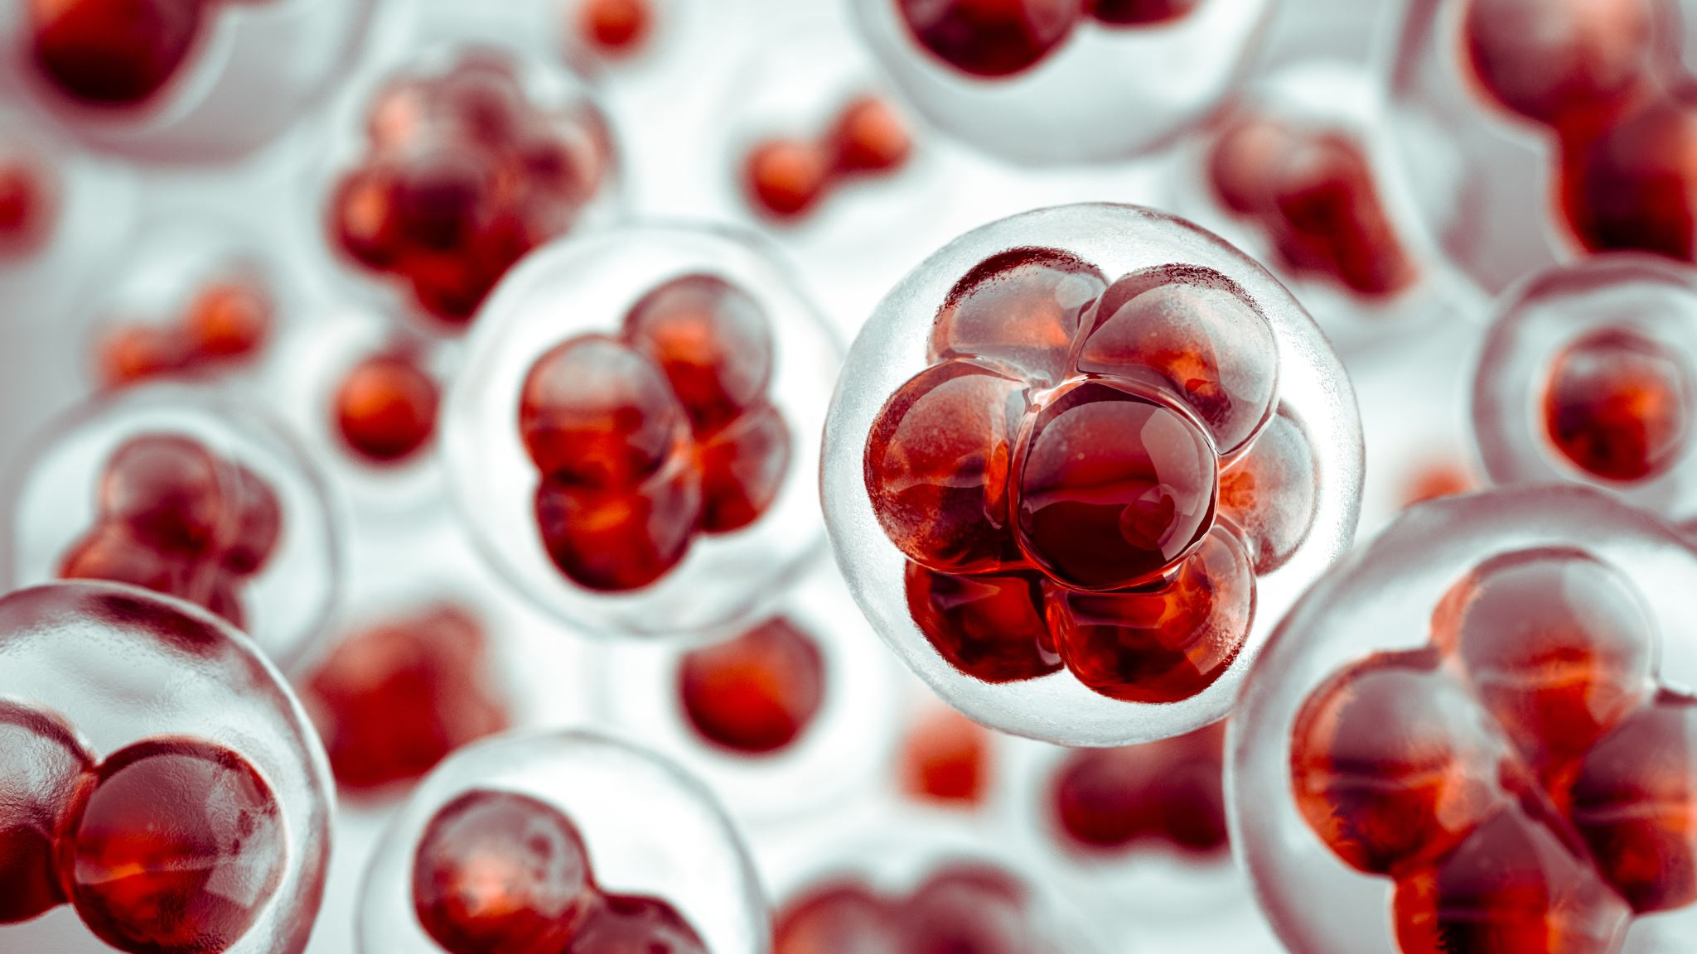
Investigating Divergence and Adaptations Between Heat Shock Proteins of Thermophilic Prokaryotes and Mesophilic Eukaryotes
Sophie Krajmalnik
University of North Texas
Spring 2025
BIOL4815 Bioinformatics
Dr. Rajeev Azad

Slide 2

Extremophiles & HSPs
Extremophiles:
  Capable of surviving extreme environmental conditions ex. temperature, pressure, salinity, pH, radiation, and more
  Structural, biochemical, and metabolic adaptations and strategies, due to selective pressures, provide these capabilities
  Important for adaptation and biodiversity, biochemical catalysts, bioremediation, survivability in outer space, and more
  Most extremophiles tend to be prokaryotes, due to their simplicity, ability for rapid evolution, and presence in early Earth conditions
Heat Shock Proteins:
  Help an organism respond to environmental stresses, such as heat, changes in oxygen content, DNA damage, and can activate
  apoptosis in stressful conditions (Hu et al., 2022)
  In thermophilic prokaryotes, HSP abundance is related to thermostability (Trent et al., 1994); in mesophilic eukaryotes, HSP abundance leads to cancer, heart issues, and more systematic problems

Slide 3
Previous Research & Current Investigation
Previous research has examined HSPs in thermophiles and has performed analyses of GC content and codon usage bias at the genome-wide level rather than on specific genes like HSPs (Singer et al., 2003; Khan et al., 2018)
Phylogenetic analyses have been performed within a domain but rarely cross-domain (Gupta et al., 1994, 1997)
Project geared towards helping to bridge the gap between the similar HSP proteins between domains and environmental category through comprehensive, direct comparison
Goal: Investigate the possible adaptation and divergence of heat shock proteins between thermophilic prokaryotes and mesophilic eukaryotes
Implement a variety of techniques learned in class integrated with RStudio
Provide insight into the mechanisms and evolutionary pressures that enable prokaryotic HSPs to withstand more heat, while eukaryotic HSPs contribute to negative pathological outcomes

Slide 4
Organism and Sequence Acquisition
Take a sample of organisms from ThermoBase, a comprehensive database of thermophiles and hyperthermophiles, keeping track of Phylum and Class
From the above sample, take a representative sample of each class in the initial sample for a total of 15 thermophilic prokaryotes to analyze
  This number was chosen simply for feasibility in the given time span and to allow for at least 1 sample for each class – future work can expand on these numbers
Run each sample through NCBI to guarantee information is available and find an HSP sequence to focus on
  Since HSP20 emerged as a frequent pattern, this specific HSP was selected over others

Slide 5
Organism and Sequence Acquisition
Once each HSP20 sequence was selected for the prokaryotic thermophiles, run each sequence through PSI-BLAST with 6 iterations (parameters: database nr, restricted to Eukaryota, word size 3, 100 target sequences, BLOSUM62)
Select the top 2 hits from PSI-BLAST for each prokaryote
  Attempted to eliminate any partial or hypothetical proteins where possible
For 15 prokaryotic organisms, hits spanned only 12 different eukaryotic organisms – fungi (Glomeromycetes and Mortierellomycetes) and plants (Magnoliopsida)

Slide 6
PSI-BLAST Analysis
PSI-BLAST Results:
Avg Percent Identity = 24.5% (stdev = 2.9)
Avg E-Value = 3.33e-58 (stdev = 1.83e-57)
Avg Bit Score = 239 (stdev = 29.3)
Expected low percent identity due to long evolutionary period of divergence between eukaryotes and prokaryotes
Average percent identity drops into the twilight zone - expected due to distance, but attempting to pull in distant homologs (likely orthologs) within the protein family; could still share functionality
  QUESTION: What is the rate of evolution? Could so many mutations have occurred that they have cycled back around to the same amino acids? Does this constant percent identity represent the constant rate of evolution within a protein family (molecular clock hypothesis)?
Bit score and extremely low E-values suggest high quality alignments – conserved structure or domains

Slide 7
Techniques Used
Multiple Sequence Alignment - MUSCLE
Distance Matrix – Poisson
Principal Component Analysis
Phylogenetic Tree – UPGMA
Bootstrapping
GC Content Analysis
T-Tests
Codon Usage Bias – Relative Synonymous Codon Usage

Slide 8

Multiple Sequence Alignment, Distance Matrix, and Principal Component Analysis
AMINO ACID LEVEL ANALYSIS

Slide 9
R Packages: Biostrings, DECIPHER
Multiple Sequence Alignment
Load amino acid sequences in FASTA format into AAStringSet object
Call AlignSeqs function on the object of FASTA sequences – specifically designed to perform multiple sequence alignment → OUTPUT: sequences aligned and color-coded according to amino acid qualities; consensus sequence at bottom
  Consensus sequence attempts to derive a “typical” sequence from the alignment, where X = unknown and + = conserved position
  AlignSeqs by default calls the MUSCLE alignment method (iterative refinement)
  Sequence alignment method can also be called on a DNAStringSet object (sequences of DNA), but protein selected as can be more informative
Cross-Domain Multiple Sequence Alignment revealed remnants of shared ancestry
  Positions with lots of variability in regions with a bulk alignment of amino acids
  Conserved positions tend to correspond to gaps put in the alignment (low identity)– not as representative of protein function
Eukaryotic Alignment revealed…
  Clustering of alignment regions around positions 90 – 210 and 305-315
  Higher in-domain similarity
Prokaryotic Alignment revealed…
  Clustering of alignment regions around positions 30-50 and 100-200 with much tighter construction
  Much higher in-domain similarity
All alignments showed high degrees of variability and most “positives” corresponding to gaps
Variety among both C-terminus and N-terminus (extensions) to help with specialization

Slide 10
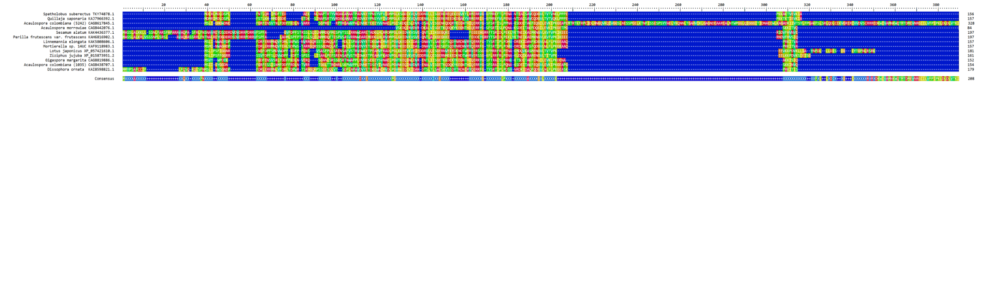
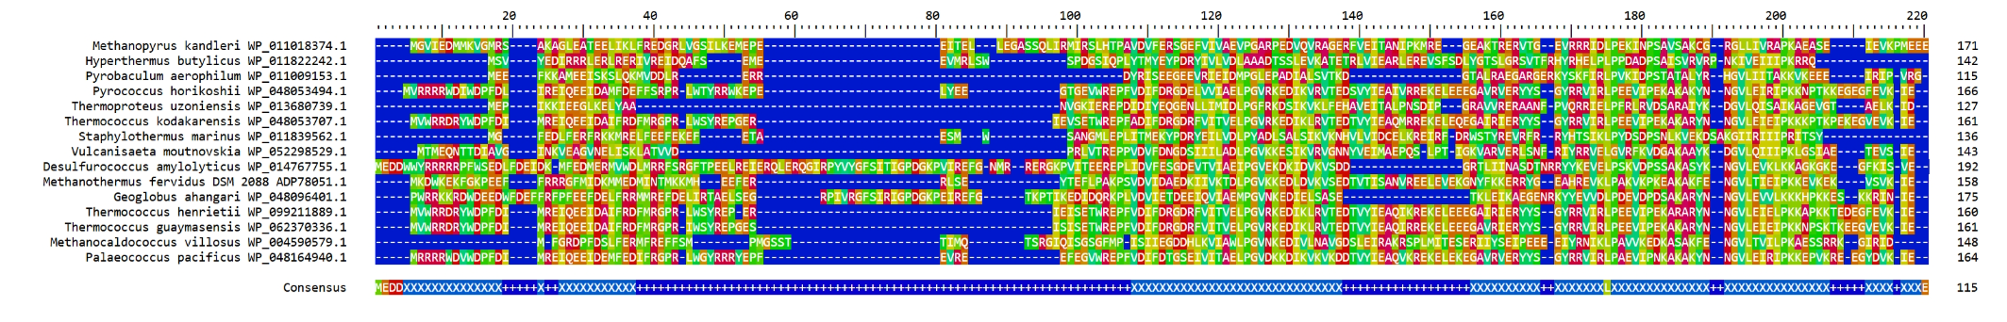
Eukaryotic Multiple Sequence Alignment
Prokaryotic Multiple Sequence Alignment

Slide 11
Distance Matrix & Principal Component Analysis
R Packages: DECIPHER, ggplot2, ggrepel
Distance Matrix: pairwise distance (“difference”) between two sequences in the multiple sequence alignment
  Call the DistanceMatrix function with the Poisson correction applied – useful for amino acid alignments; accounts for multiple substitutions per site
  OUTPUT: Distance values varying between [0, 3) – up to 3 amino acid substitutions per site (actual max = 2.88), at which point highly diverged
Principal Component Analysis (PCA): dimensionality reduction and feature selection technique – identifies principal components that maximize variance (what are the main patterns of variation?)
  Call prcomp from base R on the distance matrix generated previously, and standardize the distances (mean = 0, variance = 1)
  X-axis is principal component 1 (largest source), with Y-axis as principal component 2 (second largest source)
  Shows tighter clustering among the prokaryotes (less distance, more conservation) than among the eukaryotes, but the groups are separated

Slide 12
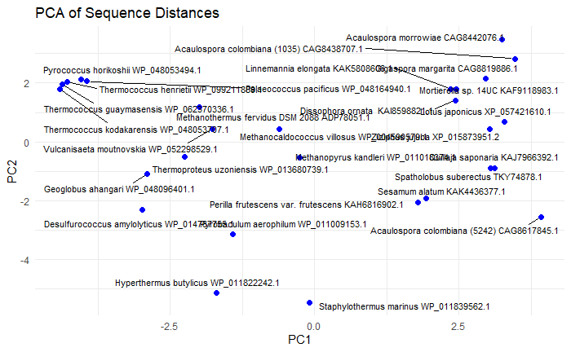
PCA Analysis:
PCA1 contributes to 30.97% of the variance; PCA2 contributes to 19.15% of the variance – overall half of variance (50.12%)
Since working off a distance matrix, specific features aren’t represented (genes, amino acids, etc.)
Possible interpretations of PC1/2: domain, environmental category, overall sequence length
Can provide insight by seeing where clusters occur and which sequences are at extremes of each principal component
Can analyze extremes for further insight
Longer C-terminus
Cluster of thermophiles from class Thermcocci
Cluster of plants (trees or flowering plants)
← Prokaryotes || Eukaryotes →

Slide 13

Phylogenetic Tree Generation
AMINO ACID LEVEL ANALYSIS

Slide 14
Phylogenetic Tree Generation & Bootstrapping
R Packages: ape, phangorn
Generate and plot phylogenetic tree based on the created distance matrix using UPGMA method
  While could introduce errors since organisms can evolve at different rates, effective method for creating a tree based on distance and can help explore the possibility of application of molecular clock hypothesis
  Future work can attempt model or character-based techniques
Generates reasonable tree, following known taxonomy
  Prokaryotes separated at bottom could be due to faster evolutionary rate
Run the bootstrap method 100 times on the initial phylogenetic tree with the distance matrix by calling boot.phylo. Using the bootstrap values, call consensus to build the consensus tree, where branches must be included in at least 39% of trees. Plot the tree with the confidence values.
  Generally supports the initial tree, but most prokaryotic clades were removed due to low confidence values – noise introduced (gaps, tails) or issue with the method used
  39% confidence is a low threshold for an actual analysis, but relatively high for visualization purposes here – 39% was the lowest to be able to perform a properly-structured tree
Ran same process on tree with neighbor-joining method and threshold of 45%
  Might introduce error due to questionable additivity of distances

Slide 15
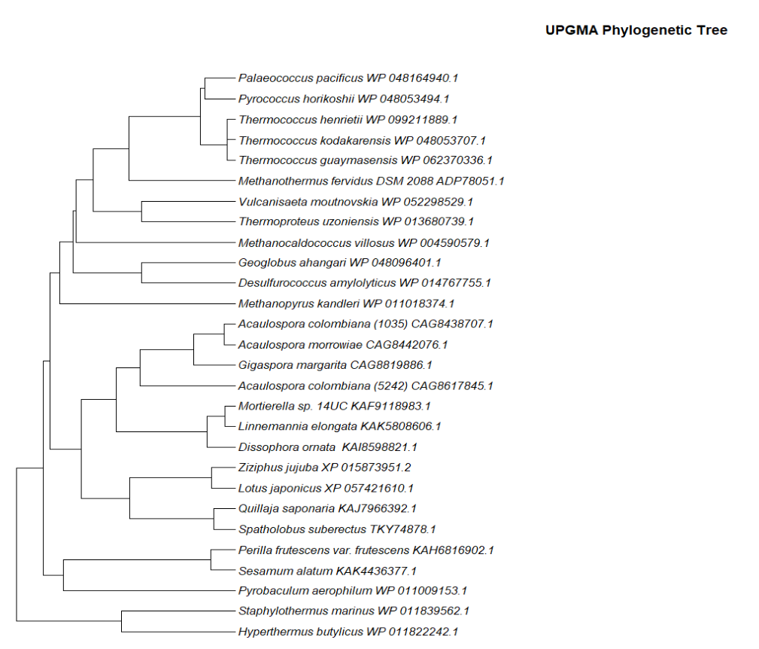
Prokaryotic
Class: Thermococci
Class: Thermoprotei
Eukaryotic
Class: Glomeromycetes
Class: Mortierellomycetes
Class: Magnoliopsida

Slide 16
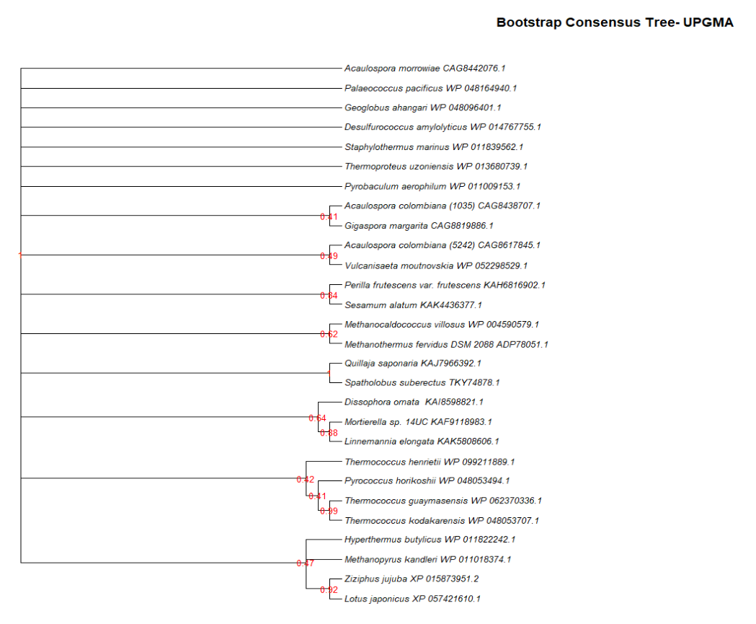
RESULTS:
Generally follows the branching logic and separation by domain indicated in initial tree
Interesting clade seen between two previously unconnected species from classes Methanococci and Methanobacteria - logical
Strong support for eukaryotic clades
Weaker support for prokaryotic clades caused them to disappear in consensus – interesting because higher identity
Interesting clade of Thermoprotei, Methanomicrobia, Magnoliopsida
Separated the two Acaulospora colombiana sequences

Slide 17
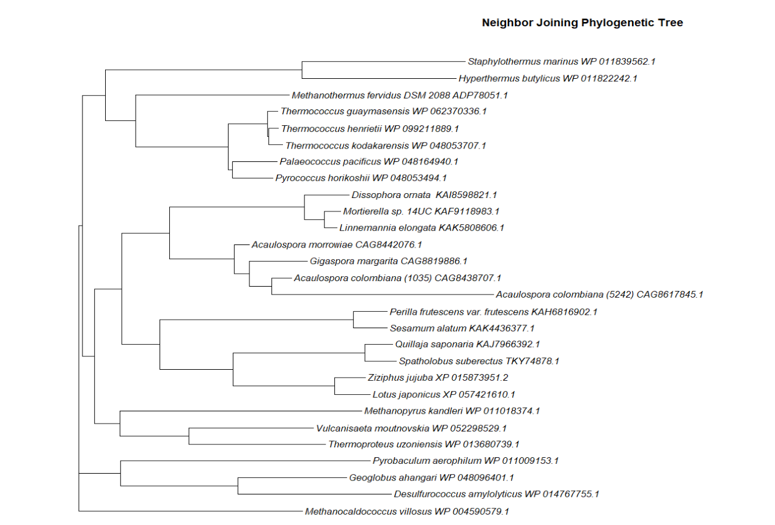
RESULTS:
Moved likely quickly evolving prokaryotes to the top of the tree
Overall structure is similar but with a difference in the order of branching
Plant clade successfully identified

Slide 18
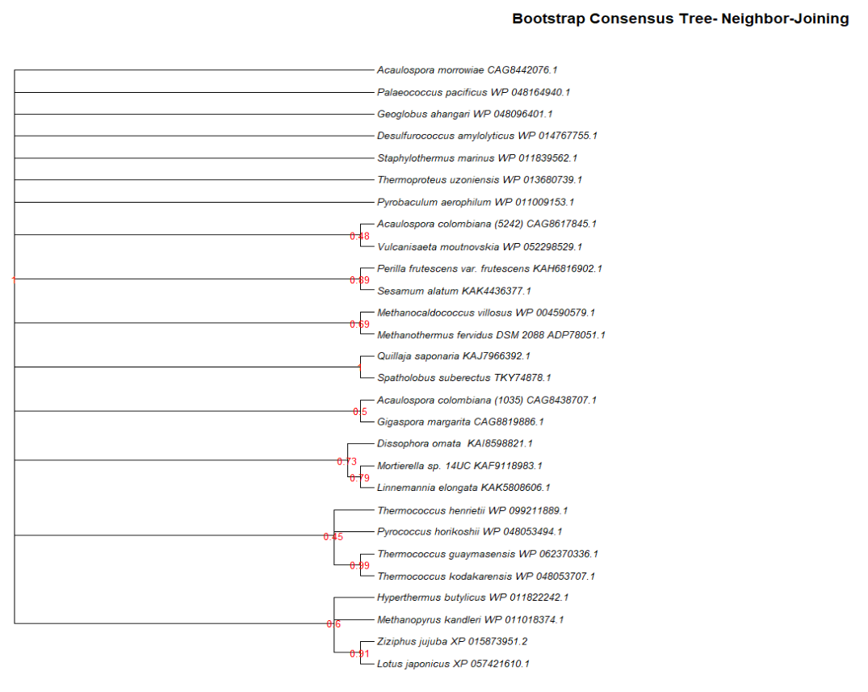
RESULTS:
Recovered same clades as UPGMA, but in slightly different order
Overall higher confidence percentage
Same recovery of interesting clade pairs (cross-domain, separating Acaulospora colombiana, combining Methanobacteria and Methanococci)

Slide 19

GC Content Analysis
DNA LEVEL ANALYSIS

Slide 20

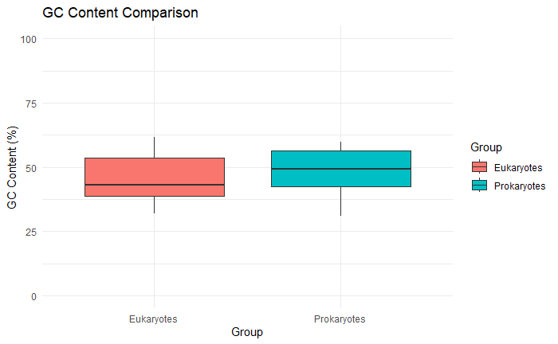
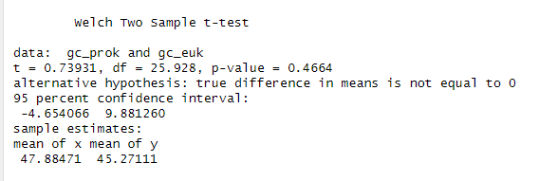
GC Content Analysis
R Packages: Biostrings
Load DNA sequences into DNAStringSet object. Call letterFrequency, focusing on letters G and C, on the DNA sequences, and store as proportion. Sum the G proportion and the C proportion to get overall GC content per sequence.
  RESULTS: Only one sequence is GC-rich (Perilla frutescens var. frutescens)
Process repeated, but with objects where sequences are separated into eukaryotes and prokaryotes → Plotted as boxplot to show difference
  Higher median GC content in thermophilic prokaryotes
  Positive skew for eukaryotes, while no skew for prokaryotes
    Check the codon usage; tails; specific class
Using a two sample t-test, there was no statistically significant different in GC content between the thermophilic prokaryotes and the mesophilic eukaryotes. The mean GC content was 47.88% in prokaryotes, and 45.27% in eukaryotes, with a 95% confidence interval ranging from
-4.65% to +9.88%.

Slide 21

Codon Usage Bias
CDS LEVEL ANALYSIS

Slide 22
Relative Synonymous Codon Usage
R Packages: Biostrings, cubar, ggplot2
Relative Synonymous Codon Usage (RSCU): observed frequency of codon / expected frequency of codon (assume equal usage for synonymous codons) – used to measure codon usage bias
Read the CDS into DNAStringSet objects, one for each domain. Clean the sequences and prepare for use with cubar. Call count_codons to create data frames with the codon frequencies, then call est_rscu to estimate RSCU for each domain group. Combine into a data frame, and plot as a scatterplot.
  Points on the guideline are used equally in the prokaryotes and eukaryotes
    Above the line = biased towards eukaryotes (CCT, ACT, TCT, ATT)
    Below the line = biased towards prokaryotes (CTC, TCA, CGC)
  Further work: Map back onto the genes to see domains
Preferred by Eukaryotes | Preferred by Prokaryotes
CCT - Proline | CTC – Leucine
ACT - Threonine | TCA – Serine
TCT – Serine | CGC - Arginine
ATT - Isoleucine

Slide 23
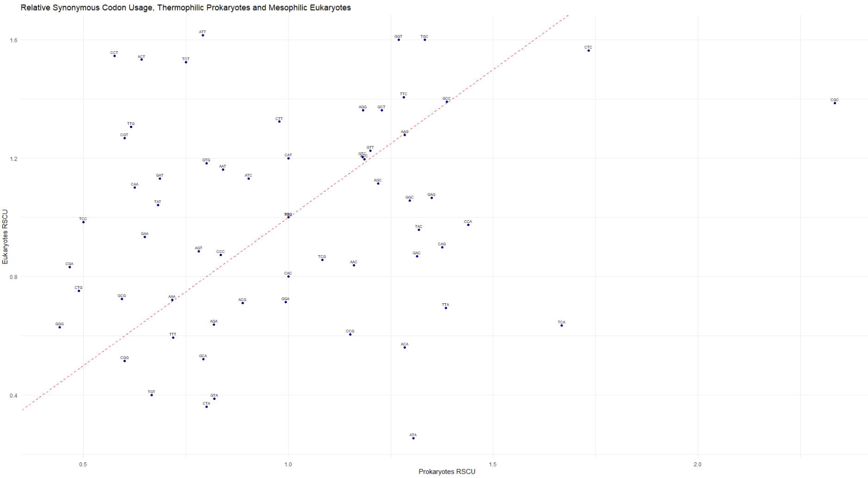
Preferred by both
Biased towards eukaryotes
Preferred by Eukaryotes | Preferred by Prokaryotes
CCT - Proline | CTC – Leucine
ACT - Threonine | TCA – Serine
TCT – Serine | CGC - Arginine
ATT - Isoleucine
Biased towards prokaryotes
Disfavored by both

Slide 24

Conclusions

Slide 25
Conclusions
MSA revealed domains of amino acids with high variability and some reasonably “alignable” domains
  N- and C- terminus possibilities with high impact on output in MSA and PCA
PCA revealed domain is highest source of variation, as expected – analyze extremes on all axes
  More variety within group of eukaryotes than in group of prokaryotes (tighter clustering)
Phylogenetic tree pulled out interesting series of combinations and separations between domain, class, and species that are worth studying
  Importance of algorithm selection, specifically as related to evolutionary rate
GC content showed no statistically significant difference cross-domain – not related to function
RSCU revealed different codons biased towards each domain group - analyze

Slide 26
Future Work
Improvements:
Focus:
Different Analyses:
Statistically significant sample sizes
Run reciprocal PSI-BLAST to ensure meaningful sequence selection
Entropy analysis
Apply machine learning
Techniques to decrease impact of domain
Specific classes
Extend to Animals
Profile HMM at termini, domain, or core level
Motif analysis
Analyze the termini
Remove termini and focus on core
Protein-folding

Slide 27
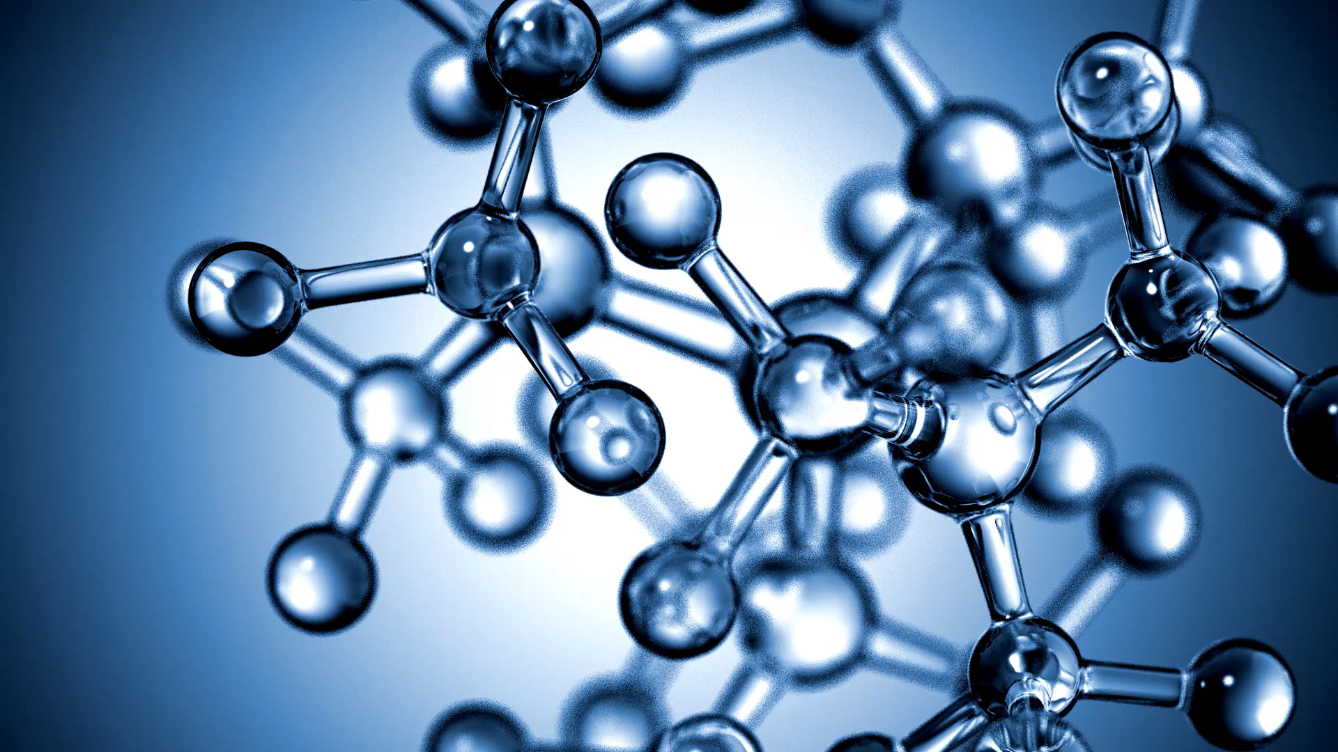
While nothing completely revolutionary was discovered, it was interesting to have a practical application of so many different bioinformatics techniques in conjunction & gain further appreciation
Pull out ideas for future analyses
Combine the techniques with validation methods and visualizations
Automation of so many of these functions through variety of R packages
  PROS: easy to perform, quick, integrated environment, variety of open-source packages
  CONS: harder to determine sources of error, learning curve

Slide 28
Bibliography
Khan, M. F., & Patra, S.
(2018). Deciphering the rationale behind specific codon usage pattern in extremophiles. Scientific reports, 8(1), 15548. https://doi.org/10.1038/s41598-018-33476-x
Kumar, S., Tamura, K., & Nei, M.
(1993). Basic Sequence Statistics. Retrieved from MEGA Manual: https://www.megasoftware.net/mega1_manual/BasicStats.html
Pagès H, Aboyoun P, Gentleman R, DebRoy S (2024). Biostrings: Efficient manipulation of biological strings. R package version 2.74.1, https://bioconductor.org/packages/Biostrings.
Paradis E, Schliep K (2019). “ape 5.0: an environment for modern phylogenetics and evolutionary analyses in R.” Bioinformatics, 35, 526-528. doi:10.1093/bioinformatics/bty633.
Parvathy, S. T., Udayasuriyan, V., & Bhadana, V. (2022). Codon usage bias. Molecular biology reports, 49(1), 539–565. https://doi.org/10.1007/s11033-021-06749-4
Rampelotto P. H. (2013). Extremophiles and extreme environments. Life (Basel, Switzerland), 3(3), 482–
485. https://doi.org/10.3390/life3030482
Schliep K.P. 2011. phangorn: phylogenetic analysis in R. Bioinformatics, 27(4) 592-593
Singer, G. A., & Hickey, D. A.
(2003). Thermophilic prokaryotes have characteristic patterns of codon usage, amino acid
composition and nucleotide content. Gene, 317(1-2), 39–47.
https://doi.org/10.1016/s0378-1119(03)00660-7
Somayaji, A., Dhanjal, C. R., Lingamsetty, R., Vinayagam, R., Selvaraj, R., Varadavenkatesan, T., & Govarthanan, M. (2022). An insight into the mechanisms of homeostasis in extremophiles. Microbiological research, 263, 127115.
https://doi.org/10.1016/j.micres.2022.127115
Trent, J. D., Gabrielsen, M., Jensen, B., Neuhard, J., & Olsen, J.
(1994). Acquired thermotolerance and heat shock proteins in thermophiles from the three
phylogenetic domains. Journal of bacteriology, 176(19), 6148–6152. https://doi.org/10.1128/jb.176.19.6148-6152.1994
Wright ES
(2016). “Using DECIPHER v2.0 to Analyze Big Biological Sequence Data in R.” The R Journal, 8(1), 352-359.
Zhang H, Liu M, Zi B
(2024). cubar: Codon Usage Bias Analysis. R package version 1.1.0.9000, https://github.com/mt1022/cubar
DiGiaocomo, J., McKay, C., & Davila, A.
(n.d.). ThermoBase: A Centralized Database of Thermophiles and Hyperthermophiles. Thermobase. https://togodb.org/db/thermobase
Gupta RS, Bustard K, Falah M, Singh D.
1997.Sequencing of heat shock protein 70 (DnaK) homologs from Deinococcus
proteolyticus and Thermomicrobium roseum and their integration in a protein-based
phylogeny of prokaryotes. J Bacteriol179:.https://doi.org/10.1128/jb.179.2.345-357.1997
Gupta, R. S., & Singh, B.
(1994). Phylogenetic analysis of 70 kD heat shock protein sequences suggests a chimeric origin for the eukaryotic cell nucleus. Current biology : CB, 4(12), 1104–1114. https://doi.org/10.1016/s0960-9822(00)00249-9
H B Rappaport, Angela M Oliverio,
Lessons from Extremophiles: Functional Adaptations and Genomic Innovations across the Eukaryotic Tree of Life, Genome Biology and Evolution, Volume 16, Issue 8, August 2024, evae160, https://doi.org/10.1093/gbe/evae160
Hu, C., Yang, J., Qi, Z., Wu, H., Wang, B., Zou, F., Mei, H., Liu, J., Wang, W., & Liu, Q.
(2022). Heat shock proteins: Biological functions, pathological roles, and therapeutic
opportunities. MedComm, 3(3), e161. https://doi.org/10.1002/mco2.161
Hurst, L. D., & Merchant, A. R.
(2001). High guanine-cytosine content is not an adaptation to high temperature: a
comparative analysis amongst prokaryotes. Proceedings. Biological sciences, 268(1466), 493–497. https://doi.org/10.1098/rspb.2000.1397

Slide 29
Appendix
Code, Images, Raw Data, and Additional Information

Slide 30
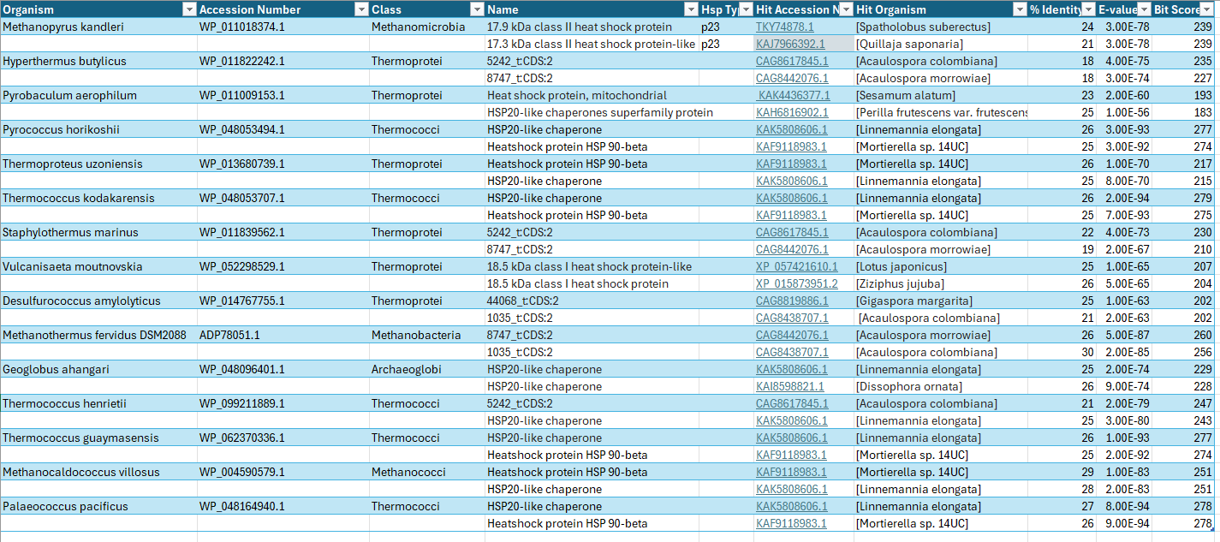
PSI-BLAST Results

Slide 31
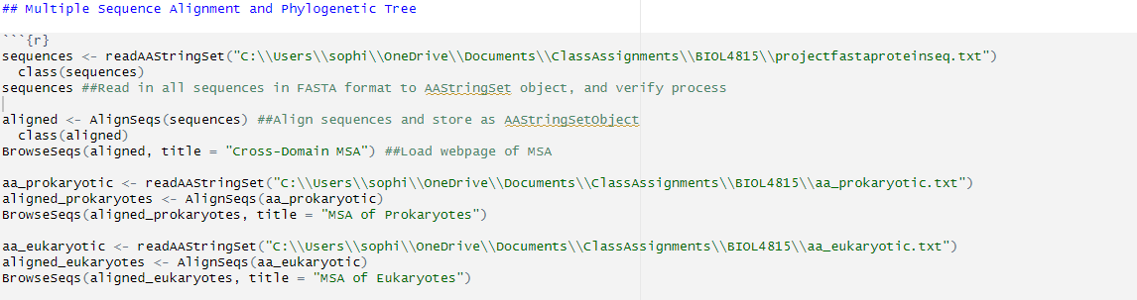
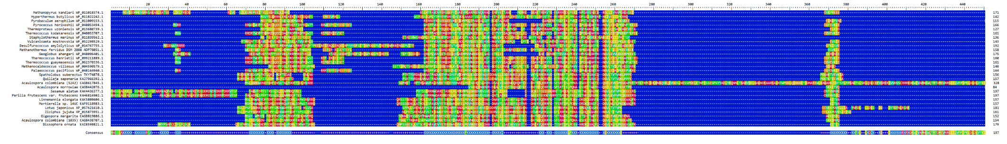
Code for Multiple Sequence Alignment
Cross-Domain Multiple Sequence Alignment

Slide 32
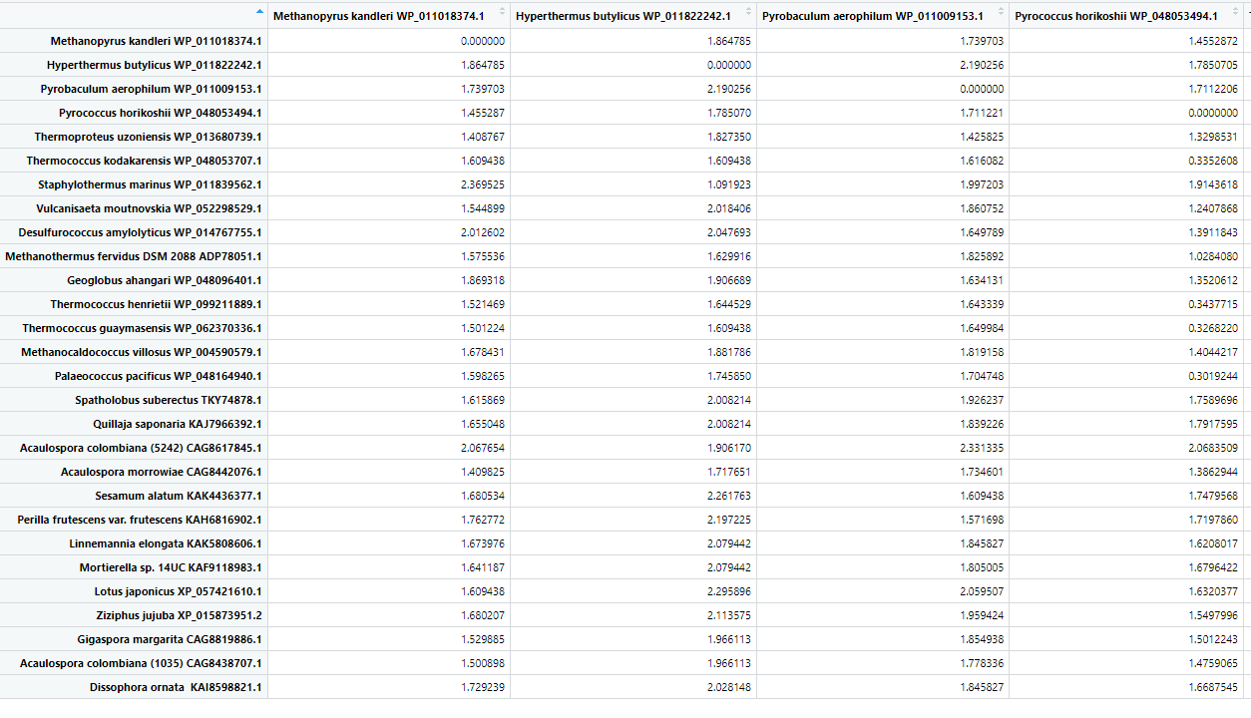
Distance Matrix
Continues for the entire matrix, as this is only a portion. The full output can be included in the Rmarkdown included with my submission.

Slide 33
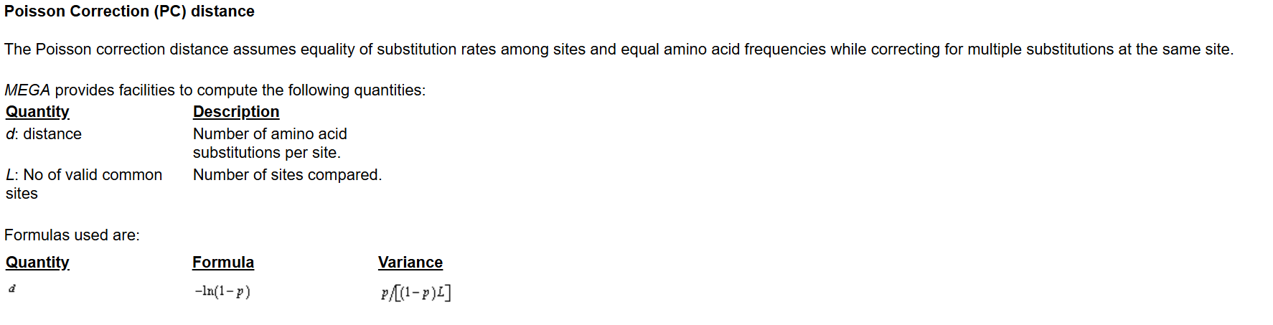
Poisson Correction
Poisson Correction (PC) distance

Slide 34
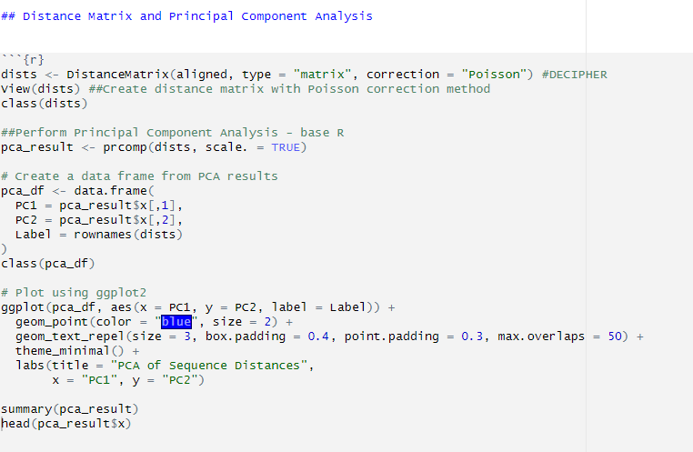
Code for Distance Matrix & PCA
Create a data frame with the first and second principal component scores for each sequence, labelled with the row names from the distance matrix
Create a dot plot with PC1 and PC2 as x and y axes, with sequence IDs as labels. Format by avoiding overlapping text, label the aces and the title, and use blue dots for each point.

Slide 35
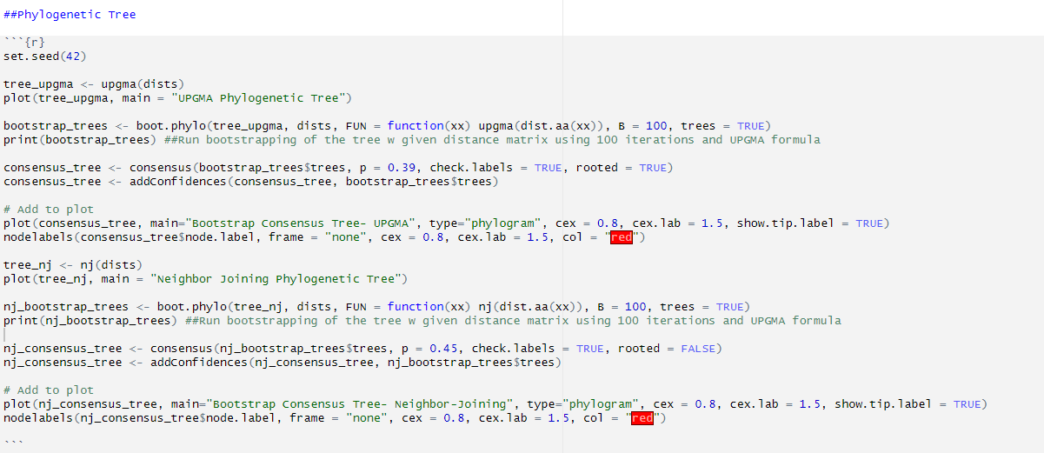
Code for Phylogenetic Tree & Bootstrapping
Construct and plot a phylogenetic tree from a distance matrix using the UPGMA method
Set a seed for reproducibility since bootstrapping requires a random process.
Perform bootstrapping on the initial phylogenetic tree from the distance matrix. FUN gives a custom function to convert the bootstrapped sequences into a distance matrix, and build a tree. 100 iterations are performed.
Build a consensus tree from the 100 bootstrap trees. A branch must be in at least 39% of trees to be included. Return a rooted tree, with the bootstrap values (addConfidences) as labels.
Repeat process with the neighbor-joining method and a threshold of 45%.

Slide 36
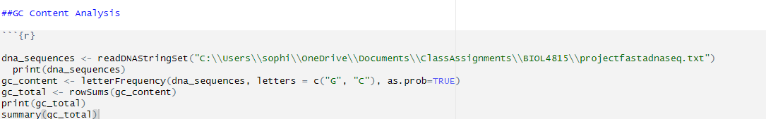
Code for GC Content Analysis
Load sequences into DNAStringSet object. Call letterFrequency, focusing on letters G and C, on the DNA sequences, and store as proportion.
The columns in the GC Content Matrix are G% and C%, so we add the two using rowSums to get the GC% for each sequence. Store as its own object, and print. Include the statistical summary.
Each of the sequences’ GC content as a proportion of their total nucleotides is represented.
Median = 0.4495
Mean = 0.4667
Range = [0.3082, 0.6166]
Only one sequence is particularly GC-rich.

Slide 37
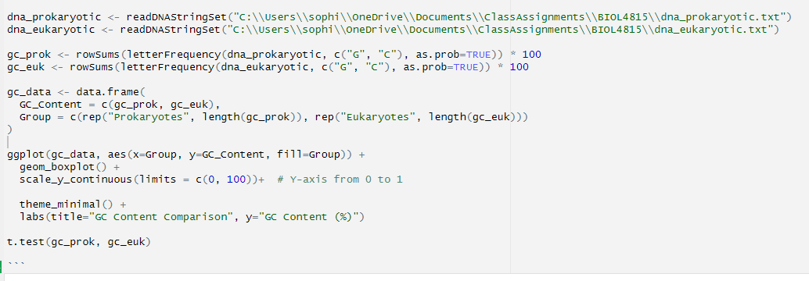
Code for GC Content Analysis
Load sequences into DNAStringSet object – one for prokaryotic sequences, one for eukaryotic sequences. Call letterFrequency, focusing on letters G and C, on the DNA sequences, and scale by 100 for percentage.
Create a data frame object with the GC% calculated above. Combine the numeric vectors for each group (prokaryotes and eukaryotes). Create a group labelled “Prokaryotes” repeated as many times as there are prokaryotic sequences (entries in GC% object), and do the same for “Eukaryotes”.
Plot the information in the data frame as a boxplot, where the x-axis is the group defined in the data frame, and the y-axis is the GC content defined in the data frame. Scale to be on a y-axis of of 0 to 100 (%) to create a fair visualization. Then perform a t-test.

Slide 38
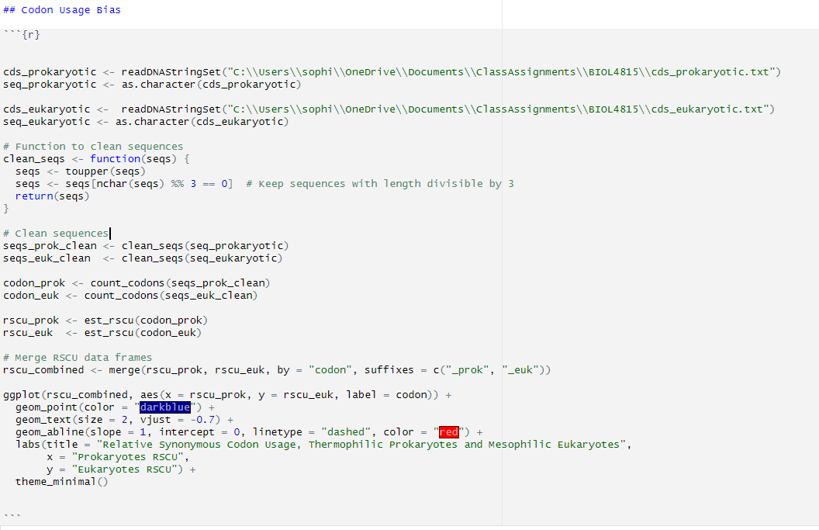
Code for Codon Usage Bias
Read CDS FASTA files for each eukaryotic and prokaryotic sequences, and convert to string of characters.
“Clean” sequences (help correct errors and put in right format for cubar functions). Convert to all uppercase and filter out any sequences whose length isn’t a multiple of 3 (number for codon).
Apply the function to the DNAStringSet objects.
Call count_codons on the cleaned sequences to scan each sequence and create a data frame of how many times each codon appears. Using this information, call est_rscu to compute RSCU and return a data frame. Then merge the two (inner join), and add labels (_prok/_euk) to distinguish the two.
Plot the combined RSCU data frame as a dot plot, with labels for each codon. Add a reference line where RSCU = 1.

