Slide 1

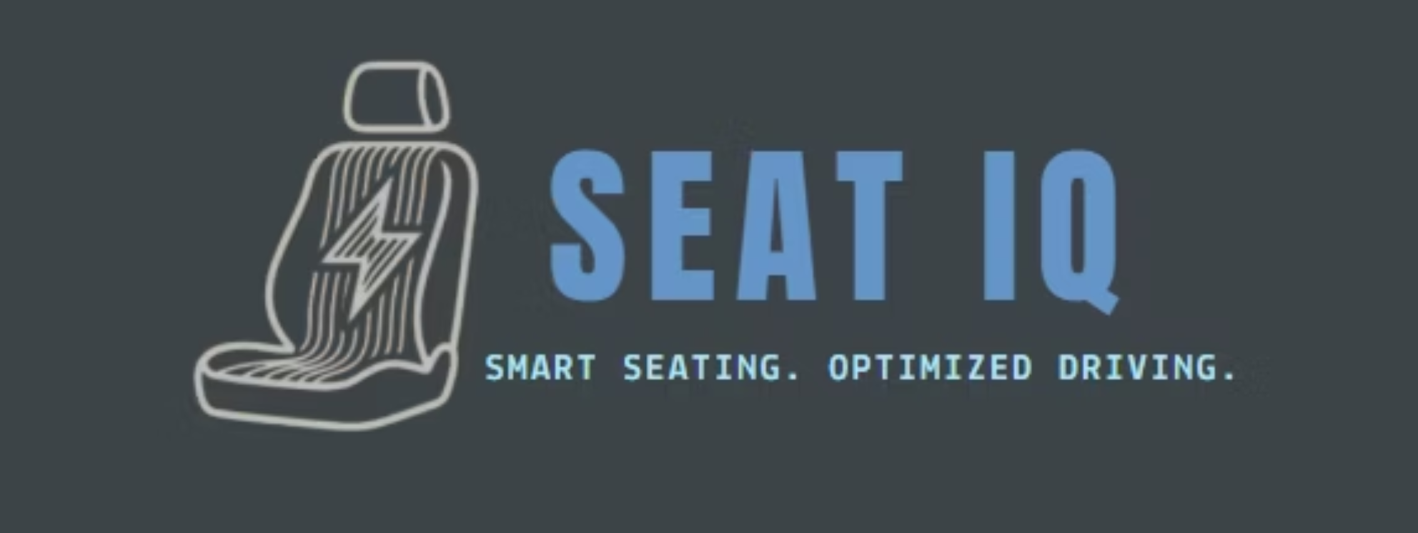

Slide 2

The Problem
6M
40K
2.4M
Crashes
Fatalities
Injuries
Police-reported car crashes in USA 2023
Lives lost in car accidents
People injured in crashes
Disparity
Historical Gap
Short-statured drivers are 47% more likely to be severely injured and 17% more likely to die in car crashes.
First female crash test dummy introduced in 2026 — decades after male dummies.

Slide 3
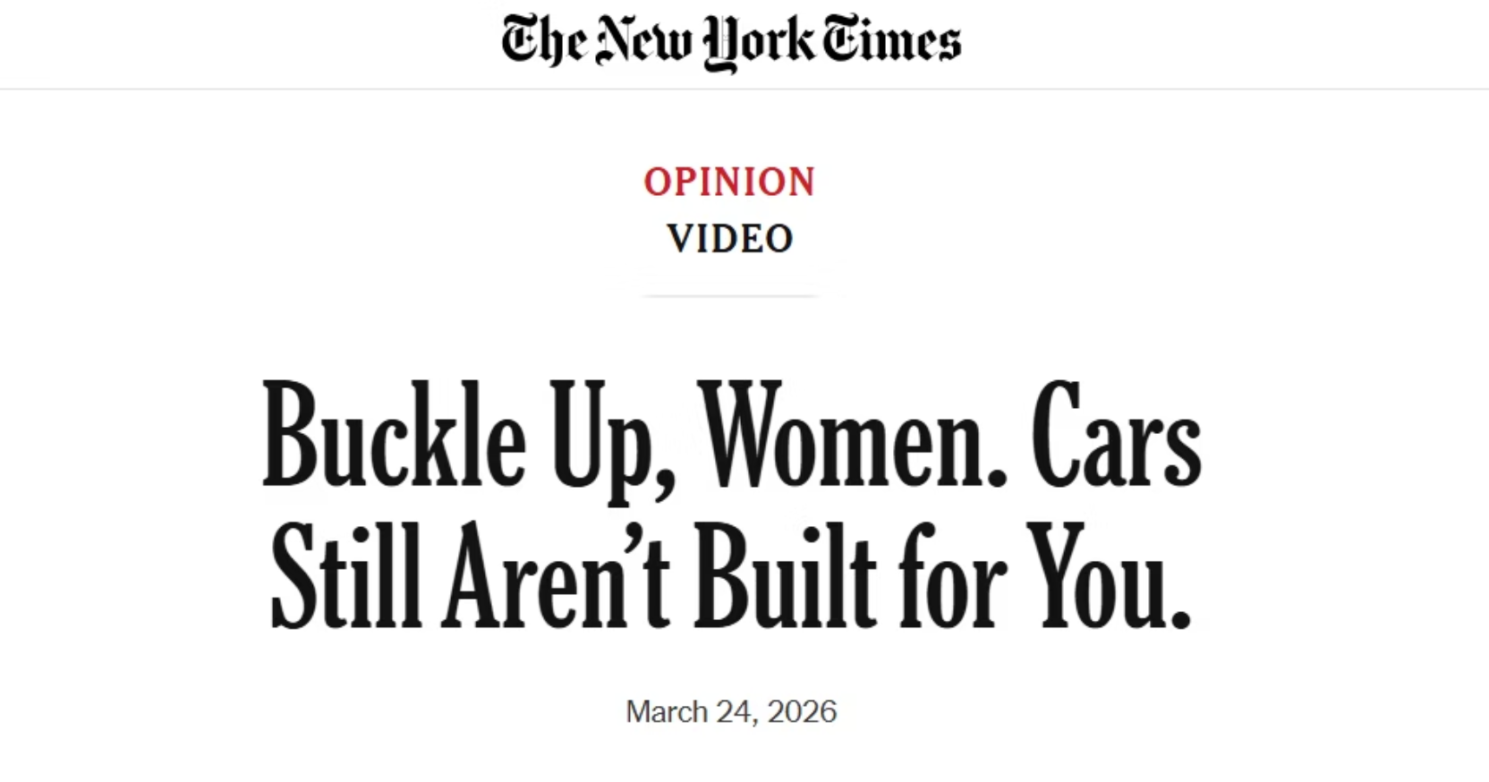
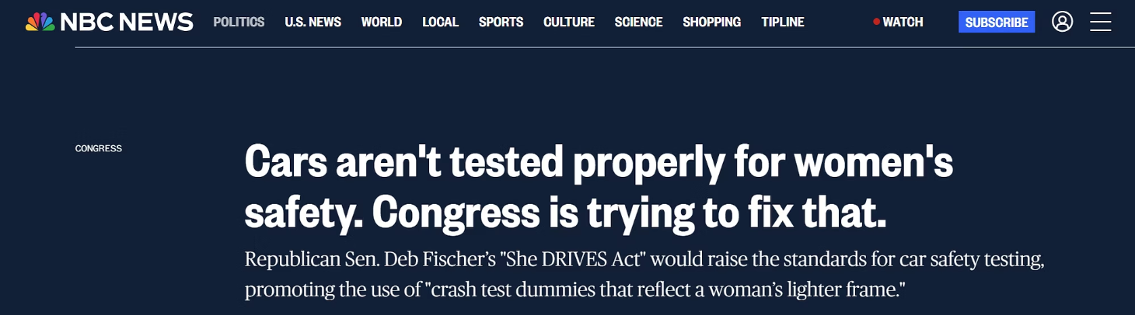
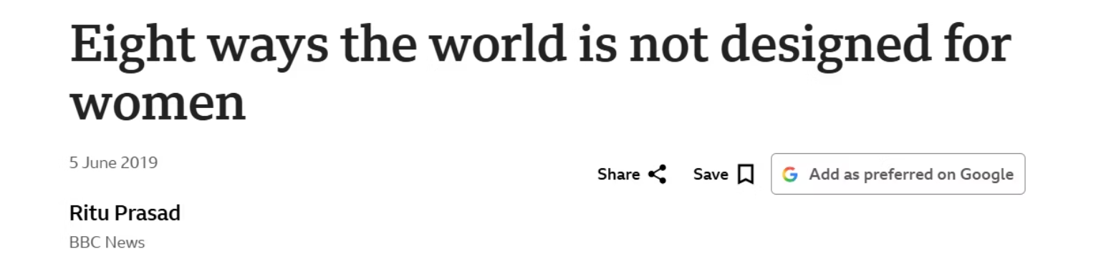
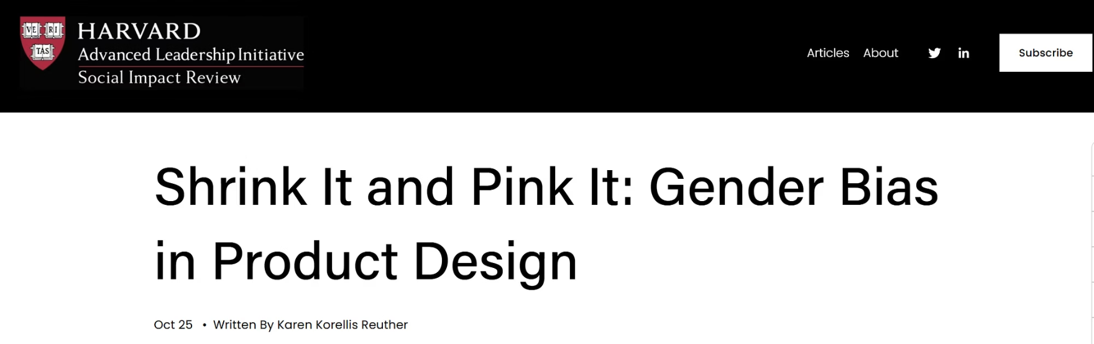
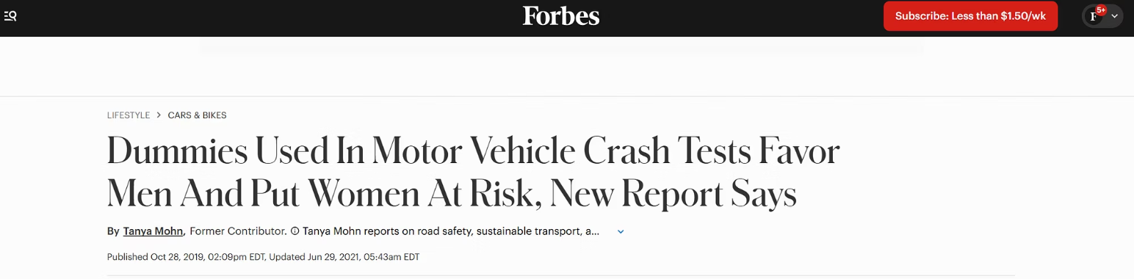
This is our reason why.

Slide 4
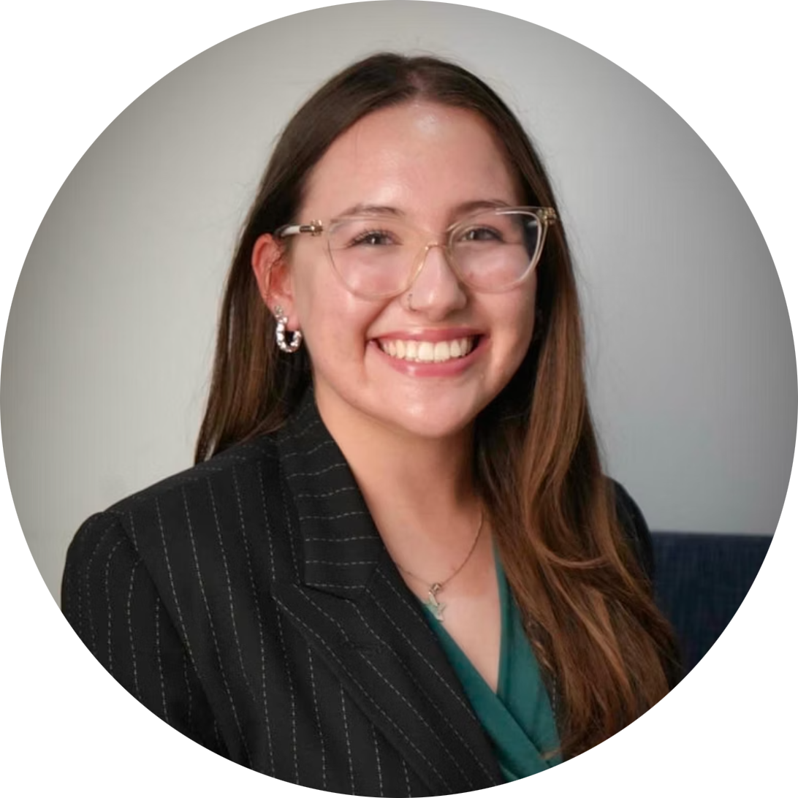


Meet the Team
Sophie Krajmalnik
Meera Bhakta
Bethany Davis
CEO, Founder
UNT Data Science '27
Co-Founder, Chief Business Officer
UNT Biology '26
Co-Founder, Chief Technology Officer
UNT Biology '26

Slide 5
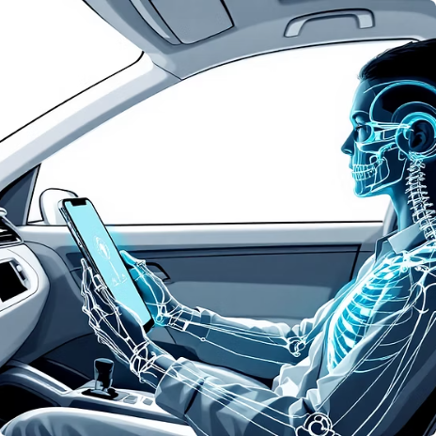



What is SEAT IQ?
A mobile app that uses your smartphone's cameras and sensors with AI and computer vision to optimize your driving position.
Scan & Analyze
Calculate Position
Guide & Optimize
Learn & Improve
Uses smartphone cameras and sensors to analyze body composition and seating position.
Bioinformatics-informed algorithm determines your ideal seating for safety, comfort, and accessibility.
Receive real-time guidance to reach your recommended optimal seating position.
Continuously enhances recommendations through ongoing data analysis and safety modeling.

Slide 6

39% Reduction in
Composite Injury Severity Scores
in Industry-Standard Software

Slide 7



The Market
SEAT IQ is completely unique to the market.
SOM: 2.2M
1
Projected to reach at year 6
SAM: 234M
2
US licensed drivers age 18-49 with high smartphone usage
TAM: 1.6-2B
3
Total licensed drivers worldwide

Slide 8

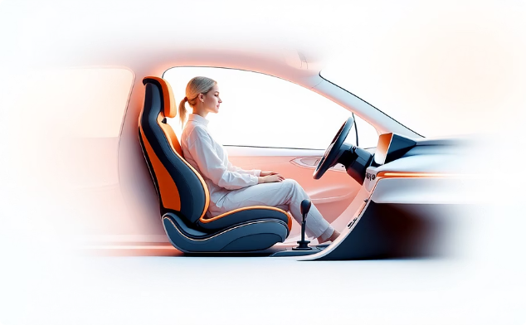
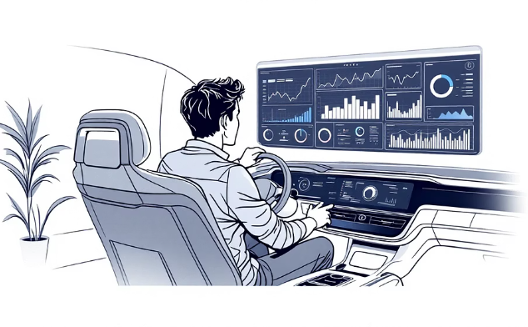
Our Target Customers
Safety-Focused Driver
Underserved Driver
The New Driver
Primary driver managing family tasks
Requires solutions for physical accessibility challenges
Inexperienced or younger, bias-aware drivers

Slide 9
Direct to Consumer Sales
1 year subscription term | Basic: $24.99/yr | Pro: $34.99/yr
Expansion Path
B2B Licensing & Revenue Sharing • Data Licensing • Advertising & Affiliate Marketing
Create stable income
Insurance, Driving Schools, Dealerships, Corporate Fleets
Distribution Partners
App Store • Advocacy Groups • Social Influencers • Reputable Agencies • Word of Mouth
Build trust and user base

Slide 10

Projected Growth & Revenue Milestones
Month 2
Month 10
Month 26
Month 68
Begin user acquisition with 10 initial users.
Launch affiliate marketing programs
Reach 20,000 users through mature B2B pipeline + organic growth.
Reach SOM with 2.2M users.
Month 5
Month 17
Month 40
Launch driving school programs.
Reach 5,000 total subscribers through direct B2C sales + early partnerships.
Launch insurance partnerships at 60-80K.
Begin with data licensing.

Slide 11
Core Requirements
1
2
3
Functionality & Value
Go-to-Market & Compliance
Distribution & Revenue Streams
Computer Vision
Biomechanical Algorithm
Real-Time Guidance
Recalibration
User Interface
Biometric Security and Privacy
IAP Compliance
Subscription Features
Analytics
Enterprise SSO
Affiliate Tracking
Data Storage

Slide 12
Core Costs
1
Tech Stack and R&D
2
Personnel
3
Testing & Validation
4
General & Admin
5
Sales & Marketing
6
App Store Fees
7
Legal Fees & Insurance

Slide 13





Our Ask
Our goal is to raise $815,000 through friends and family, initial angel investors, and crowdfunding.
60%
15%
Product Development Team
Operations
Full-stack developer, ML engineer, QA engineer
Data, tech stack, hardware, simulation software
7%
6%
Legal
Marketing
Incorporation, patent filing, NDAs, audits
User research, initial marketing, partner engagement
10%
2%
Buffer
General & Administrative
Reserve for flexibility and contingencies, carry over
Office supplies, communication, etc.

Slide 14

Development Partners
Safety and Advocacy Groups
Universities (Iowa, Minnesota)
Model-Based Systems Engineering
Oversight Agencies (NHTSA)

Slide 15






Year 0 Milestones
File LLC Articles of Organization in Delaware
Hire Core Development Team
Engage with Potential Partners
Generate Proof of Concept Algorithm
Market Crowdfunding for Feedback and Funding

Slide 16



A New Driving Experience, Prioritizing You
team@seat-iq.com

Slide 17
Cap Table & Ownership by Funding Rounds
Equity Holders
Ownership (Pre-funding)
Round 1
Seed Round
Founders (CEO, CTO, CFO)
80%
70%
60%
Option Pool
15%
15%
15%
Advisors
5%
5%
5%
Friends and Family
0%
10%
10%
Seed Investors
0%
0%
10%
Total:
100%
100%
100%
Equity Conditions:
Fundraising:
4 year vesting period
1 year cliff
Option pool reserved for future hiring
Advisor equity typically 0.5%-1%
Conversations with friend and family
Crowdfunding to create beta test pool as well
Backed by incubator or NSF grant for scientific rigor
Search for city economic development fund ex. McKinney, TX

Slide 18
Core Costs
1
2
3
Tech Stack
Personnel
Testing & Validation
Begin with outsourcing then move in-house
Begin at build
Core functionality and revenue stream requirements
Scales with user and revenue
2 developers, QA, UI/UX designer at build
C-suite take on various roles until expansion merits hiring
Expand as company scales with sales, marketing, account managers, HR, accountant
Built with standards and risk mitigation in mind.
Includes an annual security audit, NHTSA stamps and other oversight agency approvals, plus maintenance fees.
Peaks in early years then decreases, flat with regular audits
4
5
6
App Store Fees
General & Admin
Sales & Marketing
Folded into per-sale revenue and grows with user volume
These costs are bypassed with B2B sales
Starts with fully remote work and a small stipend for office use
Covers SaaS tools like Zoom and Microsoft Office, bookkeeping needs, HR needs
Legal fees and liability insurance
Talent acquisition
Grows with hiring and larger accounts
Includes paid acquisition, event costs, and tools.
Expands drastically as the business moves to B2B and scales with company growth.

Slide 19
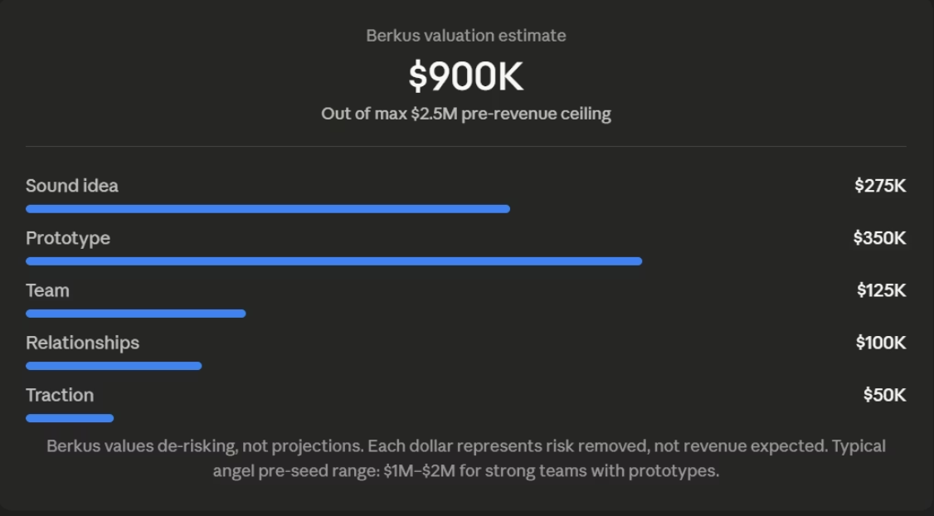
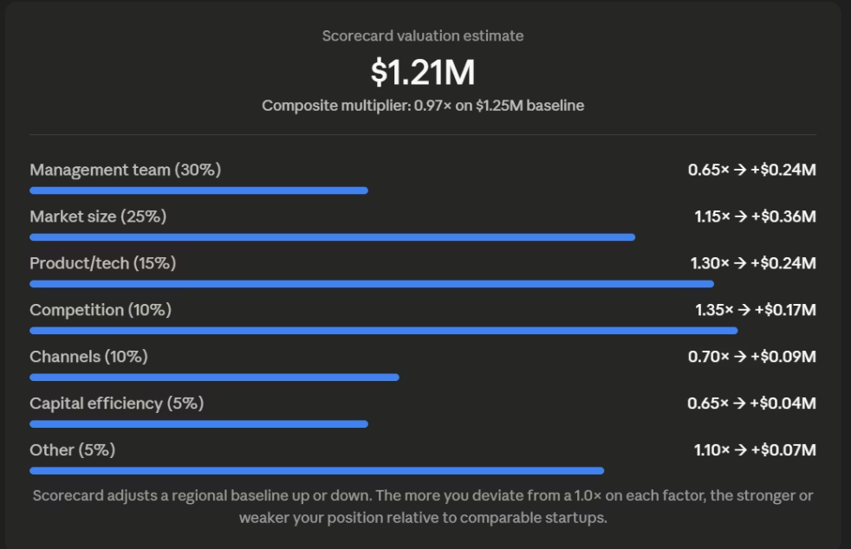
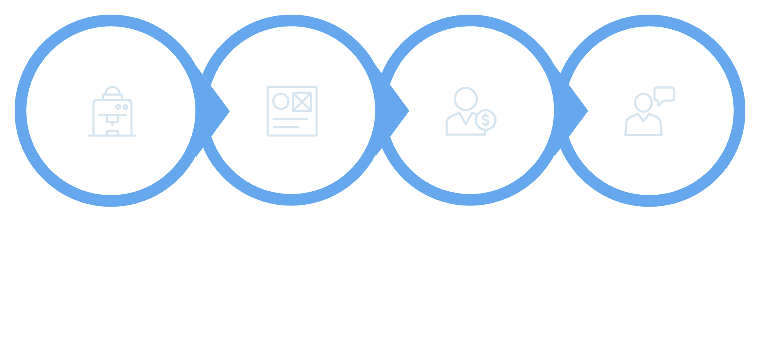

Initial Valuation
Technology & Progress
Team
Market
IP
(Proof of Concept, prototype algorithm, app wireframe)
(Hard to replicate, possibility of moat)
(Founder understanding, MBSE advisor)
(No competitor, new to market, large opportunity, attention)

Slide 20
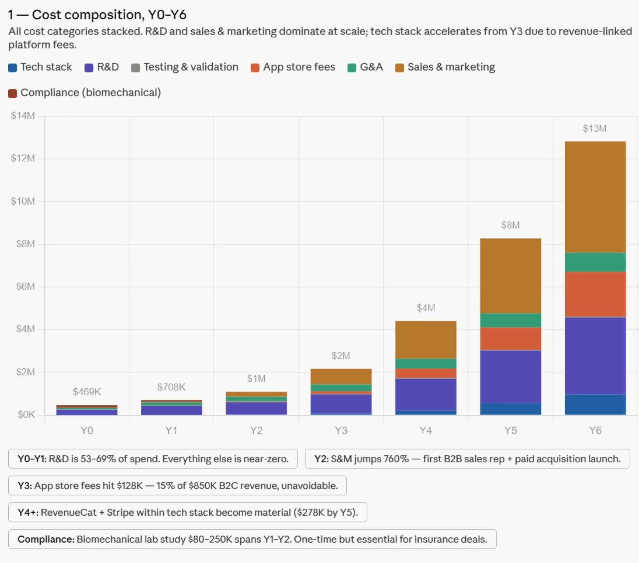

Slide 21
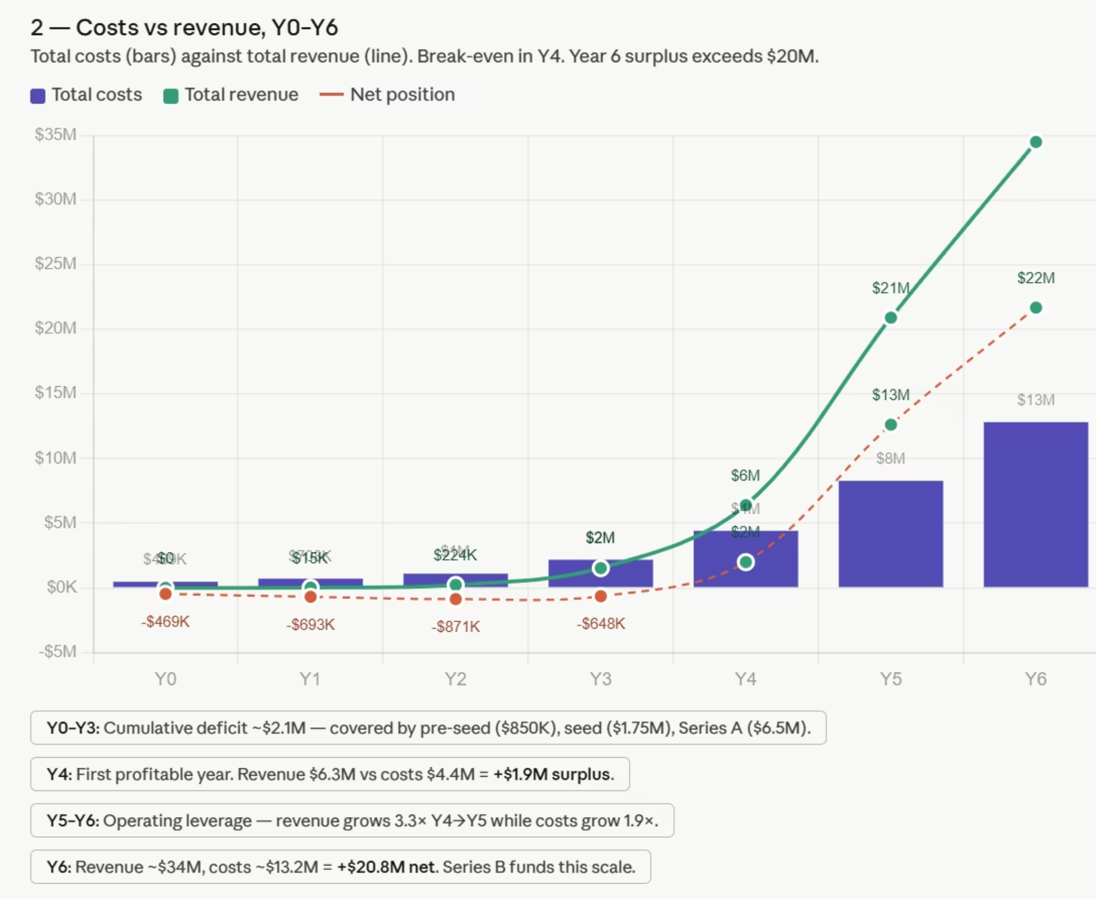

Slide 22
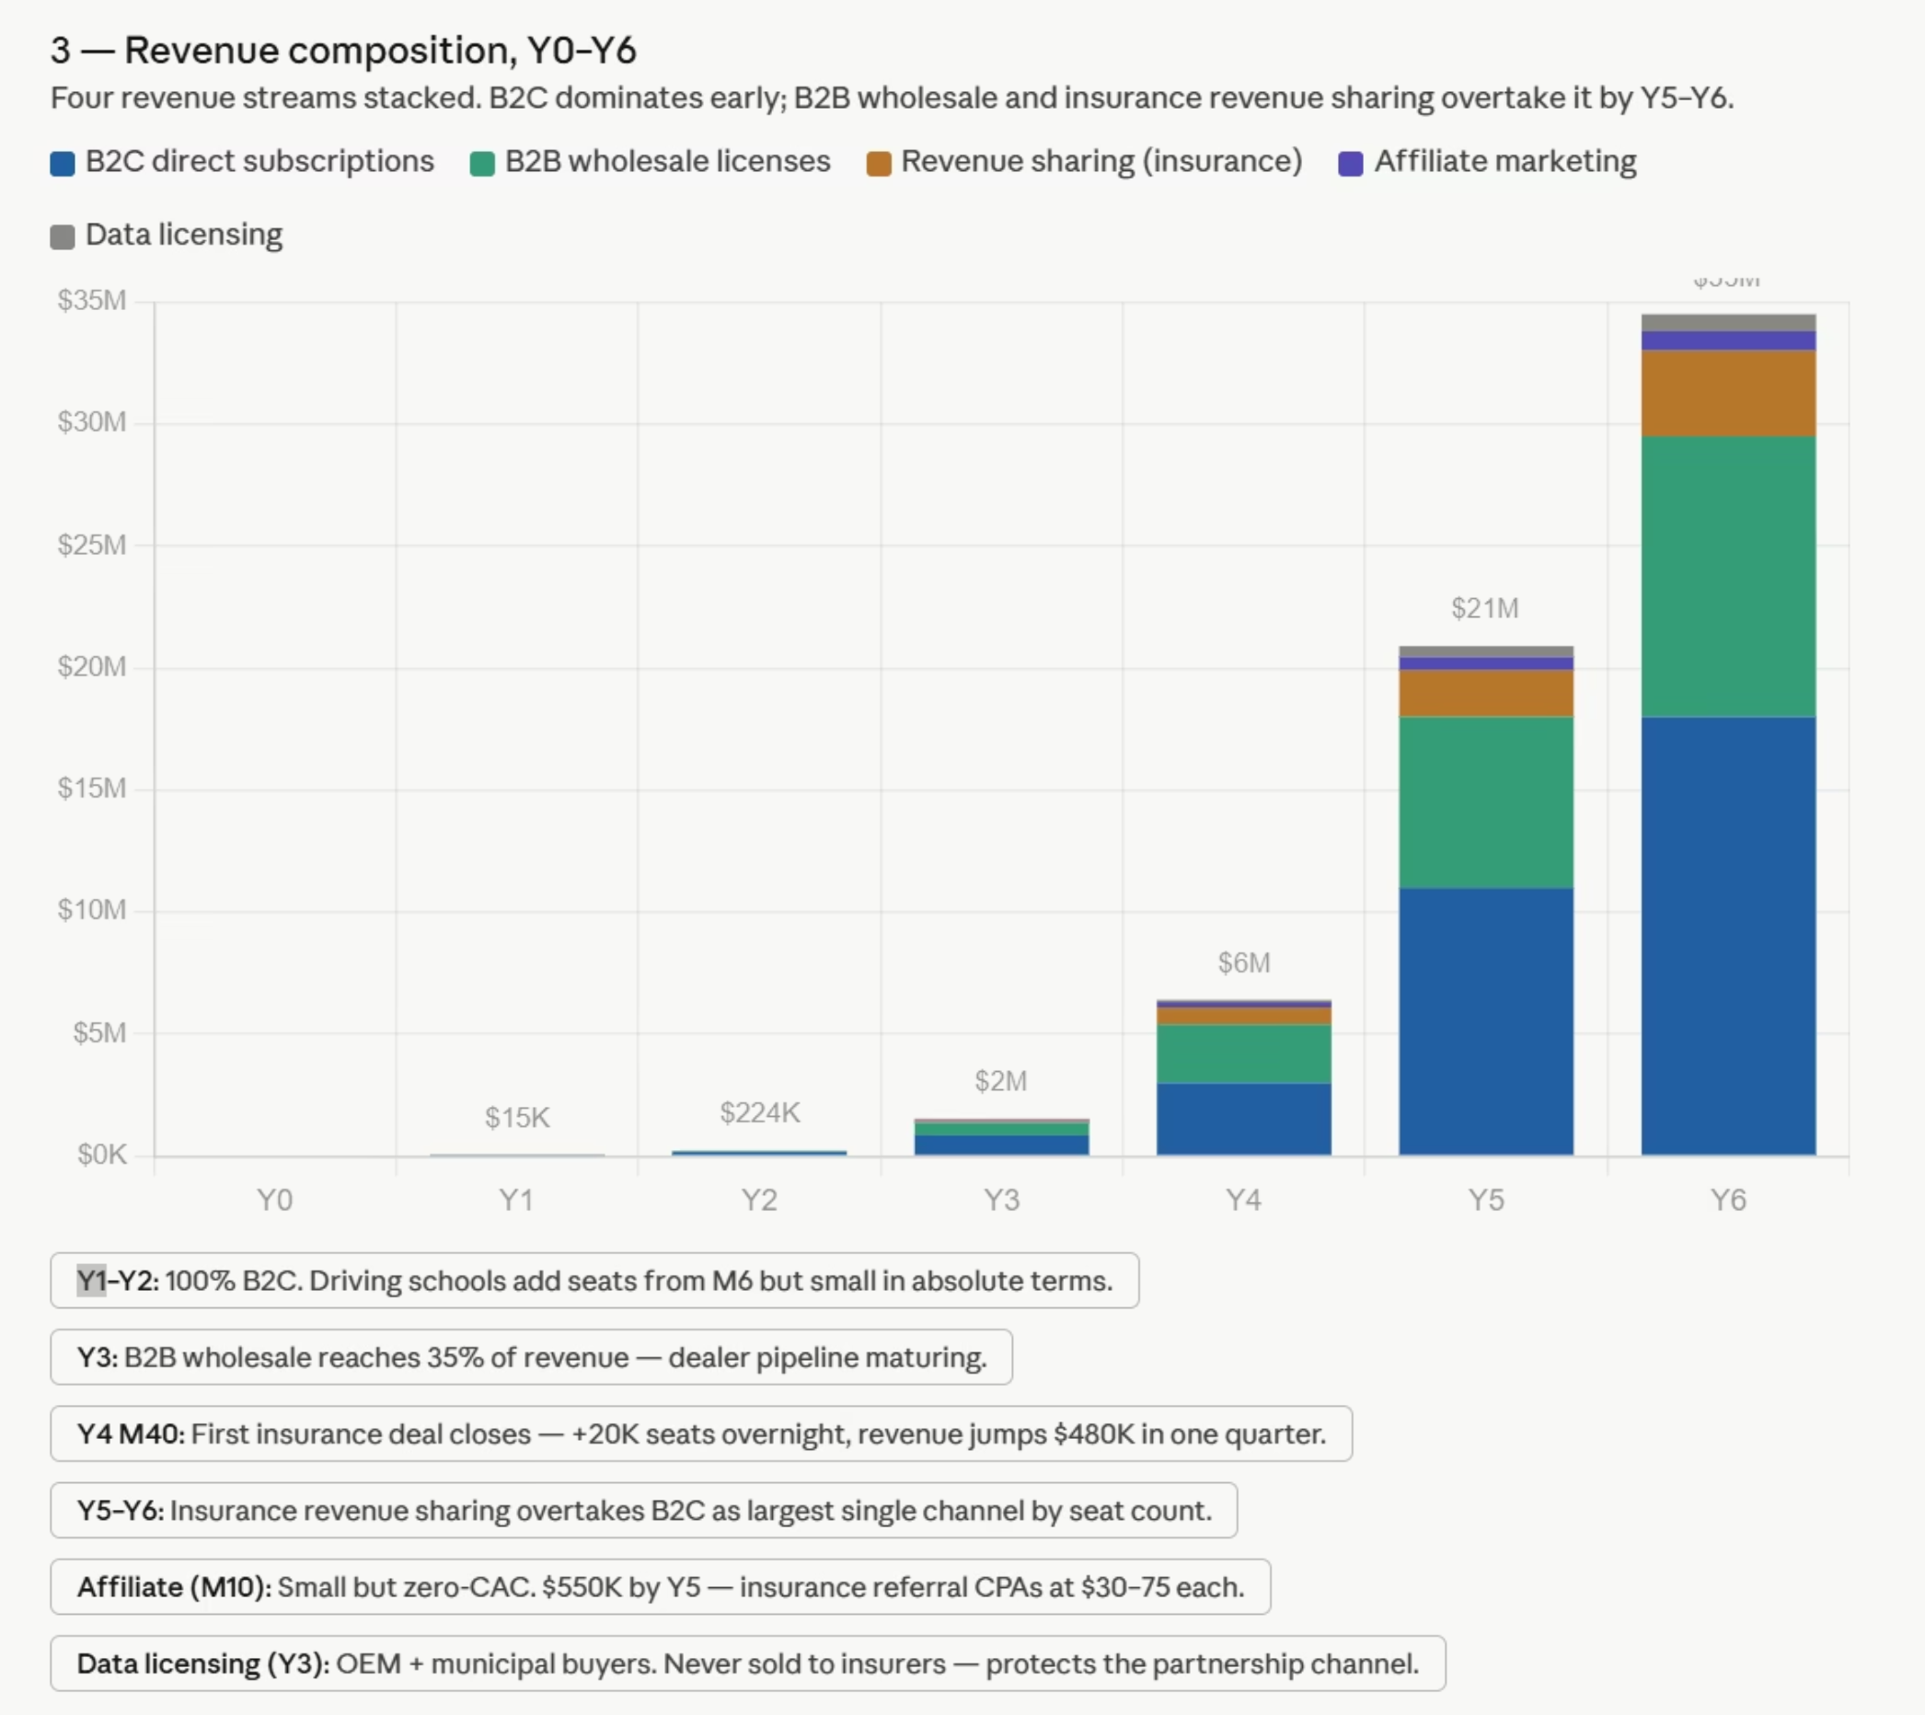

Slide 23
COMPLIANCE LANDSCAPE
Government & Regulatory Bodies
Organization
Role
Estimated Cost
When Needed
FTC
Consumer protection, data privacy enforcement
Legal review: ~$5K–$15K
Pre-launch
FDA
Ensure app is NOT classified as medical device
Legal classification: ~$5K–$10K
Pre-launch
NHTSA
Vehicle safety guidance, potential certification alignment
Testing/validation: ~$10K–$30K
Year 2–3
State Laws (CA, TX, IL)
Biometric data compliance (e.g., BIPA in Illinois)
Legal + audits: ~$10K–$25K
Pre-launch

Slide 24
Industry Standards & Certifications
Standard
Purpose
Cost
When Needed
ISO 26262
Functional safety in vehicles
$15K–$50K
Year 2–4
ISO 11226
Ergonomic posture standards
$5K–$15K
Product validation
ISO 9241
Human-system interaction
$5K–$20K
UX validation
SAE International
Automotive engineering standards
$5K–$15K
Scaling phase
SOC 2
Data security for B2B trust
$20K–$60K
Year 2–3

Slide 25
Platform & Legal Compliance
Requirement
Purpose
Cost
When Needed
App Store Policies (Apple/Google)
App approval & privacy compliance
Dev fees + rev share
Launch
ADA Compliance
Accessibility for all users
$5K–$15K
Pre-launch
HIPAA (if applicable)
Health data protection (only if medical claims)
$10K–$50K
Conditional
COPPA
Child data protection (<13 users)
$5K–$10K
If targeting minors

Slide 26
Saftey, Advocacy & Accessibility
Organization
Role
Cost
When Needed
IIHS
Vehicle safety research alignment
Partnership-based
Year 2+
Safe Roads Alliance
Road safety advocacy
Low / partnership
Year 1+
CarFit Program
Driver ergonomics & positioning
Low / collaboration
Early validation
NAWHSL
Women-focused safety leadership
Partnership
Growth phase
Women Drive Too / HERide
Underserved driver advocacy
Partnership
Early adoption
Safe Riders Program (TX)
Driver safety education
Low
Regional pilots
Women in the Driver’s Seat
Inclusive design insights
Partnership
Early design
Estimated Compliance Investment: ~$50K – $150K (Early–Mid Stage)
Critical for user trust, safety validation, and B2B partnerships.

Slide 27
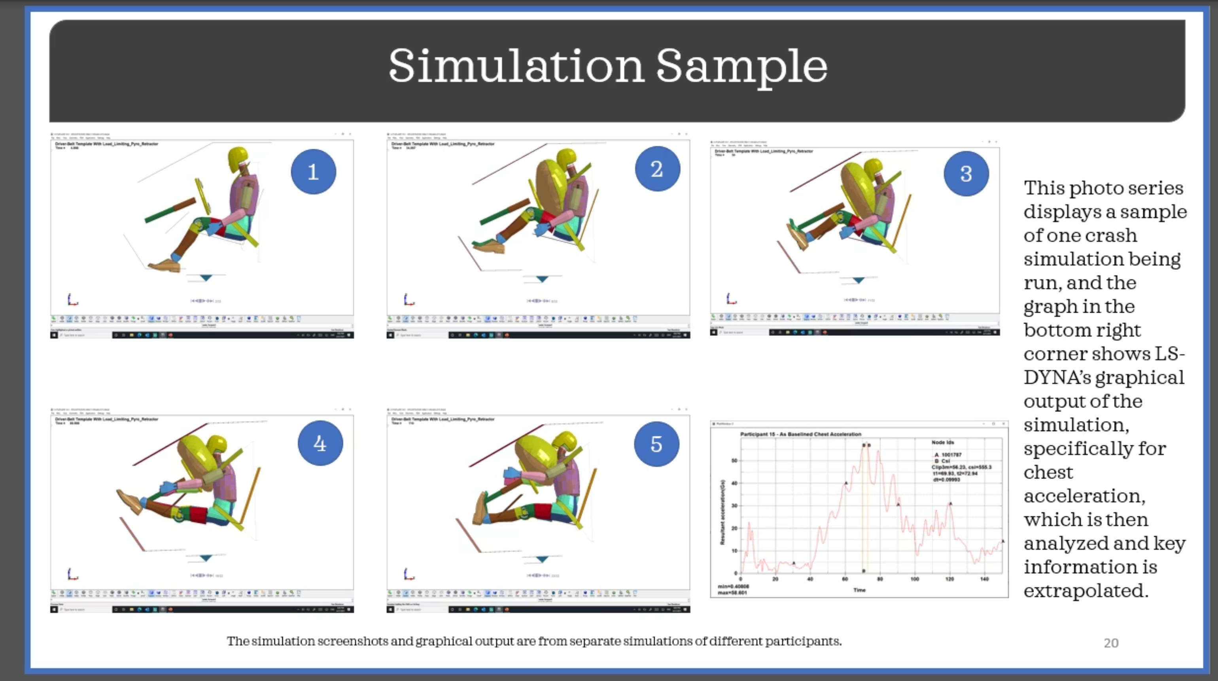

Slide 28
Business Model & Fundraising Strategy
Business Model
B2B licensing: partnerships with dealerships, fleets, and insurance providers to scale distribution
Subscription model: recurring revenue through Basic and Pro tiers with premium features
Distribution: app stores and strategic partnerships and integrations
Fundraising Strategy
Pre-seed: grants, incubators, and friends & family funding to build and validate early product
Seed: early investors to fund development, hiring, and market entry
Growth: scale through B2B partnerships, user expansion, and data-driven insights

Slide 29
Input & Output Model
Input
Output
Development team (developers, quality assurance, user interface/user experience)
Functional SeatIQ mobile application
Technology & software (app development tools, cloud services)
Real-time seating guidance & safety feedback
Data (user positioning data, driving behavior insights)
User data insights for optimization
Funding (grants, early investment)
Subscription revenue (Basic & Pro users)
Partnerships (insurance companies, dealerships)
B2B licensing revenue

Slide 30
B2B Partnerships & Distribution
Target Partners
How we will sell
How we will deliver
Value to partners
Revenue streams
Dealerships
Fleet companies (commercial vehicles, delivery services)
Insurance providers
Bulk licensing agreements with organizations
Pricing based on number of users or vehicles
Tiered plans (Basic vs Pro)
Partners will receive batches of secure access codes
Codes will be distributed to drivers/customers during onboarding
Users activate SeatIQ through the mobile app
Improves driver safety and reduces risk
Provides data insights for insurance and fleet optimization
Enhances customer experience at dealerships
Recurring B2B licensing fees
Subscription upgrades (Basic to Pro version)
Long term contracts with partners

Slide 31
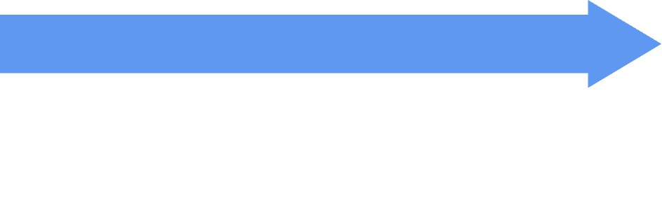



Operational Assumptions
Technology
Oversight
Google MediaPipe
Speed of recommendation & update
Continuous improvement
Proof of concept & existing tools
Pain/comfort, accessibility, safety
Integration
Data available
Physical limitation
2 devs, QA, and UI/UX —> MVP
Timeline & Marketing
Meet compliance
Federal laws
Biofidelity
Data
Can run beta tests with minimal compliance
Media hype
Advocacy and influencer traction
B2C growth shows demand for B2B growth
Insurance companies are latest launch due to proof of demand
Beta test users develop word of mouth
Development timeline
Costs & Pricing
Customers (B2B)
Appealing and stable
Revenue > cost for all streams
Data can be sold
20% wholesale discount w/ upfront purchase
Revenue sharing split 95/5
1 yr subscription mandatory
80% basic, 20% Pro
10% churn yr 1 - 2, 6% after
B2B sales bypass app store
Outsource tech —> move in-house
Staged hiring with C-suite in hands-on roles
Customers (B2C)
Company operations
Independent operations
Volume
Enough diversity through channels
By SOM, 35% B2C, 25% Wholesale, 40% Revenue Sharing
Expansion
Comfortable with data collection
Drive regularly
Experience pain point
Will pay
Will change behavior

