Slide 1
FAIRagro

Slide 2

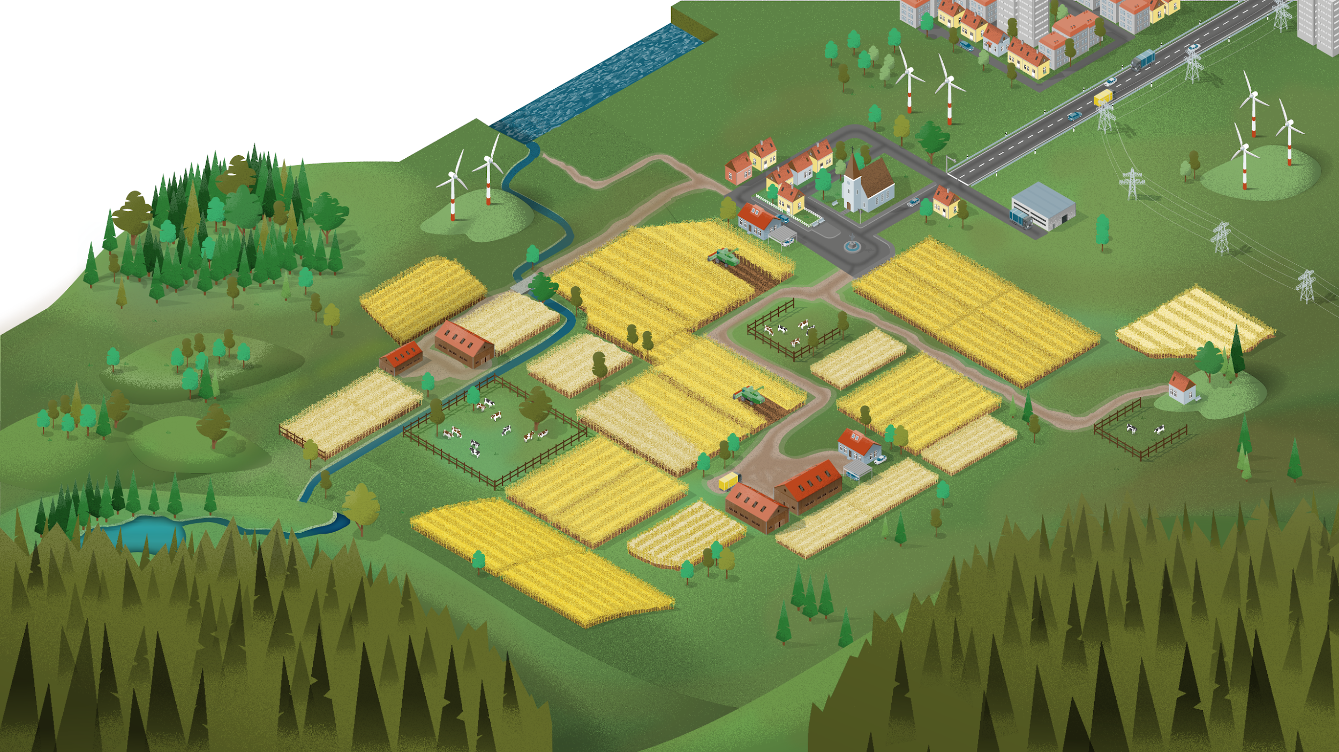







What is FAIRagro?
Scales
Subjects and disciplines
Data categories
…
Agronomy
Crop physiology/ecology
Plant pathology
Plant nutrition
Crop breeding
Crop functional genetics
Crop bioinformatics
Soil biol./chem./physics
Soil microbiology
Soil hydrology
Agroecology
Agrobiodiversity
Remote sensing
Modelling
...
time-series
geo data
Region
Plant
Landscape
farming 4.0
sensitive data
Environment
Soil
Farm field
Crop trial
legacy data
omics data
Plants
Genes
…
Illustrations: “time series chart“” by I Putu Dicky Adi Pranatha, “GPS“” by Desi Ratna, “wifi“” by El Maestro Design, “Tractor“” by parkjisun, “critical data“” by Icon Designer,
“sheet“” by Hary Murdiono JS and “DNA“” by karl from Noun Project (CC BY 3.0)
Notes:
Slide content: explain what are the different approaches from the consortium with the data generated in the agrosystem sciences
Extra content:
Agrosystems are agriculturally used landscapes and ecosystems which require an integrated systems perspective to develop sustainable crop production systems and interventions considering agri-environment interactions (plant, soil, microbiota, abiotic and biotic environment) and relationships across scales (spaces, time and organisations).
The FAIRagro domain spans different scales, from genes and crop trials to fields and regions.
Therefore, FAIRagro covers multiple disciplines within agrosystem sciences that handle various data categories, such as time series data, geospatial data, and Farming 4.0 data (i.e. remote sensing and field robotics), as well as legacy data (e.g. from long-term experiments), omics data, and occasionally personal data.

