Slide 1
FAIRagro

Slide 2

FAIRagro Services
Community support and training
1st and 2nd level
support
Data stewards, helpdesk
Training
Education materials, training concepts
Cultural change Roadshows, conferences, workshops
Agrosystem
community
FAIRagro Portal
Infrastructure-based services
Search & inventory
Networked RDIs; interlinking existing RDIs, NFDI-RDC
Reproducible science
Scientific Workflow Infrastructure
Data quality & plausibility
Improve data assessment
Notes:
Slide content: this slide is to show what are the different services that FAIRagro offers to the community. They are separated in community support and training (were all the direct contact with the community is) and in infrastructure-base services (were all the data related services are).

Slide 3
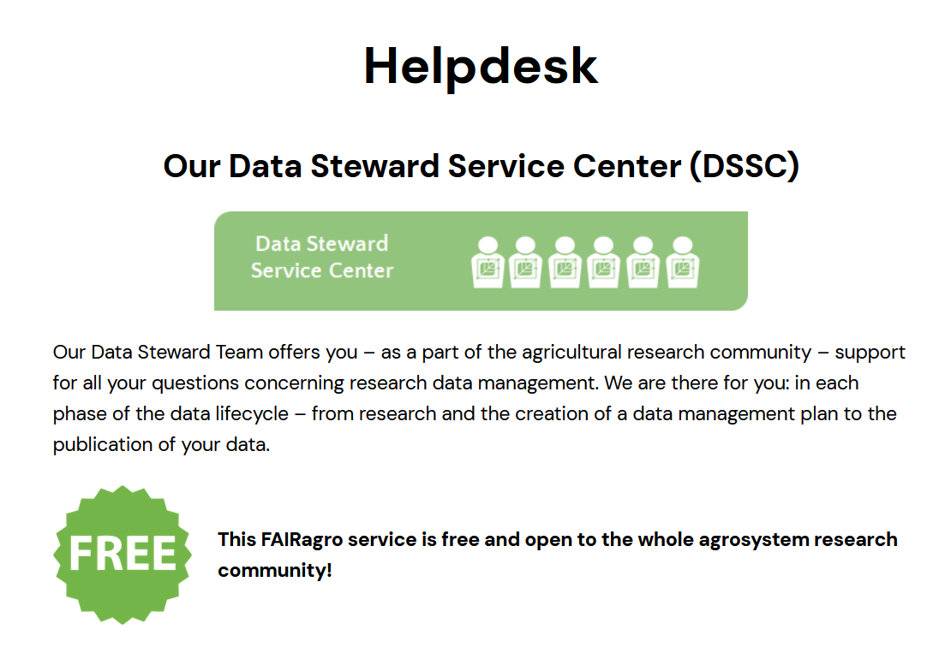
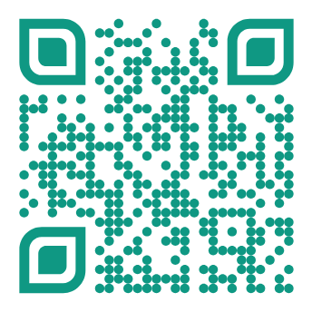


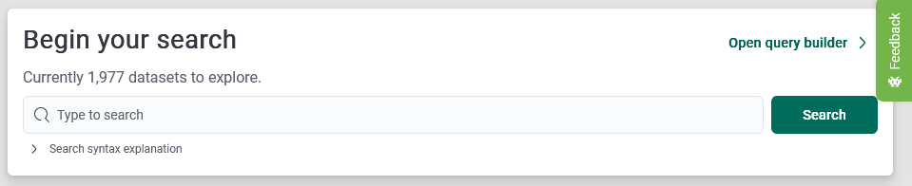
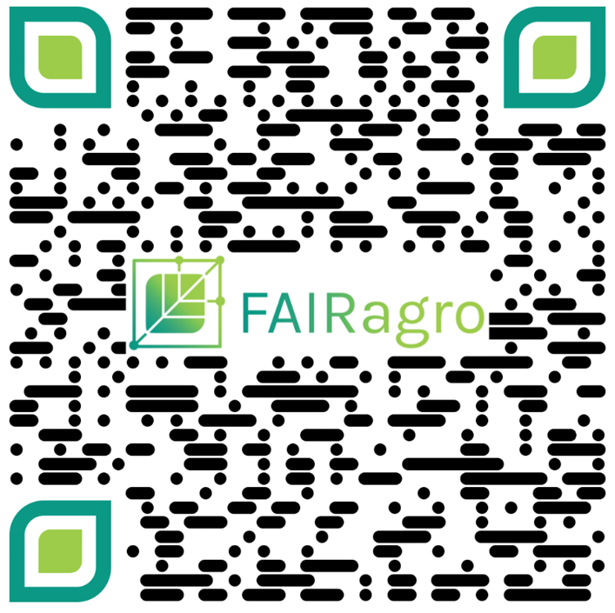

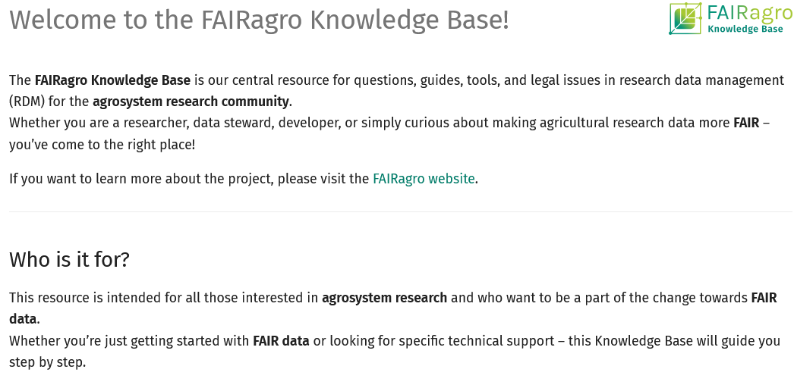

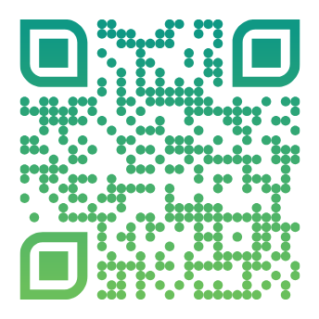
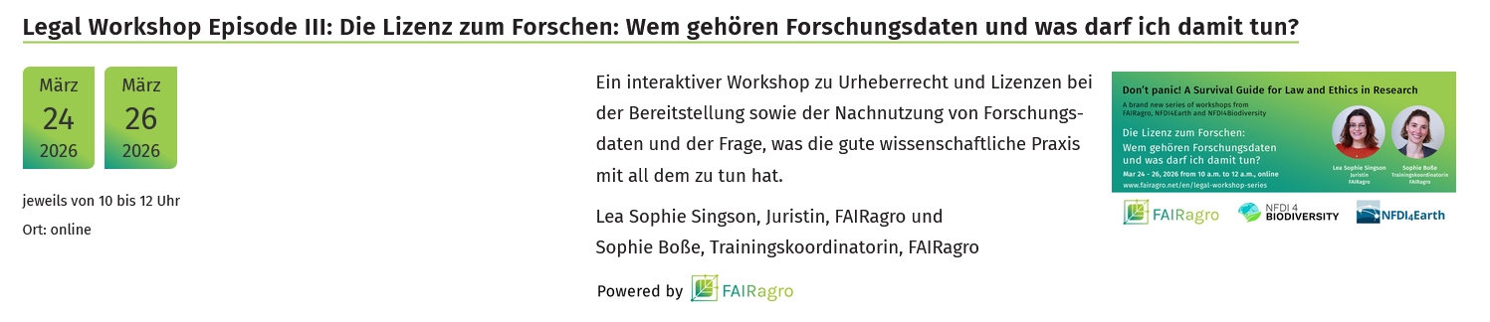
FAIRagro Services for you
Data management plans: FAIRagro RDMO + domain specific templates
https://rdmo.fairagro.net
https://search-hub.fairagro.net
https://fairagro.net/helpdesk
Training calendar
https://knowledgebase.fairagro.net
Illustrations: Screenshot SearchHub, Screenshot RDMO.faiagro, Screenshots FAIRagro Website taken 28.04.2026
Notes:
Note: see also 12-07
Slide content: summary of the different services offered by FAIRagro. The slide can be modified as new services become available and according to the target audience of the course.
A central element of FAIRagro Services is the Search Hub. It consists of two different search functions: data search and infrastructure search.
The FAIRagro Search Hub's data search function enables users to search all connected research data infrastructures (RDIs) simultaneously, eliminating the need for separate searches in each individual RDI.
The second search function of the FAIRagro Search Hub is the infrastructure search. While the data search focuses on finding existing data sets for reuse, the infrastructure search offers the possibility to search for suitable RDIs for publishing your own data.
FAIRagro RDMO provides access to an DMP tool that offers agrosystem specific DMP templates including prebuild answering options.
The Helpdesk is our central point of contact for all questions on RDM. Everyone in our Agricultural Research Community is welcome to get in touch an get support by our FAIRagro Data Stewards free of charge.
The FAIRagro Training calender is a good stop to have an overview on all discipline specific RDM training offerings by FAIRagro as well as external organisations.
The FAIRagro Knowledge Base is our central resource for questions, guides, tools, and legal issues in research data management (RDM) for the agrosystem research community.

