Slide 1
About this Course

Slide 2

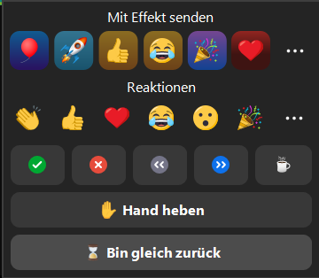


Interactivity
This course is going to be interactive!
Test area
Comment / Kommentieren
Notes:
Slide content: This slide shows participants how to use the interactive functions within Zoom.
On the left, you can see how to comment on the presenter's slides. Participants need to hover the cursor over the shared presenter's slides to make a green pen icon appear. Clicking on this icon opens the bar on the left, which allows participants to draw, write, or stamp on the presenter's slides. Participants can try this out in the test area or within the icebreaker (slides 00-05-02). Please note, that this function may not be available within the zoom webbrowser.
On the right, you can see reactions that participants can send directly after clicking the heart at the bottom of their Zoom window. Participants can use this feature to provide feedback on the presented content. The green checkmark and/or the red cross are likely to be used for quick yes/no or true/false questions. The green checkmark can also indicate that a participant has finished an exercise.

