Slide 1
Icebreaker

Slide 2
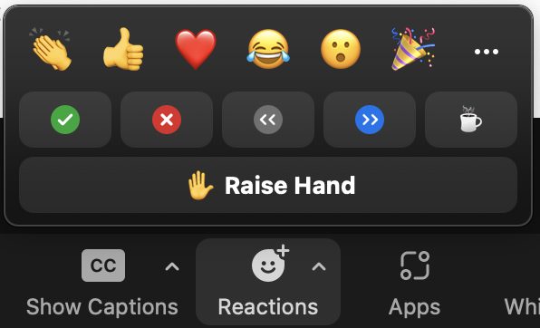

Icebreaker
This course is going to be interactive!
Use your microphone
Raise your digital hand
When it’s your turn:
  State your name and one thing you expect from the workshop
  Use just one sentence!
Choose the next one
Lower your hand
Notes:
Slide content: instructions for the icebreaker.

