Slide 1
Research Journey

Slide 2
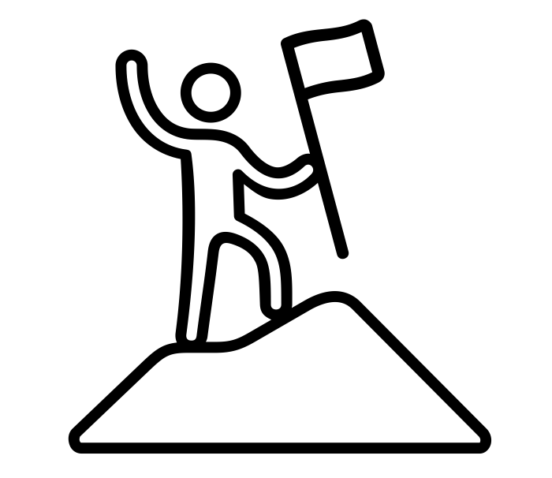
Agenda
Research Data, Data Lifecycle, FAIR-Principles
Basic Principles
Personal Data,
Data Organisation
Collecting Data
Data Management Plan
Planning RDM
Reusing Data
Finding Data, Data Documentation, Licenses
Sharing Data
Data Publication, Repositories
Wrap up
Illustration: “success” by Cuputo is licensed under CC BY 3.0
Notes:
Research Journey
If possible and suitable, we recommend using a case study to structure the topics you want to address according to a practical example, which places the topics in a possible sequence of a research project.
At this point, we have included an example research journey. Slides 00-06 can be used as an agenda and subheadings or transition slides between different topics.

Slide 3
Agenda
Research Data, Data Lifecycle, FAIR-Principles
Basic Principles
Personal Data,
Data Organisation
Collecting Data
Data Management Plan
Planning RDM
Reusing Data
Finding Data, Data Documentation, Licenses
Sharing Data
Data Publication, Repositories
Wrap up
Illustration: “success” by Cuputo is licensed under CC BY 3.0
Notes:
Research Journey
If possible and suitable, we recommend using a case study to structure the topics you want to address according to a practical example, which places the topics in a possible sequence of a research project.
At this point, we have included an example research journey. Slides 00-06 can be used as an agenda and subheadings or transition slides between different topics.

Slide 4
Research Data Management
Basic Principles
Notes:
Research Journey
If possible and suitable, we recommend using a case study to structure the topics you want to address according to a practical example, which places the topics in a possible sequence of a research project.
At this point, we have included an example research journey. Slides 00-06 can be used as an agenda and subheadings or transition slides between different topics.

Slide 5
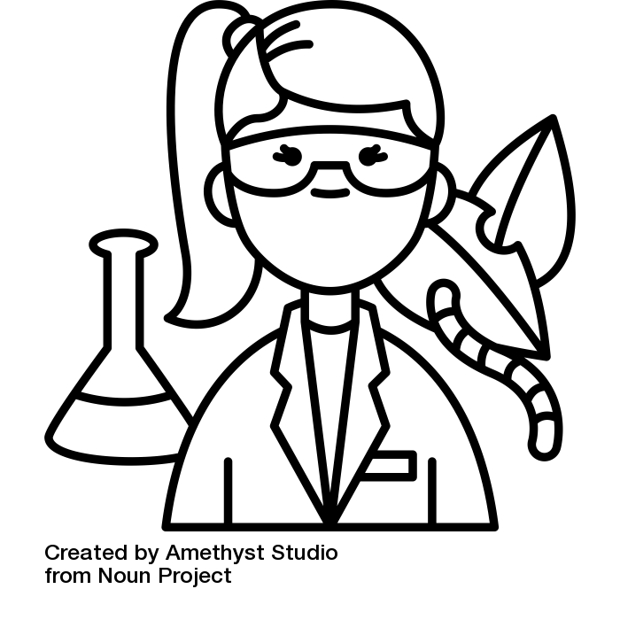
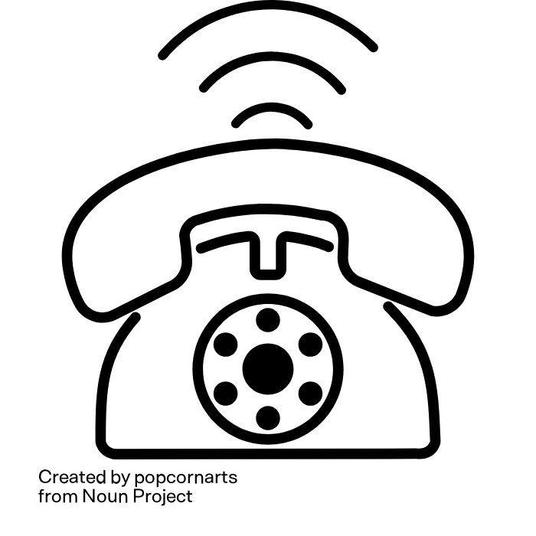
Thought experiment
This is Lena.
She is an agricultural scientist
Lena is calling you!
She wants some of your data
Illustration: “telephone” by popcornart and “biologist” by Amethyst Studio are licensed under CC BY 3.0
Notes:
Note: this refers to the brick 01-02-01-03
Slide content:
Think of a data set that you haven't actively worked with for at least a year....
and now: let's do a little thought experiment
If you like, you can close your eyes
Imagine you're sitting comfortably at your desk when the phone rings. It's Lena, a young, highly motivated agricultural scientist.
She says she has learnt that you have data that would help her enormously to advance her research project.
The data Lena is referring to is the data that you haven't actively worked with for at least a year.
As you find Lena's research project very worthy of support and have already completed all publications based on this data, you would like to make your data available to Lena.

Slide 6
Thought experiment
Who can find the data Lena is looking for in two minutes?
Will Lena be able to open the data?
Will she be able to understand the data?
  and you, do you still understand your own data?
Illustration: “biologist” by Amethyst Studio from noun project is licensed under CC BY 3.0
Notes:
Note: this refers to the brick 01-02-01-03
Slide content:
Ask the participants to rise their (digital) hand or stand up if they think that
they can find the desired data for Lena within 2 minutes?
Lena will be able to open the data?
Lena will be able to understand the data?

Slide 7

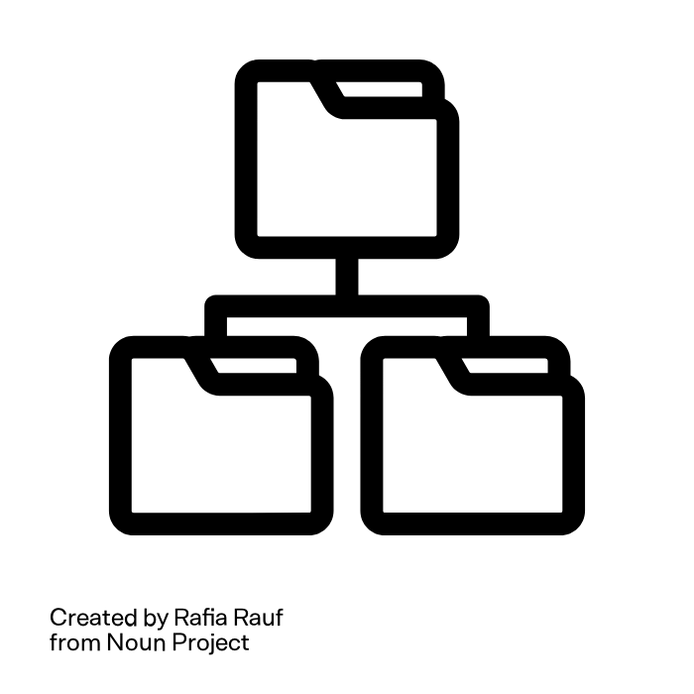
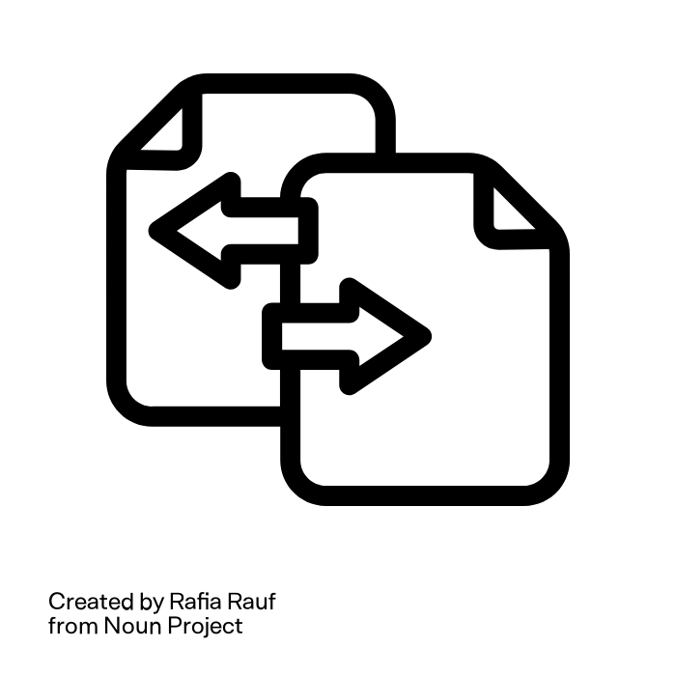

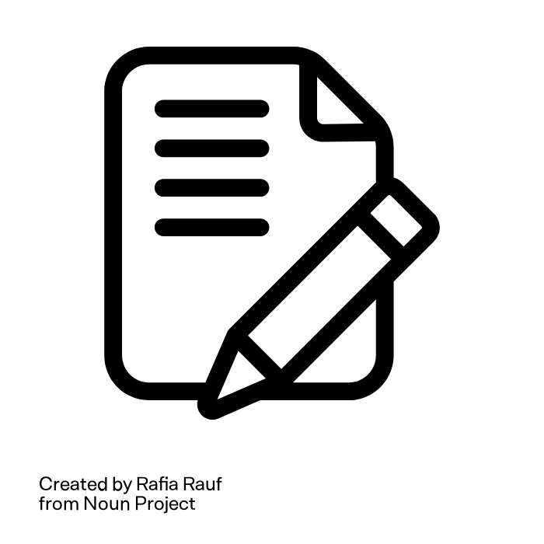
What does Lena need to be able to use the data?
Data-
organisation
Inter-
operability
Docu-
mentation
Backup
Metadata
She needs good Research Data Management
Illustration: “File Edit”, “File Transfer”, “File Tag”, “Folder Backup” and “Folder Structure” by Rafia Rauf from noun project are licensed under CC BY 3.0
Notes:
Slide content:
This slide shows, what it takes for Lena (or anyone else, including your future self) to be able to reuse the data:
Data is still available - backup
Data can be found - good data organisation
Data can be opened - interoperability - open format
Data interoperability = ability of a data set to work together with other data sets or systems without any special effort for the user
Lena knows whether the data is realy suitable for her project - metadata
Lena knows how the data was collected and processed, she understands what the abbreviations mean - data documentation
All of this are central aspects of a proper RDM
Research data management (RDM) = a set of actions that need to be taken during a research project in order to:
Obtain high-quality data
Make the data available and usable in the long term
Make research results reproducible beyond the research project

Slide 8
FAIR
Basic Principles
Notes:
Research Journey
If possible and suitable, we recommend using a case study to structure the topics you want to address according to a practical example, which places the topics in a possible sequence of a research project.
At this point, we have included an example research journey. Slides 00-06 can be used as an agenda and subheadings or transition slides between different topics.

Slide 9
Agenda
Research Data, Data Lifecycle, FAIR-Principles
Basic Principles
Personal Data,
Data Organisation
Collecting Data
Data Management Plan
Planning RDM
Reusing Data
Finding Data, Data Documentation, Licenses
Sharing Data
Data Publication, Repositories
Wrap up
Illustration: “success” by Cuputo is licensed under CC BY 3.0
Notes:
Research Journey
If possible and suitable, we recommend using a case study to structure the topics you want to address according to a practical example, which places the topics in a possible sequence of a research project.
At this point, we have included an example research journey. Slides 00-06 can be used as an agenda and subheadings or transition slides between different topics.

Slide 10
Lena's research data journey
Lena is starting her research project, therefore she is looking for data, she could reuse…
Illustration: “success” by Cuputo; “biologist” from Amethyst Studio are licensed under CC BY 3.0
Notes:
Data reuse:
means using data for other purposes than it was originally collected for.
is particularly important in science
as it allows different researchers to analyse and publish findings based on the same data independently of one another.
Reusability is one key component of the FAIR principles.
Why is data reuse important?
By reusing existing data you can:
obtain reference data for your research;
avoid doing new, unnecessary experiments -> save time and money!
make research more robust
by aggregating results obtained from different methods or samples;
by running analyses to verify that reported findings are correct
gain novel insights by connecting and meta-analysing datasets.
Source: RDMkit Elixir

Slide 11
Finding Data
Reusing Data

Slide 12
Lena's research data journey
Lena found some datasets that may suit her requirements.
Now, she needs to check the reusability.
Illustration: “success” by Cuputo; “biologist” from Amethyst Studio are licensed under CC BY 3.0

Slide 13
Data Documentation
Reusing Data

Slide 14
Lena's research data journey
Lena starts with checking the fitness-for-use of the datasets.
Check metadata!
Check documentation!
Illustration: “success” by Cuputo; “biologist” from Amethyst Studio are licensed under CC BY 3.0
Notes:
check metadata
Verify that the data satisfy your initial requirement and constraints
check documentation for reusability
What was the original research question?
How was the data collected?
Are the collection and processing methods appropriate to answer my research question?
Is the data collection process well documented? Which instruments were used? What settings/parameters?
Are protocols of the data collection shared?
Is there sufficient information available to understand the dataset and its context/origin?
Is the information complete, understandable and consistent?
Source: Gregory et al. (2018), “Finding Data” by The Turing Way Community

Slide 15
Lena's research data journey
Lena has found a data set that fits perfectly and is easy to understand - can she use it?
Check the data rights!
Illustration: “success” by Cuputo; “biologist” from Amethyst Studio are licensed under CC BY 3.0
Notes:
Is she allowed to use that data?
Is she allowed to alter it/combine it with other data?
Is she allowed to republish it?
Does she need to name the author?

Slide 16
Licenses
Reusing Data
Notes:
And in order to be able to reuse data, we need some standards and informations about the possibilities -> Licences!

Slide 17
Lena's research data journey
Unfortunately, the dataset Lena wanted to use for her work is not properly licensed, so that she can’t use it for her work.
She decides to collect data on her own.
Illustration: “success” by Cuputo; “biologist” from Amethyst Studio are licensed under CC BY 3.0

Slide 18
Agenda
Research Data, Data Lifecycle, FAIR-Principles
Basic Principles
Personal Data,
Data Organisation
Collecting Data
Data Management Plan
Planning RDM
Reusing Data
Finding Data, Data Documentation, Licenses
Sharing Data
Data Publication, Repositories
Wrap up
Illustration: “success” by Cuputo is licensed under CC BY 3.0

Slide 19
Lena's research data journey
Lena decides to collect data on her own.
Before she starts, she needs to make sure that she is aware of any legal restrictions that she will need to consider.
Is the data she collects personal data?
If so, what implications does this have for her?
Illustration: “success” by Cuputo; “biologist” from Amethyst Studio are licensed under CC BY 3.0

Slide 20
Personal Data
Collecting Data

Slide 21
Data Organisation
Collecting Data

Slide 22
Lena's research data journey
Finally, Lena has her research data to work with! But, how to store and organise it to make it easily findable in her own system?
create a proper folder structure
choose meaningful filenames
establish back up system
Illustration: “success” by Cuputo; “biologist” from Amethyst Studio are licensed under CC BY 3.0

Slide 23
Agenda
Research Data, Data Lifecycle, FAIR-Principles
Basic Principles
Personal Data,
Data Organisation
Collecting Data
Data Management Plan
Planning RDM
Reusing Data
Finding Data, Data Documentation, Licenses
Sharing Data
Data Publication, Repositories
Wrap up
Illustration: “success” by Cuputo is licensed under CC BY 3.0

Slide 24
Lena's research data journey
Lena’s research project was a great success.
Now, she wants to publish her data.
Illustration: “success” by Cuputo; “biologist” from Amethyst Studio are licensed under CC BY 3.0

Slide 25
Data Publication
Sharing Data

Slide 26
Agenda
Research Data, Data Lifecycle, FAIR-Principles
Basic Principles
Personal Data,
Data Organisation
Collecting Data
Data Management Plan
Planning RDM
Reusing Data
Finding Data, Data Documentation, Licenses
Sharing Data
Data Publication, Repositories
Wrap up
Illustration: “success” by Cuputo is licensed under CC BY 3.0

Slide 27
Lena's research data journey
Lena is starting her next project. She knows that planning all these RDM steps in advance will help her to be better prepared.
write a data management plan
Illustration: “success” by Cuputo; “biologist” from Amethyst Studio are licensed under CC BY 3.0

Slide 28
Data Management Plan
Planning RDM

Slide 29
Agenda
Research Data, Data Lifecycle, FAIR-Principles
Basic Principles
Personal Data,
Data Organisation
Collecting Data
Data Management Plan
Planning RDM
Reusing Data
Finding Data, Data Documentation, Licenses
Sharing Data
Data Publication, Repositories
Wrap up
Illustration: “success” by Cuputo is licensed under CC BY 3.0

