Slide 1
What are Data?

Slide 2
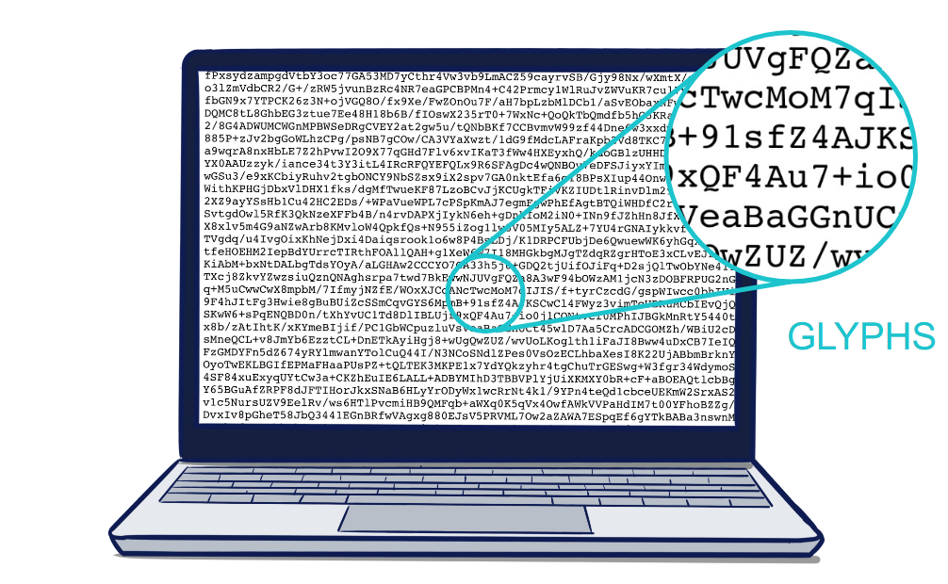
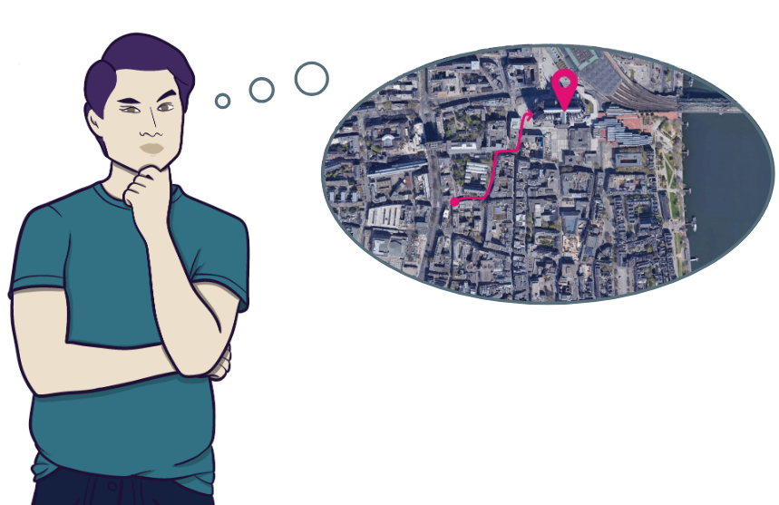
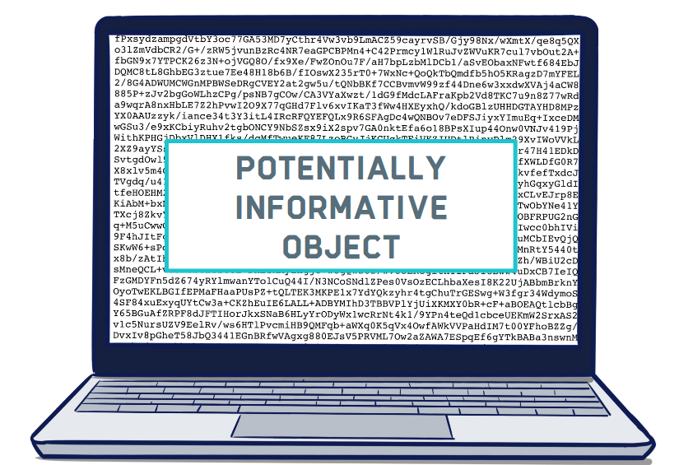
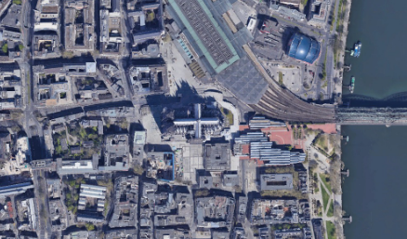
What are Data?
Glyphs
Data
Information
String concatenation
Potentially Informative Object
Human Interpretation
<Foliennummer>
Source: Gerlich et al. 2023 is licensed under CC BY 4.0
Notes:
Slide content: What are Data?
Let’s start with an example: imagine a satellite sending data back to Earth.
This is what actually arrives at the device receiving the transmission...
just a string of characters...
we call these characters glyphs. To a human, this sequence of glyphs is incomprehensible and must be processed by a machine so that it can be interpreted by humans. And that is data, …
a potentially informative object.
Colloquial: circumstances, facts or events
Technical: symbols that represent information
When the data is processed by the receiving device, it is converted into this image. (The satellite image shows Cologne city centre.) This processed form enables people to interpret and analyse the data in order to extract information, ...
for example, to identify the cathedral in the image and...
to find the shortest route from the opera house to the cathedral.
Idea: a thought that can be acted upon, or a guiding principle to follow

Slide 3
From idea to wisdom
IDEA
a thought that can be put into action
05
WISDOM
An eye for the bigger picture
01
04
KNOWLEDGE
Internalised information
DATA
potentially informative object
02
03
INFORMATION
Human interpretation of data
<Foliennummer>
Notes:
Slide content:
Knowledge is internalised information, such as knowing how to navigate the streets of Cologne from the Opera House to the Cathedral based on the satellite image you have seen.
The highest level of information content is wisdom, which means putting the acquired knowledge into context, seeing the bigger picture. Let’s suppose you have been exploring Cologne’s city centre for a few days and are approached by someone who asks you for the shortest route to the main station. You show them the way on a map – that is wisdom. Of course, as researchers, we strive to attain wisdom through our work.
We have seen that the information content increases when context, meaning and insight are added to data.
The key message is: data is potential information and must be processed and placed in context to make it accessible to a human audience.

