Slide 1
Research Data

Slide 2
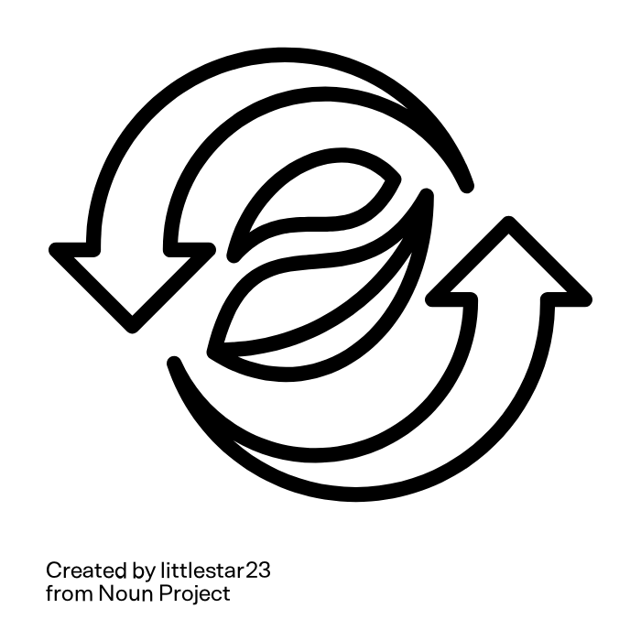
Difficulties in reusing agricultural research data
Data complexity.
Data quality standards differ across disciplines.
Data handling since size and number of datasets rises.
Datasets are useful for original producer, but reuse ist difficult
Epistemologically problems: ambiguities, missing documentation, …
Logistic problems: undiscoverable data, different data types, …
Notes:
Slide content:
data complexity
because of the many species involved
new high-throughput technologies
plant phenotyping has undergone an explosion in the size and number of datasets
[Quote: “The complexity of phenotypic data is a hindrance to reuse. Like most domains of science, though perhaps to an even greater extend because of the many species involved as well as new high-throughput technologies, plant phenotyping has undergone an explosion in the size and number of datasets. However useful each of them may be to the original producer, their potential to deepen our understanding of plant biology remains unmaterialized because meta-analyses across independently generated datasets are difficult, both epistemologically (ambiguities, missing documentation) and logistically (undiscoverable data, different data types)”]
leads to data handling problems
data quality standards differ across disciplines
-> so, even if datasets are useful for original producer, it may be difficult to reuse them for meta-analyses for example:
due to epistemologically problems like ambiguities, missing documentation
due to logistic problems like different data types, oder undiscoverable data,..
We can all contribute to making it easier. FAIRagro wants to solve as many problems as possible.

