Slide 1
File Formats

Slide 2
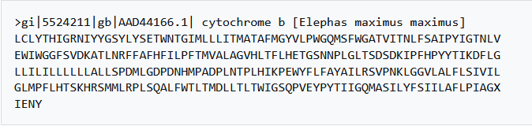
File formats in agricultural data
Standardized and open-source file formats:
  for Excel documents: CSV and ODS are open and widely supported
  raster data: GeoTIFF, netCDF, COGs (Cloud-optimized Geotiffs)
  vector data: ESRI shapefiles, geojson
  genetic sequences: FASTA
FASTA
<Foliennummer>
Illustration: Screenshot from wikipedia (public domain)
Notes:
slide content:
Tabular Data (Excel files)
Many of you work with spreadsheets for field trials or lab measurements.
CSV (Comma-Separated Values)
Simple text format, readable by almost all statistical software (R, Python, etc.).
Ideal for data sharing and archiving.
ODS (OpenDocument Spreadsheet)
Open standard maintained by OASIS.
An open alternative to XLSX.
Recommendation: Even if you work in Excel, export data as CSV for sharing and archiving.
Raster Data (e.g., remote sensing, soil maps, yield maps)
GeoTIFF – Standard format for georeferenced raster data.
netCDF – Suitable for multidimensional data (e.g., climate time series).
COGs (Cloud Optimized GeoTIFFs) – Optimized for cloud-based access to large datasets.
Vector Data (e.g., field boundaries, management zones)
ESRI Shapefile – Widely used GIS standard (though technically older).
GeoJSON – Text-based, web-friendly, and easy to share.
Genetic Sequences
FASTA – Internationally established text-based standard used in bioinformatics.

Slide 3
File formats of agricultural data
Text | Adobe PDF /A | “.pdf” | Microsoft Word XML | ".docx"
 | Text | ".txt", ".asc", ".sts" | Open Document - text | ".fodt", ".odt"
Tabular data | Comma separated values (CSV) | ".csv" | OpenDocument - spreadsheet | ".fods", ".ods"
 | Tab separated values | ".tsv", ".tab" | Microsoft Excel XML | ".xlsx"
Images | JPEG 2000 | ".jpxml", ".jp3d", ".jpf", ".jpm", ".jpx", ".jp2" | TIFF | ".tiff", ".tif"
 | PNG | ".png" | Scalable Vector Graphics (SVG) | ".svg"
Audio/Video | AIFF | ".aiff", ".aif", ".aifc" | MPEG-4 | ".m4v", ".m4r", ".m4b", ".m4p", ".m4a", ".mp4"
 | WAV | ".wav" | Motion JPEG2000 | ".mjp2", ".mj2"
 | Free Lossless Audio Codec (FLAC) | ".flac"
Geo-spatial data | Raster Data: | GeoTIFF | Vector Data: | ESRI shapefiles (“.shp”)
 |  | netCDF |  | geojson
 |  | COGs (Cloud-optimized Geotiffs)
Genotyping data | FASTA |  | Variant Call Format (“.VCF”) | ".VCF"
 | FASTQ
<Foliennummer>
Source: modified from the University of Edinburgh - Information Services - Research Data Service, Publisso - by FAIRagro 2024
Notes:
slide content:
this slide shows a collections of recommended file formats for different agricultural file types.

