Slide 1
Research Data Management

Slide 2
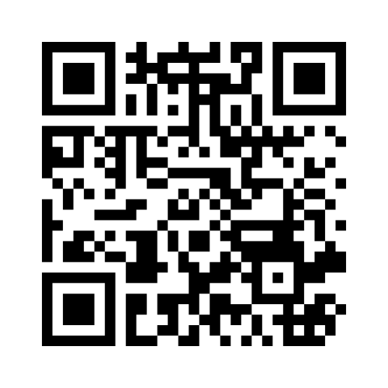
Are you familiar with these feelings?
please go to menti.com
enter this code: 5204 7572
or scan the QR Code
Replace me!
Replace me!
Notes:
Note:
Create a Mentimeter using the statement you find in the following slide or choose another Variation described in the next slides’ notes to hear, what of these feelings feel familiar to your participants.

Slide 3
Are you familiar with these feelings?
I’ve spent more time looking for a file than analysing it.
→ File organisation
Version control = emailing myself the latest file.
→ Versioning
My backup plan is hoping nothing goes wrong.
→ Data backup
I have folders called ‘final_final_REALversion2’.
→ File naming
If I get hit by a bus, nobody could make sense of my folders.
→ Documentation & transparency
DMPs? Oh, those things I write 5 mins before deadline.
→ Data management Plans
I have no idea where to publish my data - so I just keep it on my laptop.
→ Data publication & repositories
I’m not sure who owns the data, but I hope it’s not my problem.
→ Legal, ethical & ownership issues
Metadata? I barely have data.
→ Metadata & data description
Notes:
Slide Content: this slide shows some typical situations/feelings in RDM, that may feel familiar to the participants. It also shows which RDM topic the specific situation /the feeling is related to.
Variations:
Online or in person - use an online interactivity tool like menti to ask the participants if they agree to this statement
In Person - read all statement out loud and ask the participants to stand up, if it feels familiar to them

