Slide 1
Research Data Management

Slide 2

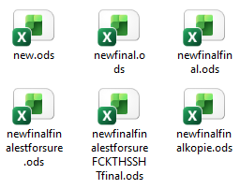
Are you familiar with these feelings?
What did I call it again?
Was is the wild type picture or the resistant cultivar one?
Where is my RAW data?
You want to see my data?
You will never understand them!
I cannot find this file!
Oops… deleted!
Do I have a backup?!?
What version was it?
Source: Modified from Auer 2023; Illustration: Screenshot Zoom, Screenshot Windows 24.04.2026
Notes:
Slide content:
This sentences show what is the main reason for undertaking research data management: to understand your own data.
Please use the comment function in Zoom - leave a heart, a star or a green tick for these statements if you are familiar with them

