Slide 1
Research Data Management

Slide 2
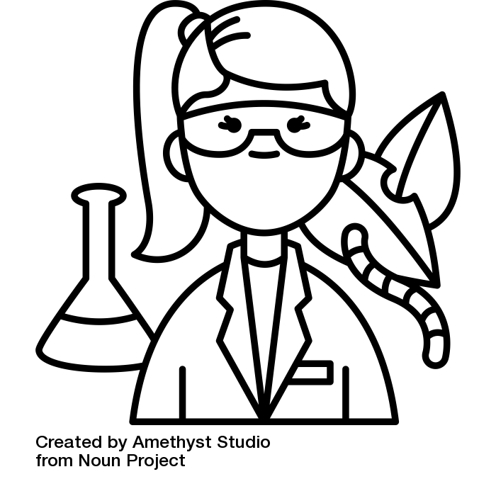
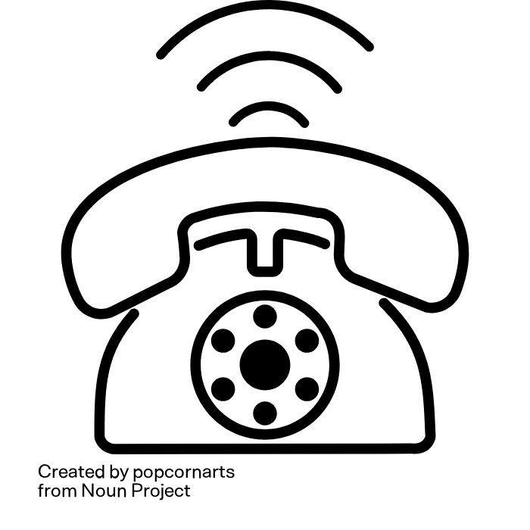
Thought experiment
This is Lena.
She is an agricultural scientist
Lena is calling you!
She wants some of your data
Illustration: “telephone“” by popcornart and “biologist“” by Amethyst Studio are licensed under CC BY 3.0
Notes:
Slide content:
Think of a data set that you haven't actively worked with for at least a year....
and now: let's do a little thought experiment
If you like, you can close your eyes
Imagine you're sitting comfortably at your desk when the phone rings. It's Lena, a young, highly motivated agricultural scientist.
She says she has learnt that you have data that would help her enormously to advance her research project.
The data Lena is referring to is the data that you haven't actively worked with for at least a year.
As you find Lena's research project very worthy of support and have already completed all publications based on this data, you would like to make your data available to Lena.

Slide 3
Thought experiment
Who can find the data Lena is looking for in two minutes?
Will Lena be able to open the data?
Will she be able to understand the data?
  and you, do you still understand your own data?
Illustration: “biologist“” by Amethyst Studio from noun project is licensed under CC BY 3.0
Notes:
Slide content:
Ask the participants to rise their (digital) hand or stand up if they think that
they can find the desired data for Lena within 2 minutes?
Lena will be able to open the data?
Lena will be able to understand the data?

Slide 4


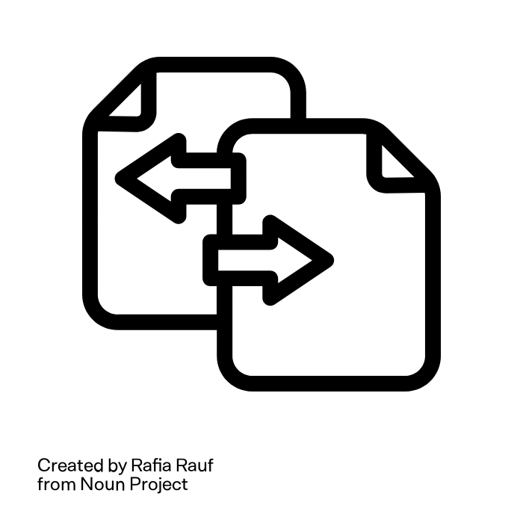


What does Lena need to be able to use the data?
Data-
organisation
Inter-
operability
Docu-
mentation
Backup
Metadata
She needs good Research Data Management
Illustration: “File Edit”“, “File Transfer”“, “File Tag”“, “Folder Backup”“ and “Folder Structure”“ by Rafia Rauf from noun project are licensed under CC BY 3.0
Notes:
Slide content:
This slide shows, what it takes for Lena (or anyone else, including your future self) to be able to reuse the data:
Data is still available - backup
Data can be found - good data organisation
Data can be opened - interoperability - open format
Data interoperability = ability of a data set to work together with other data sets or systems without any special effort for the user
Lena knows whether the data is realy suitable for her project - metadata
Lena knows how the data was collected and processed, she understands what the abbreviations mean - data documentation
All of this are central aspects of a proper RDM
Research data management (RDM) = a set of actions that need to be taken during a research project in order to:
Obtain high-quality data
Make the data available and usable in the long term
Make research results reproducible beyond the research project

