Slide 1
Research Data Management

Slide 2

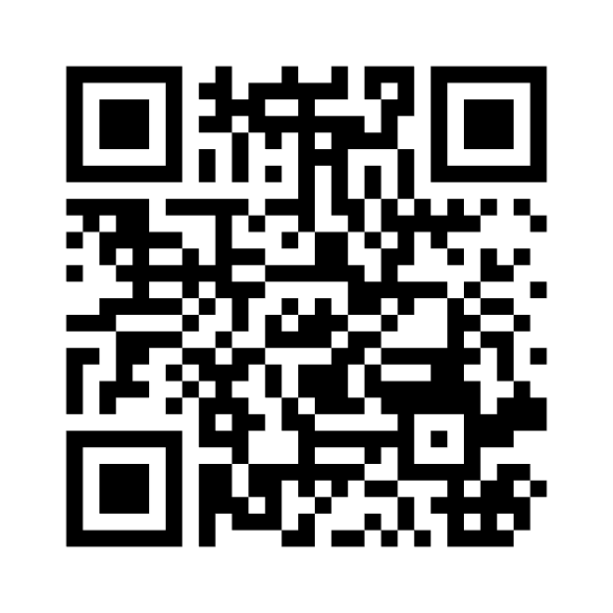
Discussion
What are Benefits of a proper Research Data Management?
go to menti.com
enter code: 8332 6593
Replace me!
Notes:
Note: Register for a free account on mentimeter.com (or choose a similar tool) and create a word cloud with the question "What are Benefits of a proper Research Data Management?". Generate a QR Code to your menti and add it, together with the Menti Code, into this slide.

