Slide 1
Research Data Management

Slide 2
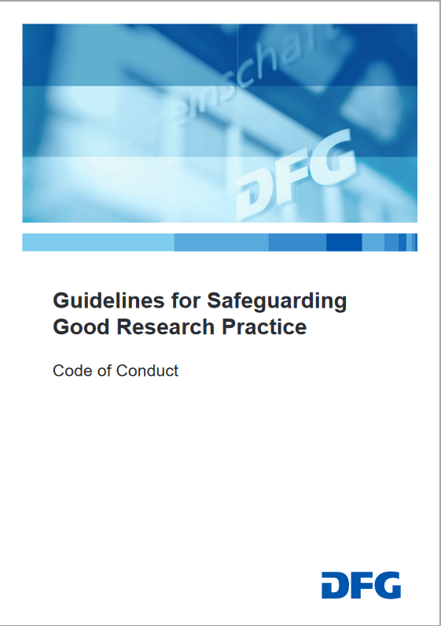
Why RDM is important - for science
Essential part of good scientific practice
  11 of the DFG's 19 guidelines (also) describe the handling of research data
Reusable research data saves money, time and resources
Ensures transparency, verifiability and reproducibility
Source: forschungsdaten.info; Illustration: Deutsche Forschungsgemeinschaft (2022). Guidelines for Safeguarding Good Research Practice. Code of Conduct
Notes:
Slide content:
A proper RDM is a central point in safeguarding good scientific practice - if you have a look into the guideline for safeguarding good research practice of the DFG, you can find, that out of the 19 guideline, there are 11, who (also) describe the handling of research data:
Guideline 7: quality assurance across phases
Guideline 8: Stakeholders, responsibilities and roles
Guideline 9: Research design
Guideline 10: legal and ethical frameworks, rights of use
Guideline 11: methods and standards
Guideline 12: documentation
Guideline 13: establishing public access to research results
Guideline 14: authorship
Guideline 15: publication organ
Guideline 17: archiving
Guideline 19: Procedures in cases of alleged research misconduct

Slide 3
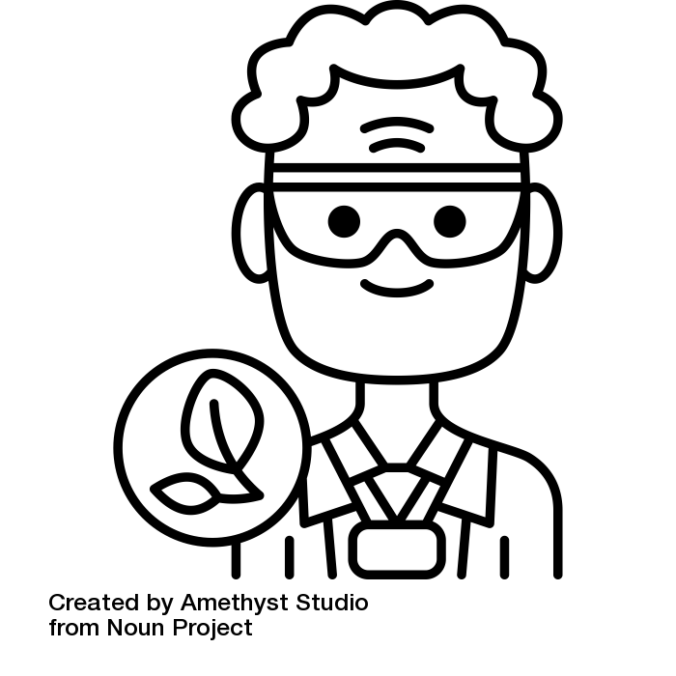
Why RDM is important - for you
Eligibility for financing
Saves time, nerves and resources
Facilitates the induction of new employees
Enhances teamwork and collaborations
Helps meet formal and legal requirements
Helps to keep track of the project
Guaranteeing transparency, verifiability and reproducibility
Citations, citations, citations, …
Source: Modified from Assmann et al. 2022, Bobrov et al. 2021, Bres et al. 2022, Jacob et al. 2022,
Lindstädt et al. 2019 und Voigt et al. 2022 von ZB MED 2024, Illustration: “botanist“” by Amethyst Studio is licensed under CC BY 3.0
Notes:
Slide content:
Certain funding sources (e.g. Horizon Europe) are only available to projects that draw up a data management plan.
Any additional funding conditions relating to the handling of research data are already covered by a professional DMP.
Duplication of work (e.g. having to spend time familiarising oneself with the data again) is avoided through appropriate documentation and preparation of the data.
If the data is requested during the review process, it is already prepared for this purpose through data management.
Many journals require publication
Professionally standardised FDM processes reduce the future effort involved in reusing the data, whether by the original researchers or by third parties.
The risk of data loss is minimised by FDM measures such as data documentation, data backup and suitable long-term archiving (LTA). Data can thus still be used decades later.

Slide 4
Benefits of good RDM
For researchers
Visibility
Reputation
Data ownership
Eligibility for funding
Saves time, money and resources
Preventing data loss
Additional benefits
Helps keep track of the project
Helps meet formal and legal requirements
Enhances teamwork and collaborations
Guaranteeing transparency, verifiability and reproducibility
Source: Modified from Assmann et al. 2022, Bobrov et al. 2021, Bres et al. 2022, Jacob et al. 2022, Lindstädt et al. 2019 and Voigt et al. 2022 by ZB MED 2023
Notes:
Slide content:
List of benefits that researchers could have if they apply good RDM actions to their work.
In the presentation, you can highlight a few; there’s no need to list them all.
The additional benefits are not only for researchers, but also for their colleagues, the institutions where they work, and funding bodies.

