Slide 1
Research Data Life Cycle

Slide 2
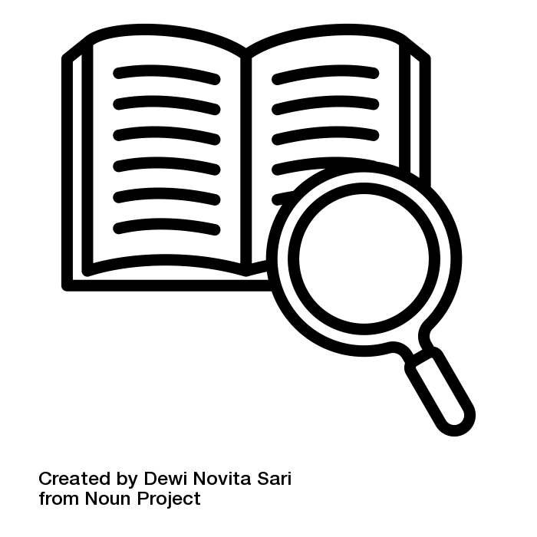
What is the Research Data Life Cycle?
Model that illustrates the steps of research data management and describes how data should ideally flow through a research project to ensure successful data curation and preservation.
Sources: Nanyang Technological University and Princeton Research Data Service modified by ZB MED 2023; Illustration “definition” by Dewi Novita Sari is licensed under CC BY 3.0
Notes:
This slide is recommended if exercise 01-03-02-01, 'Sorting the Steps of the RD Lifecycle', follows it. Therefore, the cycle itself is not shown on this slide.
Slide content: Research Data Life Cycle definition

Slide 3

Research Data Life Cycle
Illustration: Elixir’s RDMkit is licensed under CC BY 4.0
Notes:
Slide content: the research data life cycle with all it’s steps

