Slide 1
Research Data Life Cycle

Slide 2
Research Data Life Cycle - Exercise
Arrange the steps of the research data life cycle in the right order:
Planning
Data Collection
Data Processing & Analysis
Data Sharing & Publishing
Digital Preservation
Data Discovery & Reuse
Sources: Modified from Biernacka et al. 2020 by Engelhardt et al. 2022, Nanyang Technological University and Princeton Research Data Service by ZB MED 2023
Notes:
Note: You could simply ask the participants to put their hands up to share their ideas on sorting, or you could let them work in groups. For in-person training, you could do an analogue exercise with small groups and prepared cards on which the terms are written. For online training, you could use a shared whiteboard like this on: https://www.figma.com/board/fkteUpYMhyRTK1U4up4PY8/Untitled?node-id=0-1&t=ueYPoCRQhOOz1bk9-1
The right order is: Planning, Data Collection, Data Processing & Analysis, Data Sharing & Publishing, Digital Preservation, Data Discovery & Reuse

Slide 3
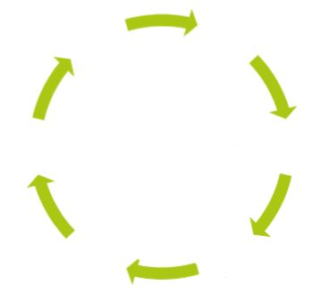
Research Data Life Cycle - Solution
Data Discovery & Reuse
Planning
Digital Preservation
Data Collection
Data Sharing & Publishing
Data Processing & Analysis
Notes:
Slide content: solution for the exercise

