Slide 1
Research Data Life Cycle

Slide 2

Data life cycle - Plan
Examples to include in a DMP
Measuring instruments:
  Need to purchase new or project-specific equipment?
  What kind of software do they use?
  What kind of formats will you get?
Data types:
  Is it public data?
  Do you have to anonymise them?
Remember! A DMP is a living document
<Foliennummer>
Illustration: Lifecycle by Elixir’s RDMkit is licensed under CC BY 4.0
Notes:
Slide content:
Ideally, we will talk about a DMP in another section of the course; if not, we should explain here what a DMP is and why it is worth creating one.
This slide is to make aware about the different question you have to ask yourself before preparing a project, and how you shold document them in a DMP.
Remember! A DMP is a living document, you can always make modifications if you find that things are missing or some old procedures need to be changed and updated

Slide 3
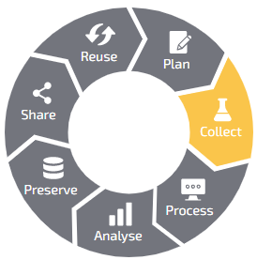
Data life cycle - Collect
Electronic Field Books (EFB)
Applications for digital data acquisition, e.g. phenotyping data in the field
Examples: Bonitur App (JKI), ODK, KDSmart, Field Book
Field Experiment Management Systems (FEMS)
Software to manage field experiments
Examples: AgroFIMS, Quick Trials, agmatix
Electronic Lab Notebooks (ELN)
Software for documenting experiments, resulting research data and processes in the lab
Examples: eLabFTW, benchling
<Foliennummer>
Illustration: Lifecycle by Elixir’s RDMkit is licensed under CC BY 4.0
Notes:
Slide content:
The collect phase of a project is where you gather all the information you need to be able to work with them. In this slide we give some ideas and possibilities that can help to manage the data in your project.
In further slides we will talk about what an ELN, a Field Experiment Management System and an EFB are.

Slide 4
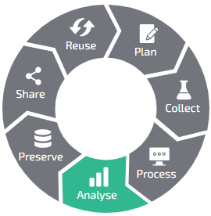

Data life cycle - Analyse (Big)Geodata
Challenges: geodata accumulation & complex evaluation methods
Cloud computing as one solution:
  data stored on networked central servers and processed quickly and fully automatically without barriers
  cloud providers with a geo-focus include CreoDIAS, CODE-DE and EO-Lab
Reproducible Workflows
FAIRagro has developed the workflow hub SciWIn
  integrates computing, storage, and versioning for computer workflows
  all can be stored as FAIRdigital objects
<Foliennummer>
Illustration: Lifecycle by Elixir’s RDMkit is licensed under CC BY 4.0
Notes:
Slide content:
Analyse is one the crucial parts of the Data Life Cycle for the Research Data. We focus on the challenges posed by the accumulation of large amounts of geodata and how to operate with them.
BigGeoData:
Continuously accumulating geodata and modern, complex evaluation methods pose new challenges, particularly in terms of data processing. Cloud computing is one of the solutions, whereby data can be stored on networked central servers and processed quickly and fully automatically without barriers.
There are numerous platforms on which processing infrastructure and geodata are freely available. Cloud providers with a geo-focus include CreoDIAS, CODE-DE and EO-Lab, for example, which also have connections to numerous geodata archives.
On the other side, we bring the SciWin infrastructure in this slide to make people aware of the resources FAIRagro has created for the agrosystem community to deal with their analysis and their data. You can open the GitHub link and show it to the participants or let them some time to read about SciWin in the FAIRagro website: https://fairagro.net/en/services/sciwin/
Documentation and publication of your analysis is key for reproducibility of your research!
The digital workflow hub SciWIn - this tool can help you with integrated computing, storage and versioning, besides input and output data, the workflow itself is stored as a FAIR digital object for making it easily accessible and reproducible

Slide 5
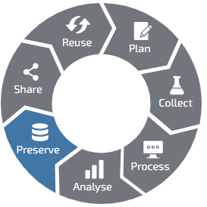
Data life cycle - Preserve
Use of standardized and open-source file formats
  raster data: GeoTIFF, netCDF, COGs (Cloud-optimized Geotiffs)
  vector data: ESRI shapefiles, geojson
  genetic sequences: FASTA
Well described and self-explanatory documentation
  International standards for phenotyping data: miappe
  National & international standards for soil science: German systematics, the FAO's World Reference Base, USDA's Soil Classification
  The use of Ontologies is always recommended: Gene Ontology, Crop Ontology
<Foliennummer>
Illustration: Lifecycle by Elixir’s RDMkit is licensed under CC BY 4.0
Notes:
Slide content:
Preserve agricultural data has extra challenges if we look at the different file formats we can use for all the different types of documents that we are generating.
In this slide we suggest some general aspects for preservation, such as the use of standardized formats and also the use of open-source formats (there are some examples in the slide).
Another important aspect in the preservation step is the documentation: all projects need well described and self-explanatory documentation.
We give some examples for different well known standards in the agricultural field.

Slide 6
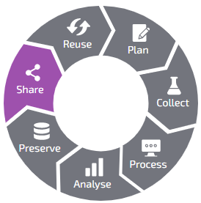
Data life cycle - Share
Discipline-specific Repositories to share agrosystem research data:
BonaRes-Repository hosted by ZALF
  agricultural, soil and landscape ecology datasets
e!DAL-PGP Repository hosted by IPK Gatersleben
  phenotyping and genotyping plant research data
OpenAgrar repository of the federal authorities
  collective repository of research institutions affiliated with the Federal Ministry of Agriculture, Food and Regional Identity (BMLEH) in Germany
<Foliennummer>
Illustration: Lifecycle by Elixir’s RDMkit is licensed under CC BY 4.0
Notes:
Slide content:
to share the data is not only important to have it in a form that other researchers can use it, but also needs to be shared in relevant repositories for the agricultural sciences, so the people working with this topics will find them easier.
We have in this slide a list of some of the important repositories to publish data in the agrosystem sciences.

Slide 7
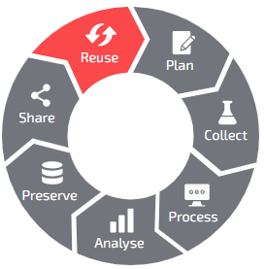
Data life cycle - Reuse
To assess the development of soils/environment:
  Overview of European long-term experiments: BonaRes' LTE Overview
Environmental information on the location & time of the experiment:
  Soil data -> BGR Soil Atlas or SoilGrids250m
  Geodata management systems -> DataCube technology, GeoNode, etc.
  Earth Observational Data -> EO-Finder, Sentinel-Hub and EarthExplorer
  Climate Data Center provides data from the German Weather Service
To undertake a sequence data analysis is important to have a reference:
  Plant genomes -> Ensemble Plants, MaizeGDB
  Protein information -> UniProt
  Gene classification -> GeneOntology
<Foliennummer>
Illustration: Lifecycle by Elixir’s RDMkit is licensed under CC BY 4.0
Notes:
Slide content:
this slide gives examples on where to find data to reuse for your resear project based on an experiment where soil and environment play a big part on it.
Step 1: repeated measurements over many years or sites can be very useful, since (many) soil properties change with time. This is also the case for several other agricultural data sets. Long-term data is especially valuable. https://tools.bonares.de/ltfe/
Here also, long-term experimental data is valuable. If you have data from before, you can say something about how a soil / environment develops over time which is needed in many predictions, models, etc.
Step 2: The BGR Soil Atlas is a map service for the soil overview map of Germany. It also contains information about the topsoil and the soil thickness, i.e. the depth of the soil above the solid rock.
SoilGrids250m is operated by ISRIC at Wageningen University and Research. The map service contains global information about soils in the form of raster data. It shows soil classifications according to WRB, chemical properties such as nutrient content and pH value as well as soil physical properties such as density and grain size as well as organic carbon content.
In addition to cloud-based infrastructures, there are modern geodata management systems (DataCube technology, GeoNode, etc.) that serve to make data findable and retrievable.
EO Search Platforms
EO-Finder
Sentinel-Hub
EarthExplorer
others:
GeoNode
STAC
Furthermore, many research institutions and authorities offer access to geodata via web services (e.g. the Climate Data Center the German Weather Service, or the Webdienste of the Federal Agency for Cartography and Geodesy) and data catalogues such as GeoNode (e.g. https://geonode.org/gallery/).
Step 3 - Genetic data:
A reference genome that is as complete as possible is particularly important for analysing sequence data. This can be found, for example, in the NCBI-Database (National Center for Biotechnology Information) the US National Library of Medicine or specifically for plants at the European platform Ensembl Plants.
Information on proteins can be found on the European website UniProt.
The classification of genes is aided by the GeneOntology.
Researchers working on maize will find a comprehensive compilation of information in the MaizeGDB of the US Department of Agriculture.
e!DAL-PGP Repository, phenotypic and genotypic data from experiments with cultivated plants can be found.

Slide 8

Data life cycle - Reuse
FAIRagro makes data from different repositories findable via the FAIRagro Search Hub
  The central search portal for agricultural science datasets and repositories
  The goal is to promote the implementation of the FAIR principles in the field of agricultural research
<Foliennummer>
Source: Julian Schneider,; Illustration: Lifecycle by Elixir’s RDMkit is licensed under CC BY 4.0
Notes:
Slide content:
the FAIRagro Search Hub offers - besides the Dataset Search - the possibility to search for data repositories, that are of interest for agricultural research data and closely related domains.
https://repositories.search-hub.fairagro.net/

