Slide 1
Good Research Practice
Notes:
Sophie

Slide 2
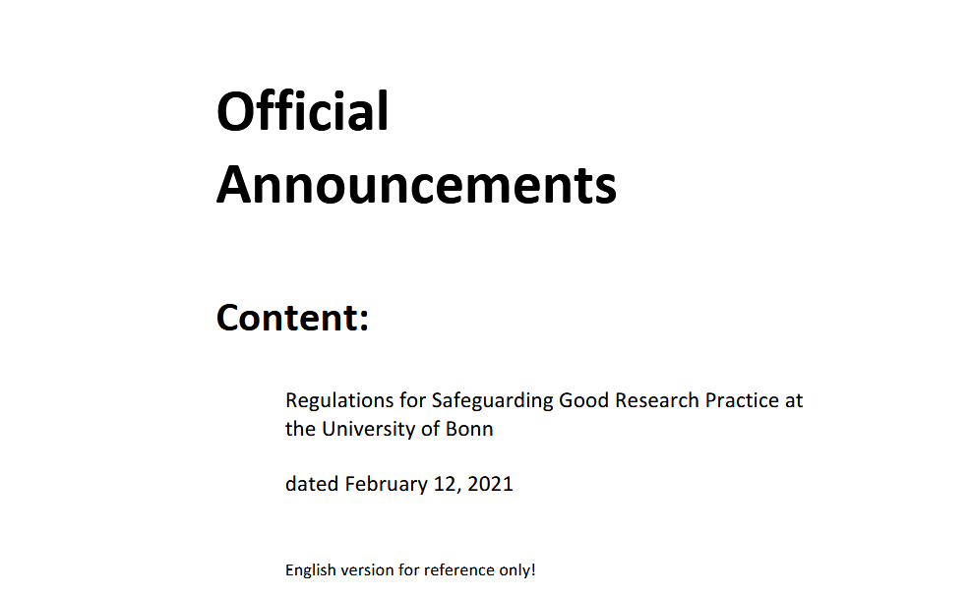
How is the good research practice made legally binding?
employment contracts
statutes of research institutions and universities
DFG funded projects
Illustration: University of Bonn 2023
Notes:
Slide Content:
employment contracts can obligate employees to adhere to the Good Scientific Practice -> if they fail to do that, it can be considered a breach of contract and they can be reprimanded
similar with statutes -> then reprimand directly from the statute
DFG funding is dependent on the adherence to the GSP -> if projects don’t do that, they can lose funding

