Slide 1
Good Research Practice
<Foliennummer>

Slide 2
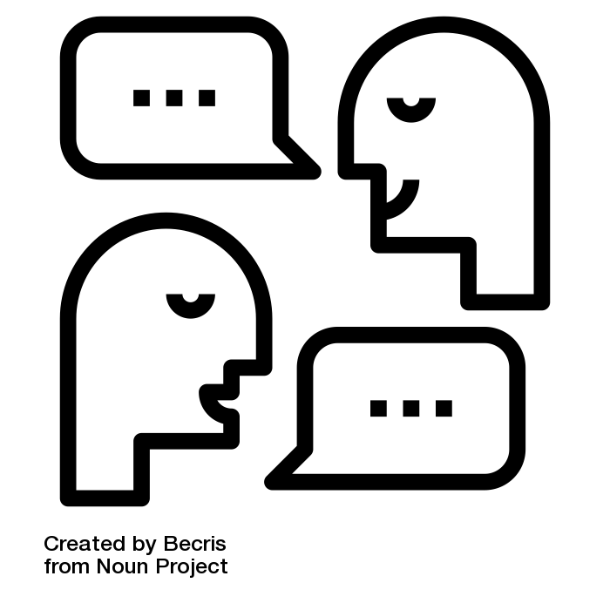
How is RDM connected to good research practice?
What do you think?
Why is RDM important for safeguarding good research practice?
<Foliennummer>
Source: “discussion” by Becris is licensed under CC BY 3.0
Notes:
Note:
Discussion in plenum about the relevance of RDM for safeguarding the good research practice. Alternatively, you could consider using an interactive tool such as Mentimeter.

