Slide 1
Good Research Practice
Consequences
Notes:
Sophie

Slide 2
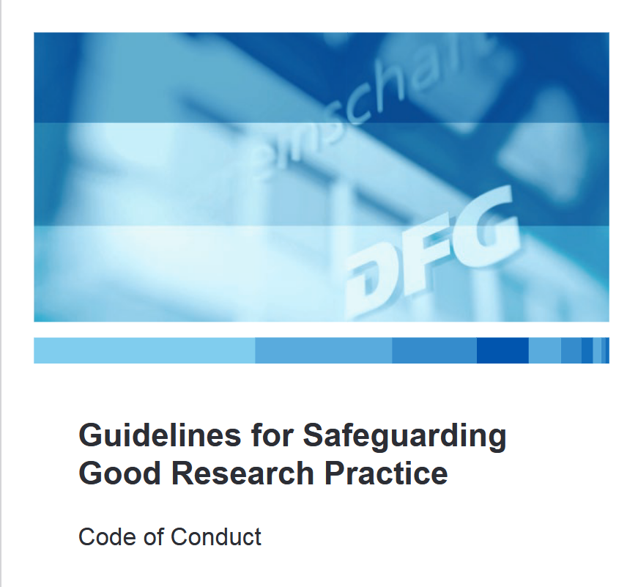
Guidelines for Safeguarding Good Research Practice (DFG)
11 out of 19 Guidelines are RDM-relevant!
Guideline 7: quality assurance across phases
Guideline 8: Stakeholders, responsibilities and roles
Guideline 9: Research design
Guideline 10: legal and ethical frameworks, rights of use
Guideline 11: methods and standards
Guideline 12: documentation
Guideline 13: establishing public access to research results
Guideline 14: authorship
Guideline 15: publication organ
Guideline 17: archiving
Guideline 19: Procedures in cases of alleged research misconduct
Source: Modified from DFG and forschungsdaten.info by Singson 2025;
Illustration: Screenshot from DFG (2022). Guidelines for Safeguarding Good Research Practice. Code of Conduct. licensed under CC BY SA
Notes:
Slide content:
Guideline 7: Researchers carry out each step of the research process lege artis. When research findings are made publicly available [...], the quality assurance mechanisms used are always explained.
Guideline 8: he roles and responsibilities of the researchers and research support staff participating in a research project must be clear at each stage of the project.
Guideline 9: Researchers take into account and acknowledge the current state of research when planning a project. To identify relevant and suitable research questions, they familiarise themselves with existing research in the public domain. [...]
Guideline 10: They [Researchers] comply with rights and obligations, particularly those arising from legal requirements and contracts with third parties, and where necessary seek approvals and ethics statements and present these when required. [...] The legal framework of a research project includes documented agreements on usage rights relating to data and results generated by the project.
Guideline 11:To answer research questions, researchers use scientifically sound and appropriate methods. [...]
Guideline 12: Researchers document all information relevant to the production of a research result as clearly as is required by and is appropriate for the relevant subject area to allow the result to be reviewed and assessed. In general, this also includes documenting individual results that do not support the research hypothesis. The selection of results must be avoided.[...]
Guideline 13: As a rule, researchers make all results available as part of scientific discourse. [...]. Researchers decide autonomously – with due regard for the conventions of the relevant subject area – whether, how and where to disseminate their results. [...]
Guideline 14: An author is an individual who has made a genuine, identifiable contribution to the content of a research publication or text, data or software.[...]
Guideline 15: Authors select the publication medium carefully, with due regard for its quality and visibility in the relevant field of discourse.[...]
Guideline 17: Researchers back up research data and results made publicly available as well as central materials on which they are based [...]. Where justifiable reasons exist for not archiving particular data, researchers explain these reasons. [...].
Guideline 19: HEIs and non-HEI research institutions establish procedures to handle allegations of research misconduct. They define policies and regulations on the basis of a sufficient legal foundation. [...]

Slide 3
Guidelines for Safeguarding Good Research Practice (DFG)
11 out of 19 Guidelines are RDM-relevant!
Guideline 7: quality assurance across phases
Guideline 8: Stakeholders, responsibilities and roles
Guideline 9: Research design
Guideline 10: legal and ethical frameworks, rights of use
Guideline 11: methods and standards
Guideline 12: documentation
Guideline 13: establishing public access to research results
Guideline 14: authorship
Guideline 15: publication organ
Guideline 17: archiving
Guideline 19: Procedures in cases of alleged research misconduct
Statements regarding using rights and citing
Source: Modified from DFG and forschungsdaten.info by Singson 2025;
Illustration: Screenshot from DFG (2022). Guidelines for Safeguarding Good Research Practice. Code of Conduct. licensed under CC BY SA
Notes:
Slide content:
The Guidelines also give hints about the rightholdership of scientific data -> usually the scientist creating the data
It also makes statements about the obligation to cite the source of scientific data and publications

Slide 4
Guidelines for Safeguarding Good Research Practice (DFG)
11 out of 19 Guidelines are RDM-relevant!
Guideline 7: quality assurance across phases
Guideline 8: Stakeholders, responsibilities and roles
Guideline 9: Research design
Guideline 10: legal and ethical frameworks, rights of use
Guideline 11: methods and standards
Guideline 12: documentation
Guideline 13: establishing public access to research results
Guideline 14: authorship
Guideline 15: publication organ
Guideline 17: archiving
Guideline 19: Procedures in cases of alleged research misconduct
Worth reading: https://wissenschaftliche-integritaet.de/en/
Source: Modified from DFG and forschungsdaten.info by Singson 2025;
Illustration: Screenshot from DFG (2022). Guidelines for Safeguarding Good Research Practice. Code of Conduct. licensed under CC BY SA

