Slide 1
Good Research Practice
Examples
Notes:
Sophie

Slide 2

Guidelines regarding Research Data in DFG Projects
Specification of Requirements Relating to the Handling of Research Data in Funding Proposals: what to include in your proposal(s)
Catalogue of questions:
Data description
Documentation and data quality
Storage and technical archiving of the project
Legal obligations and conditions
Data exchange and long-term data accessibility
Responsibilities and resources
Source: DFG 2022 modified by Singson 2025, Illustration: screenshot from die Deutsche Forschungsgemeinschaft (DFG, German Research Foundation), DFG bewegt is licensed under CC BY 4.0
Notes:
In addition, the DFG has specified the requirements of Handling RD in funding proposal
its a catalogue of questions you have to include in your proposal
For those of you working at the university of Bonn - it might be interesting that there is also a Guide on Handling research Data in dfg projects by the University of Bonn
You can have deeper lock at this on your own.

Slide 3
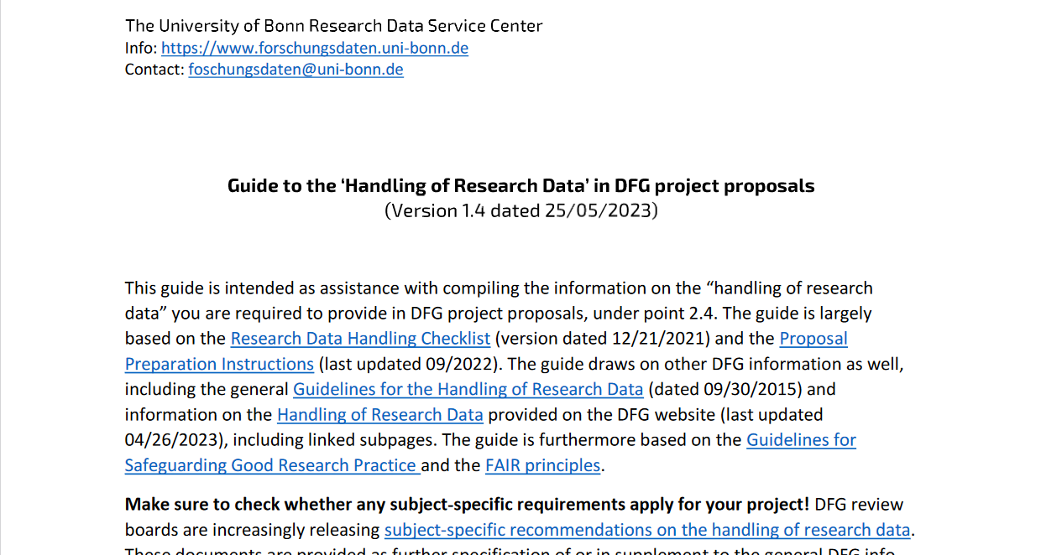
Universitary Data Policies
most universities and research institutes have their own research data policies
Examples are Georg-August-Universität Göttingen and the Rheinische Freidrich-Wilhelm University Bonn
Source: DFG 2022; Illustration: University of Bonn 2023 is licensed under CC0
Notes:
Note: think about adding your institutional research data policy
Slide content: it might be interesting, that most universities and research institutes have their own policies that describe how their employees have to handle their research data.
You can have deeper lock at this on your own.

Slide 4
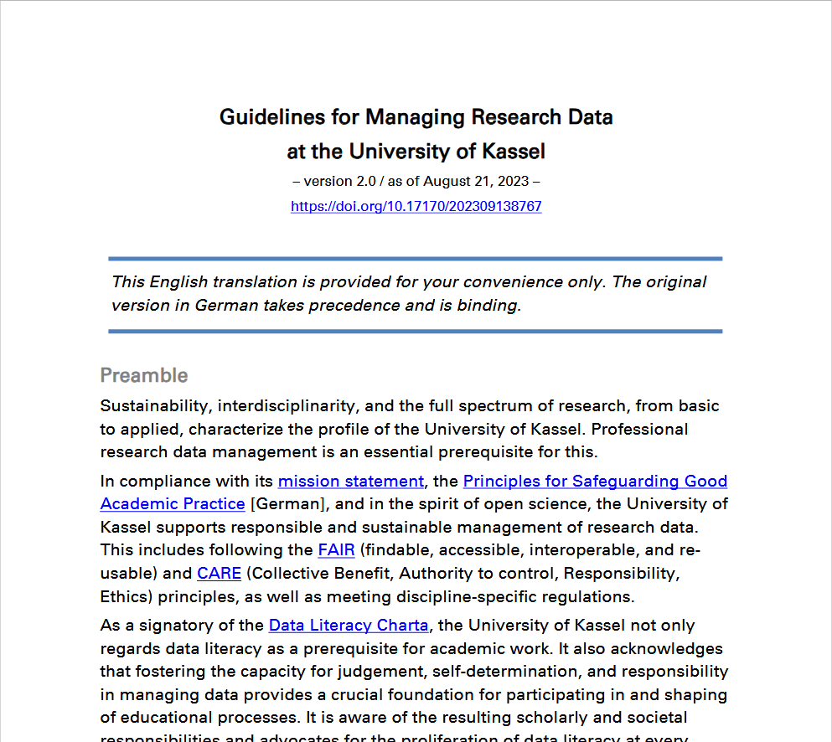
Guidelines for Managing Research Data at the University of Kassel
Decided by Presidium 08/2023 (P/113) and published in newsletter of the University of Kassel No. 17/2023
Complements the Principles for Safeguarding Good Academic Practice at the University of Kassel
Encourages Open Access Publication of data and / or data retention usually 10 years
Data management is documented by a regularly updated data management plan
If necessary, keep a record of processing activities (RPA; Art. 30 GDPR) → https://dsb.uni-kassel.de/
Defines obligations and responsibilities for researchers and the University
Illustration: Screenshot RD-Guidelines Uni Kassel
Notes:
Slide content: deeper look into the reglementation of good research practice and the handling of research data at the university of Kassel (as an example).
There is also a Guide on Handling research projects by the University of Kassel.
It encourages open access publication of data and the requirement of data retention for a minimum of 10 years. Data should be “as open as possible, as closed as necessary”
- If personal data is processed as part of the research project, the researchers will also keep a record of processing activities in accordance with article 30 of the general data protection regulation,. Which must be kept up to date. (a Record of processing activities (RPA=VVT (de)) according to article 30 (1) GDPR must be created)
You can have deeper lock at this on your own.

