Slide 1
Policies and Guidelines
Examples
Notes:
Sophie

Slide 2

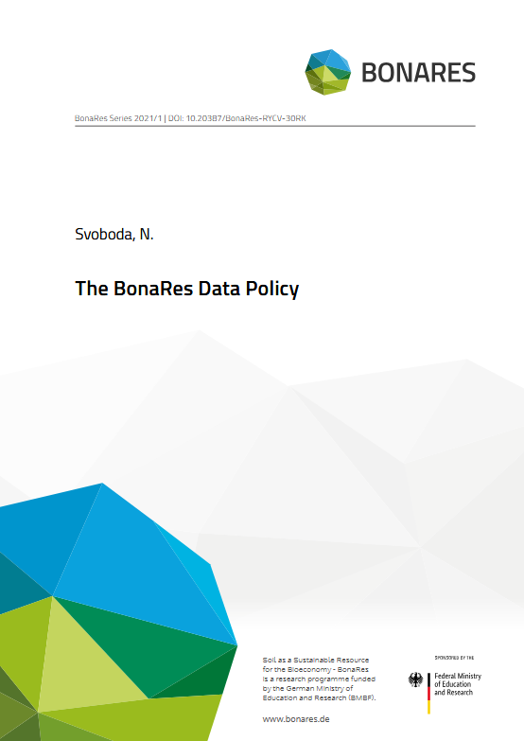
Examples of Research Data Policies
Examples of institutional RD policies
Research Data Policy of the technical University of Berlin: https://www.tu.berlin/en/about/organization/legal-matters/guidelines-directives/research-data-policy
RDM policy of the Helmholtz Centre for Environmental Research: https://rdm.pages.ufz.de/guidelines/research-data-management/RDM-policy/
RD Policies of discipline-specific repository
The BonaRes Data Policy:
https://doi.org/10.20387/BonaRes-RYCV-30RK
Illustrations: Screenshots Technical University of Berlin, Svoboda 2021 is licensed under CC BY 4.0
Notes:
Slide content:
Here is an example of a research data policy from the Technical University of Berlin. If you are considering establishing a research data policy at your institution or research project, bear in mind that you should tailor it to its specific circumstances – don't just copy an existing policy.
You can have a look at this Guidline for Research Data Policies for Research project (german): http://dx.doi.org/10.14279/depositonce-16196
You can also have a look at another example of the Helmholtz Centre for Environmental Research: https://rdm.pages.ufz.de/guidelines/research-data-management/RDM-policy/

