Slide 1
FAIR Principles

Slide 2
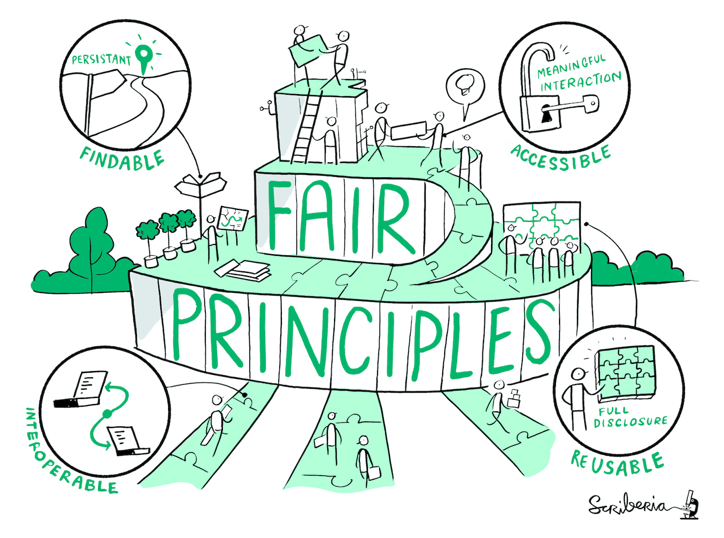
What are the FAIR data principles?
Set of principles that may act as a guideline for those wishing to enhance the reusability of their data holdings.
FAIR stands for:
Findability
Accessibility
Interoperability
Reusability
Source: Wilkinson et al. 2016 modified by ZB MED 2022, Illustration: Image by The Turing Way Community & Scriberia (2023) is licensed under CC BY 4.0
Notes:
Slide Content:
Principles that must be fulfilled when dealing with sustainably reusable research data (human and machine)
Principles that should be taken into account when setting up services or research data infrastructures
Given the multiple aspects of FAIR, data is not either FAIR or UNFAIR. FAIR is more a spectrum. In other words, data can be FAIR to a greater or lesser extent.
Findable
The first step in (re)using data is to find them. Metadata and data should be easy to find for both
humans and computers. Machine-readable metadata are essential for automatic discovery of
datasets and services, so this is an essential component of the
FAIRification process
Accessible
Once the user finds the required data, she/he/they need to know how they can be accessed,
possibly including authentication and authorisation.
Interoperable
The data usually needs to be integrated with other data. In addition, the data needs to interoperate
with applications or workflows for analysis, storage, and processing
Reusable
The ultimate goal of FAIR is to optimise the reuse of data. To achieve this, metadata and data
should be well-described so that they can be replicated and/or combined in different settings
Sources: Wilkinson et al.: The FAIR Guiding Principles for scientific data management and stewardship https://doi.org/10.1038/sdata.2016.18
European Union document: Cost-benefit analysis for FAIR research data - https://data.europa.eu/doi/10.2777/02999

