Slide 1
FAIR Principles

Slide 2
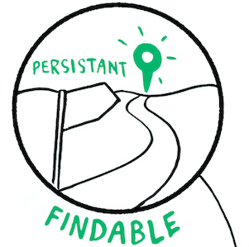
What makes your data Findable?
Assign a globally unique and persistent identifier (e.g. DOI) to your (meta)data
Describe your data with rich metadata
Metadata include the identifier of the data it describes
Register the (meta)data in a searchable resource (e.g. data repository)
Source: Modified from Wilkinson et al. 2016 by Vandendorpe & Lindstädt 2020, Image by The Turing Way Community & Scriberia (2023) is licensed under CC BY 4.0
Notes:
Slide content: In order to improve findability, we enunciate some steps to make research data more findable.
First, it means that '(Meta)data are assigned a globally unique and persistent identifier.' This is often a DOI (Digital Object Identifier), but there are other types as well. The key is that it's a unique and lasting address for your data, making it easy to locate."
Second, 'Data are described with rich metadata.' essential here to mention is, that Good metadata provide information that helps others to find data.
And third, 'Metadata clearly and explicitly include the identifier of the data it describes.' This creates a clear link between the metadata and the actual data, ensuring that there's no confusion."
Finally, '(Meta)data are registered or indexed in a searchable resource (e.g., a data repository).' This means that your data should be deposited in a place where others can search for it, like a database or online archive."
If I want to use data - first of all I must find it.
Therefore the data and/or its Metadata must be indexed in a searchable resource - and this resource needs enough information about the data that I find it by searching for suitable parameters.
When I once found it, I should be able to find it again and again by using its identifier.
We will talk about all the things that are important for that later on today: repositories, metadata, pids

Slide 3
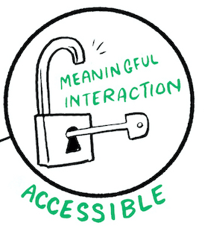
What makes your data Accessible?
Access without special or proprietary tools
Use a standardized communications protocol for your (meta)data:
  The protocol is open(-sourced), free (no-cost), and universally implementable (e.g. HTTP, FTP, ...)
  The protocol allows for an authentication and authorization procedure, where necessary
Metadata are accessible, even when the data are no longer available
Source: Modified from Wilkinson et al. 2016 GO FAIR by Vandendorpe & Lindstädt 2020 and Rathmann et al. 2021,
Image by The Turing Way Community & Scriberia (2023) is licensed under CC BY 4.0
Notes:
Slide content: once i found the data, i need access to it - by using an open, free and universally implementable standardized communication protocol.
Important: FAIR data is often, but not always open. 'FAIR ≠ FOIR (O = Open). FAIR is broader than just Open Data. Data can be FAIR without being completely open to everyone. So even if you can’t make your data openly available/ downloadable for everyone, you can still make your data FAIR by making your metadata (means the information about your data) openly available - so I can find, that this data, I really need exists, and I know, whom I need to write an email for asking for the data.
Being Accessible doesn't necessarily mean that everyone can immediately download your data, but it does mean that there are clear ways to access it.
Standardized…: This means that if someone has the identifier, they can use a standard web protocol to find information about the data (metadata).
The 'protocol is open… : This ensures that access isn't restricted by special software or expensive tools.
And 'Metadata are accessible… : Even if the data itself is removed (for legal or ethical reasons, for example), the metadata should remain. This is important for transparency and reproducibility.

Slide 4
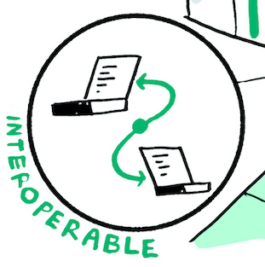
What makes your data Interoperable*?
Use for your (meta)data:
  vocabularies & thesauri
  language for knowledge representation (ontologies)
Include in your (meta)data qualified references to other (meta)data
* Data interoperability is the ability of a dataset to work with other datasets or systems without special effort on the part of the user.
Source: Modified from Wilkinson et al. 2016, GO FAIR and Open Data MOOC by ZB MED 2022, Image by The Turing Way Community & Scriberia (2023) is licensed under CC BY 4.0
Notes:
Slide content:
Imagine trying to combine data from two different spreadsheets where the columns are labelled differently – that's a lack of interoperability.
(Meta)data use vocabularies that follow FAIR principles. Controlled vocabularies and ontologies help ensure that terms are used consistently
The data usually needs to be integrated with other data
Interaction/integration of data with applications/workflows for analysis, storage and processing
Therefore, datasets should be compatible with other datasets or systems without special effort on the part of the user.
(Meta-)data include qualified references to other (meta-)data
This means linking your data to related datasets, allowing for a network of interconnected information
Readable data for computers:
Commonly used vocabulary, ontologies, thesauri (PID)
Good data model (defined framework for describing and structuring (meta-)data)
So, after finding and downloading the data, I need to be able to open it. So that means, the data needs to be interoperable - it works with other datasets or systems without special effort. So if the Data is in a common and open format, I don’t need to buy 20 licenses for special software.

Slide 5
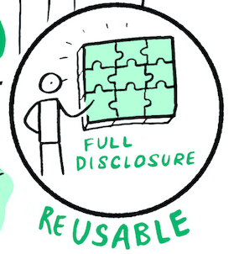
What makes your data Reusable?
Describe your (meta)data with accurate & relevant attributes
Release your (meta)data with a clear and accessible data usage license
Associate your (meta)data with detailed provenance
A good example:
Papoutsoglou, E. A. (2022) „A case-study for improved reusability of plant phenotyping data with MIAPPE“. Zenodo. doi: 10.5281/zenodo.5572772
Source: Modified from Wilkinson et al. 2016, GO FAIR by ZB MED 2022, Image by The Turing Way Community & Scriberia (2023) is licensed under CC BY 4.0
Notes:
Slide content:
(Meta-)Data are associated with detailed information of origin.
Detailed description of the (meta-)data:
Context were the data generated (experimental protocols, etc.)
Special features or limitations of the data
Generation of the data: when, under what circumstances, who, parameter settings, name and version of software used
Is it raw data or processed data?
Variable names should be explained or self-explanatory (i.e., defined in the controlled vocabulary of the research domain)
Link data to licenses (under what conditions may data be reused)
Provenance is the history of the data – how it was collected, processed, and modified. This helps others assess its quality and reliability.
…data usage license
Once I found the data, I downloaded it and I opened it, I still need two things for being able to reuse the data: I need to know, if I am allowed to reuse the data (therefore it needs to be properly licensed), and I need to understand the data - therefor I need enough information about the data - it must be properly documented.

