Slide 1
FAIR Principles

Slide 2
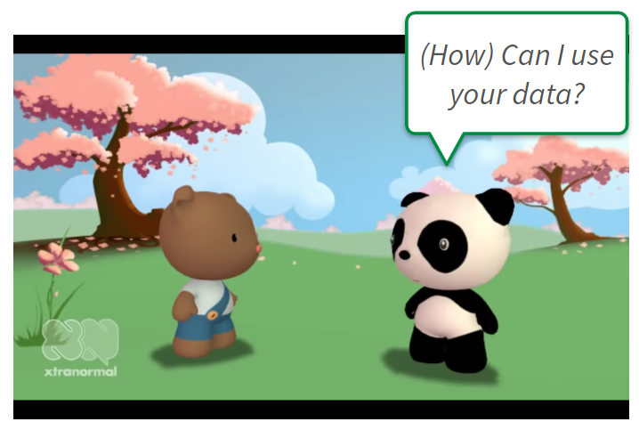
Source: Screenshot from Data Sharing and Management SNAFU in 3 Short Acts by NYU Health Sciences Library is licensed under CC BY 4.0
Notes:
Video source: https://www.youtube.com/embed/66oNv_DJuPc?autoplay=1&start=0&rel=0
Note:
There are two options to use the video for an exercise:
Option 1: watch it in the beginning of the workshop, to make people aware of all the topics to discuss about (04-03-02)
Option 2: watch after the workshop to find the questions about the new knowledge they have acquired during the workshop (12-02)
Option 1:
After watching the video, talk about the different positions and make the Menti/rise hand exercise to see what type of participants are there.
After that, give some solutions for some of the problems encountered in the video.

Slide 3


Which role from the video feels familiar to you?
go to menti.com
and enter the code XXXX XXXX
replace me!
Source: Screenshot from Data Sharing and Management SNAFU in 3 Short Acts by NYU Health Sciences Library is licensed under CC BY 4.0
Notes:
Slide content: create a Menti or similar tool (in Online meetings) or let the participants to rise their hands (for in person meetings), when they feel they play one of this roles in their day to day research life.
You can describe to roles:
the brown bear: only one copy in a USB stick, no connection to the data producer, no metadata information, no ORC-ID, …
the panda bear: wants to reuse the data but encounters many problems.
They don’t have to be one or the other. There are situations where the participants will feel like the brown bear, and other were they will feel like the panda bear.
Source: https://www.menti.com/alie6nep9eqz

Slide 4
FAIR Practice?
" I am not sure where my data is!"
"That [USB-Stick] is my only copy."
"You will need the program that created the hexadecimal file!"
"Everything you need to know is in the article."
Source: Screenshot from “Data Sharing and Management SNAFU in 3 Short Acts” by NYU Health Sciences Library is licensed under CC BY 4.0
Notes:
Slide content: make the participants aware about the different problems that occur during the video. How can you tackle this problems with your RDM knowledge?
In the next slides we will talk about how to handle some of this problems

Slide 5



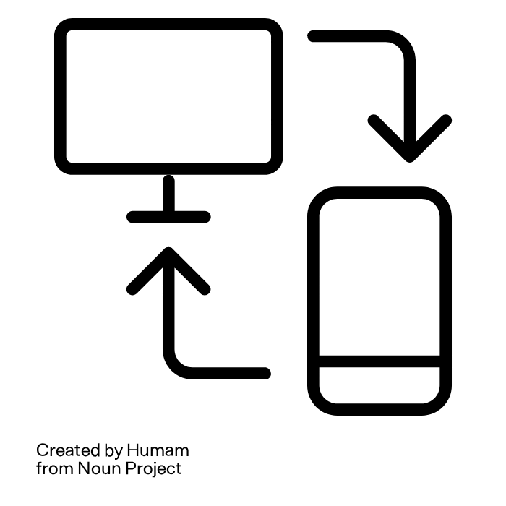
FAIR Practice? - Problems
" I am not sure where my data is!"
… no ID, not indexed
"That [USB-Stick] is my only copy."
… no defined access protocol
"You will need the program that created the hexadecimal file!"
… no standard format
"Everything you need to know is in the article."
… no metadata, no licence
Source: Wibberg & Schnitzer (de.Nbi); Illustrations: “Components“” by feri ulan taufiq, “Magnifying Glass“” by AB Designs, “synchronization“” by Humam, “Data“” by Sunardi are licensed under CC BY 3.0
Notes:
Slide content:
here are some of the problems that the Bear has faced during the video. Give the participants some time to think about this problems. In the next slide you will see some possible solutions to this problems.

Slide 6
FAIR Practice? - Problems & Solutions
" I am not sure where my data is!"
… no ID, not indexed
"That [USB-Stick] is my only copy."
… no defined access protocol
"You will need the program that created the hexadecimal file!"
… no standard format
"Everything you need to know is in the article."
… no metadata, no licence
Helpful RDM strategies:
Backup
Publication in a storage repository (ID, access)
Description of data format and program; change format if necessary
Description of data
Insert metadata
Define responsibilities
Source: Wibberg & Schnitzer (de.Nbi); Illustrations: “Components“” by feri ulan taufiq, “Magnifying Glass“” by AB Designs, “synchronization“” by Humam, “Data“” by Sunardi are licensed under CC BY 3.0
Notes:
Slide content:
in this slide you can describe some of the possible solutions for the problems that the Bear encountered in the video.
Connect the problems and the solutions with the FAIR principles:
the data were not findable in a repository
the data were not accessible (the USB is the only copy…)
the data were not interoperable, there is no standard format (you will need the program to open the data…)
the data were not reproducible because not all the information needed to understand them was in the article or even provided by the brown bear.

