Slide 1
Data Organisation

Slide 2
Folder Structure
<Foliennummer>
Notes:
Data Organisation

Slide 3
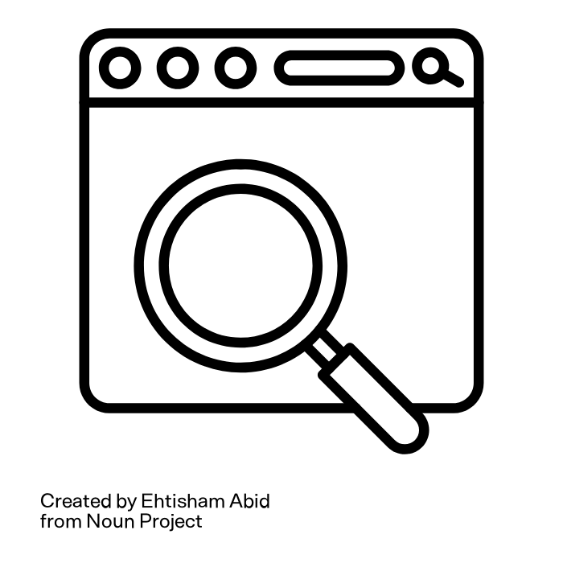

How long do you take?
To find a file you haven't used for at least 6 months?
LET'S try!
Think about a file you want to find.
Ready, steady, GO!
<Foliennummer>
Illustration: “Race“” by Adrien Coquet and “searching“” by Ehtisham Abid from Noun Project are licensed under CC BY 3.0
Notes:
slide content:
Think about a file, that you haven’t used for at least 6 months - for example a first version of a paper you wrote last year, the abstract for a poster you presented at a conference half a year ago, the output of a fieldexperiment two years ago, …
Now, start searching for this file - how long does it take to find it?
Ready, steady, GO!

Slide 4
How long do you take?
And how long would your neighbour take to find your file?
<Foliennummer>
Illustration: “searching“” by Ehtisham Abid from Noun Project is licensed under CC BY 3.0
Notes:
slide content:
Great, you all have found your files - and probably some of you were quite dast. But now imagine your seat neigh should find exactly this file in your system - how long would that take? (Don’t worry, you don’t need to share your laptop with Great, you all found your files — and some of you were probably quite fast. But now, imagine your seat neighbor searches for this exact file in your system. How long would that take? (Don't worry; you don't need to share your laptop with your neighbor right now.)

