Slide 1
Data Organisation

Slide 2
Folder Structure
Notes:
Data Organsation

Slide 3
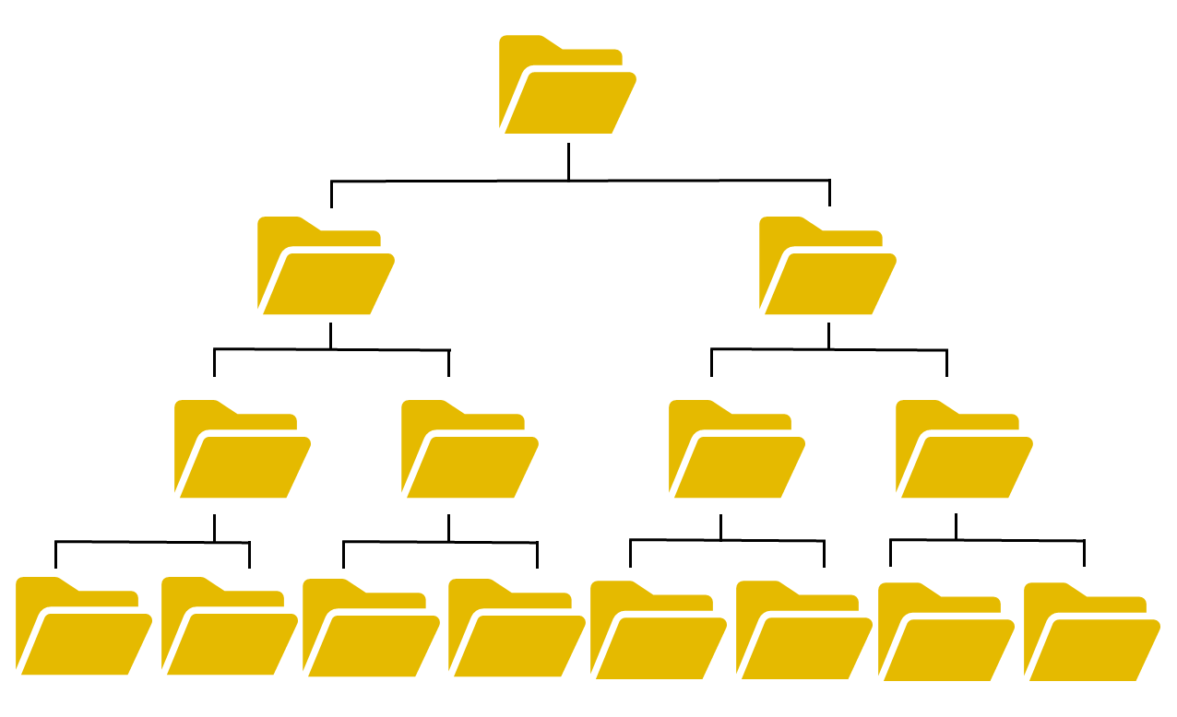
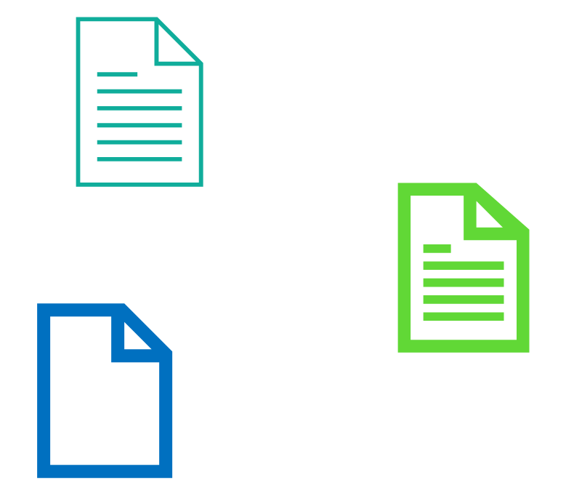
Recommendations for folder structures
L0
Chaotic
L1
L2
Hierarchical
Alphabetical
L3
Source: Ireneusz Kleppert (2024)
Notes:
slide content:
To make it easier to find files, especially if you have a lot of data, you should avoid a chaotic or alphabetical approach to storing data. Instead, a proper folder structure is a hierarchical arrangement in which folders are created to make it easier to find data. A typical hierarchical folder structure has a root folder and several levels of subfolder.
Therefore you should choose a folder structure that is hierarchical, clear, comprehensive, efficient and conclusive. To make it clear and comprehensive for other team members, make sure the structure is self-explanatory and has intuitive navigation.
(Vandendorp & Boße, 2024)

Slide 4
Recommendations for folder structures
Avoid overlapping categories
  no copies of files in different folders!
Apply naming conventions
Maximum 4 levels
Maximum 10 elements per folder
Avoid generic folders
Hierarchical Folder Structure
L0
L1
L2
L3
Source: Bobrov et al. 2021 and Bres et al. 2022 modified by FAIRagro
Notes:
slide content:
There is no one-size-fits-all solution: the optimal folder structure depends on the specific project requirements.
To make the structure easy to browse, do not make it too deep: use a maximum of 3 to 4 levels.
In addition, if the folders are too large, it is difficult to find the right file in the folder: so limit your folders to a maximum of 10 items per folder.
Short, meaningful folder names that follow a comprehensive naming convention make browsing a folder structure more efficient.
Make sure you don't have overlapping categories, as you shouldn't have copies of files in different folders, since this can lead to confusion and make it difficult to keep track of different versions of the file.
If you need to see a file in more than one folder, you can use shortcuts to the file instead. This allows you to keep a single reference file.
In particular, make sure you have a 'raw data' folder for each type of data or experiment. It is important to store your raw data separately so that the original versions of the files or their documentation are preserved and the original files can be reconstructed.
You should avoid using generic "current stuff" folders.
Also, be careful about creating researcher-specific folders within a project: folders are about the content, not the authors. If you use researcher-specific folders, external contributors will not be able to understand what data is stored in these folders.
Sometimes it is a good idea to number the folders to ensure that they work well with the system's default order.
For clarity, the folder structure should be identical on servers and local devices.
(Vandendorp & Boße, 2024)

Slide 5

Recommendations for folder structures
Distinguish between….
  work vs. private material
  own vs. others’ work (papers vs. literature)
  research vs. administrative content
  raw vs. processed vs. final data
  experiment vs. analysis
Remember: folders are about the content, not the authors!
Sources: Schmid 2021 modified by FAIRagro,; Illustration: photo by Alexander Grey is licensed under Unsplash license
Notes:
slide content:
But each project has its own needs and you will need to find out what works on a case-by-case basis
There are several approaches to building your hierarchy.
For some projects, it may be helpful to use a folder structure that follows the different parts or workflow of the project. This
can support the step-by-step creation, analysis and publication of data.
One folder per dataset comprising data and its description
Project with several datasets → Project information in parent folder
You can also consider basing your hierarchy on functionalities, people involved, date or time period, data types, creation methods or processing steps.
Be careful to distinguish between:
● Work vs. private material
● Own work vs. work of others (papers vs. literature)
● Research vs. administrative content
● Raw data vs. processed data vs. final data
● Experiment vs. analysis
● Experimental runs/replicates (where appropriate)
(Vandendorp & Boße, 2024)

