Slide 1
Data Organisation

Slide 2
Folder Structure
Notes:
Data Organsation

Slide 3
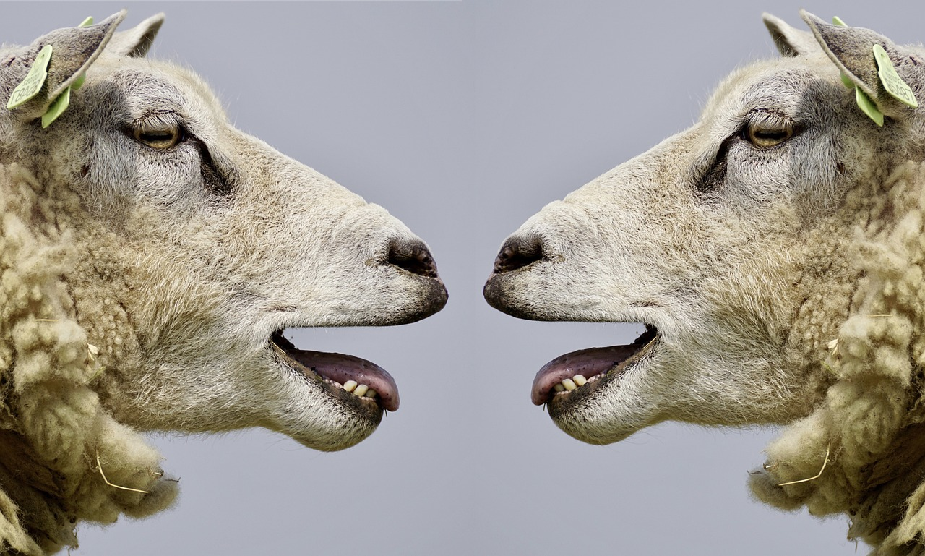
What about your Folder Structure?
Discuss with your neighbour!
Identify at least one thing that could be improved!
Image: photo from Pixabay is licensed under Pixabay license
Notes:
slide content:
Please discuss with your neighbor about your current folder structure: what works well, what yould be improved? Identify at least one thing, that you can improve today!
note: give approximately 5 minutes time for that

