Slide 1
Data Organisation

Slide 2
Folder Structure
Notes:
Data Organsation

Slide 3
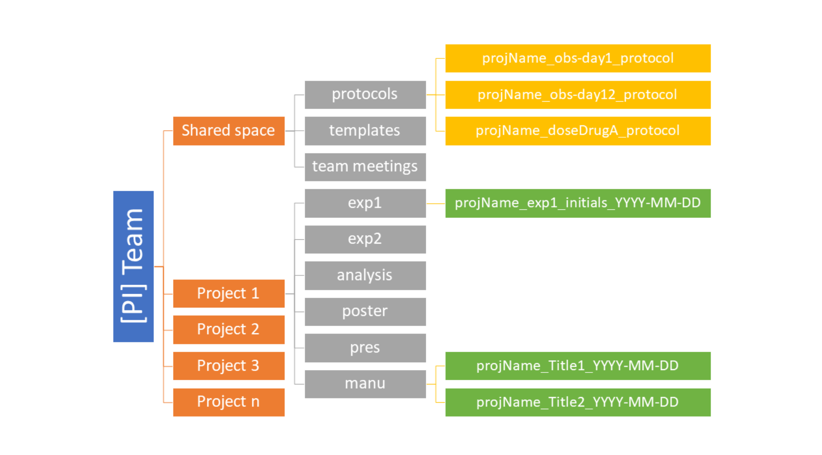
Example of folder structure
Source: Briney et al. 2020 licensed under CC BY 4.0
Notes:
slide content:
The requirements for a folder structure differ depending on whether it is used by a research team or an individual researcher.
Here you find an example of a folder structure designed for a whole team of researchers.
This structure distinguishes between the team's shared space and the project folders. The shared space contains all files related to the project team and its working structure. In addition, each research project has its own folder with its own subfolders, which can be customised to meet the needs of each individual project.
(Vandendorp & Boße, 2024)

Slide 4
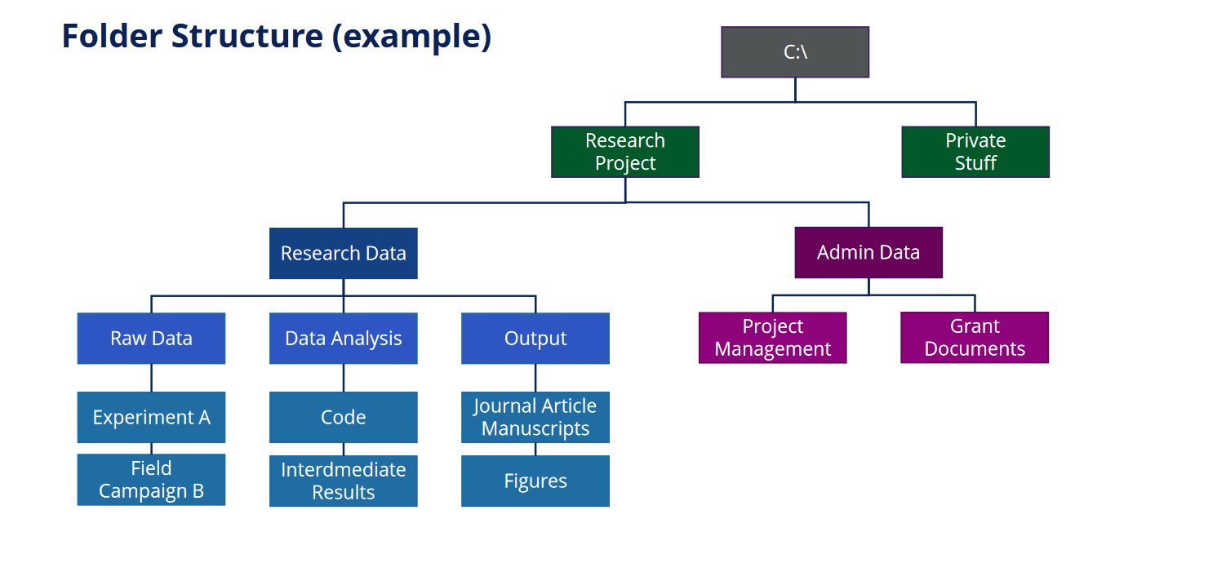
Example of folder structure
Illustration: Von der Dunk 2021 is licensed under CC BY 4.0
Notes:
slide content:
This slide shows an example of a folder structure that might be suitable for an individual researcher who has a strict separation between their single research project and their private data. The research data folder is structured along the project workflow from raw data through data analysis to results. This structure can be extended to include additional folders for additional research projects if required.

Slide 5

Example of folder structure
Project
  Data
    Raw_data
    Processed_data
    Documentation
  Code
    Src
    Output
      Plots
    Documentation
  Protocols
Manuscripts
Conference_reports
Administrative_information
Source: Bobrov et al. 2021 modified by FAIRagro,; photo by Agnivesh Jayadeep on Unsplash
Notes:
slide content:
Different approaches to store code and data
In contrast to the last example, this one differentiate between data and code at the same level, with raw data and processed data being separate subfolders of the root "data" folder.

