Slide 1
Data Organisation
<Foliennummer>

Slide 2
Folder Structure
Notes:
Data Organisation

Slide 3
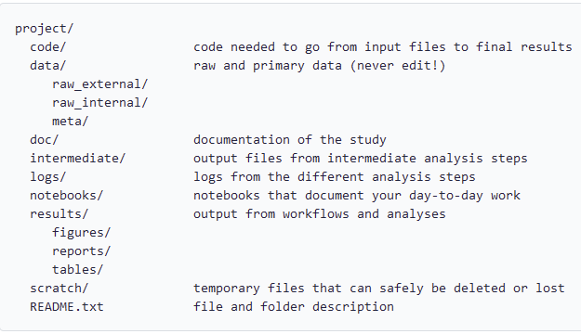
Recommendations for establishing a system
Invest time planning out the folder structure
Establish the system as a group
Provide a method for easy adoption
  provide a template
  document the system in a README file
Source: by Bobrov et al. 2021 and Bres et al. 2022 modified by FAIRagro,; Illustration: Mičetić et al. from RDMkit licensed under CC BY 4.0
Notes:
slide content:
Invest time planning out folder structure before collecting data/writing your first line of code [de Kok 2018]
The more carefully you plan it, the easier it will be to find your way around later [Biernacka et al. 2020].
Understand What You Have or will have - what types of files will we created during the project? [Sweet 2022]
Establish a system as a group and prioritise it for implementation [Goldberg, Longwood RDM] (everyone must be able and willing to stick to the system!)
Interview Your Users (you and your colleagues):
What are the current pain points when searching for files?
How do they currently search for files?
What are the workflows you go through to find and use files?
What kind of files are you seeking on a regular basis?
How do they share files? [Sweet 2022]
Provide a method for easy adoption
In order for everyone (including your future self) to be able to adhere to your folder structure or tag-based system, you should produce comprehensive documentation of it and make it easily available to all members of the team.
You might consider documenting the folder structure together with the file naming convention in a DMP, SOP or README file.
Relationships between elements (e.g. between code and the data file needed to run it), between the data file and associated documentation or metadata, or between multiple files should be documented as needed. Without such a file, it may be difficult to reconstruct these conventions after some years.
Think about creating README files for project-level documentation (information relevant to all files in the folder), as well as for file/folder-level documentation (information specific to each file/folder).

