Slide 1
Data Organisation
<Foliennummer>

Slide 2
Version Control
Notes:
Data Organisation

Slide 3
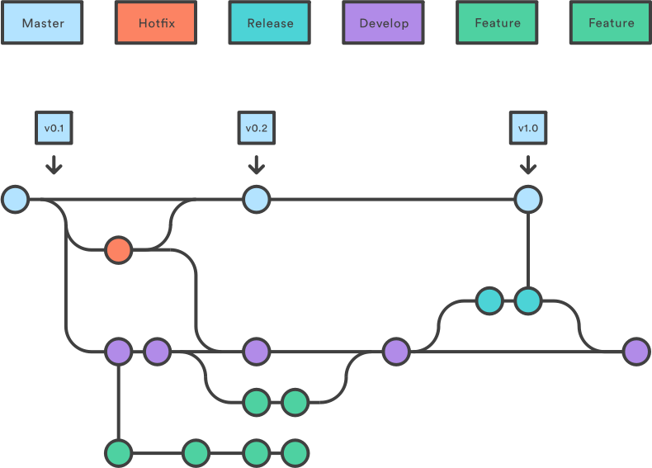
Version Control
Version control = practice of tracking and managing changes to a file or set of files over time so that you can recall specific versions later.
Benefits of version control
Working concurrently without conflict
Keeping several versions of every file
Keeping a complete long-term change history of every file
Being able to trace and annotate each change made to the file(s)
Making research more comprehensible
Source: ZB MED 2023; by Bres et al. 2022, Di Russo 2020 and Git modified by FAIRagro; clipart by gbrown on openclipart is licensed under CC 0
Notes:
slide content:
Versioning or version control is the practice of tracking and managing changes to a file or set of files over time so that you can later retrieve specific versions.
We recommend that you meet with project partners to decide how versioning will be carried out, how version changes will be documented, and how a version change will be defined.
Purpose and use of versioning
Versioning helps you to keep a complete long-term change history of each file by tracking, tracing and annotating your steps (i.e. changes made to the file(s)) and also allows you to go back one step.
Versioning also allows you to keep multiple versions of each file, and to create new versions of the same file - or even new results - by incorporating new data and/or changes to a file’s structure; this is particularly important in the case of software.
Versioning also supports debugging in software. Overall, versioning makes your research easier to understand.
(Vandendorp & Boße, 2024)

Slide 4
Options of file versioning
In file names
Within data
In text files
With a Version Control System (VCS)
Versioning and change tracking are available for collaborative documents and storage locations.
Source: Vandendorpe & Boße 2024
Notes:
slide content:
Versioning can be done in
the file name (see slide “manual file versioning)
in the data (e.g. in the header or a column for comments)
in a text file (e.g. in a README file)
using a version control system (VCS) (see slide “Version Controle system”)
collaborative document and storage locations (e.g. wiki, Google Docs, cloud), versioning is available in situ (i.e. within the document/storage location and in real-time)

