Slide 1
Data Organisation
<Foliennummer>

Slide 2
Version Control
<Foliennummer>
Notes:
Data Organisation

Slide 3
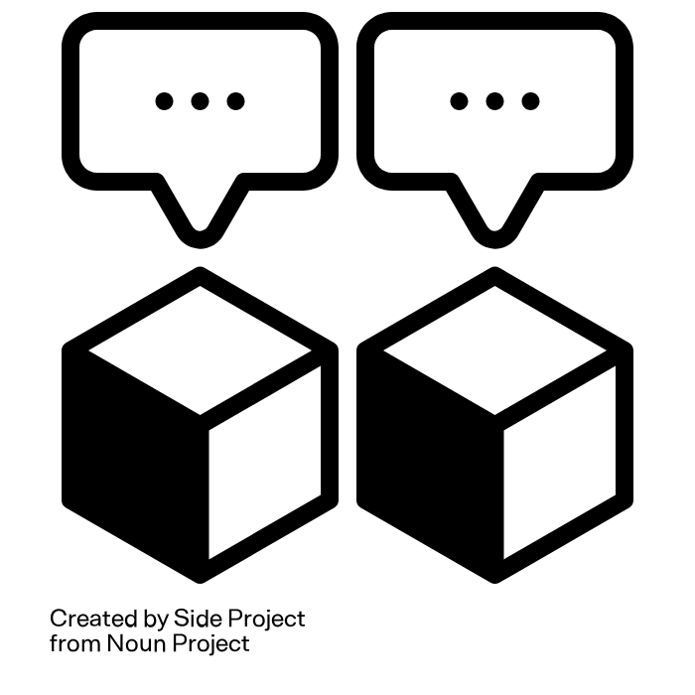
Manual file versioning
Use a version control table (e.g. doc from the University of Sydney)
Define responsibilities for completion of files
Use semantic versioning: MAJOR.MINOR.PATCH
  Ex1Test1_SmithE_v1.0.0.xlsx
  Ex1Test1_SmithE_v1.2.5.xlsx
  Ex1Test1_SmithE_v2.1.1.xlsx
Save milestone versions
Store obsolete versions separately after backup
<Foliennummer>
Source: Vandendorpe & Boße 2024, Illuststration: “Versioning“” by Side Project is licensed under CC BY 3.0
Notes:
slide content:
Manual file versioning can be done using semantic versioning. You can do this by adding a "v" to the end of each file name, followed by a maximum of three numbers separated by a period (note that these are the only periods allowed in a file name other than the one before the extension).
The first number is called MAJOR and indicates important changes.
The second number is called MINOR and indicates less drastic changes.
The third number is called PATCH, and is mainly used by software developers to indicate bug fixes.
Examples of semantic versioning would look like this: Filename_vMAJOR.MINOR.PATCH.FileExtension
● Ex1Test1_SmithE_v1.0.0.xlsx
● Ex1Test1_SmithE_v1.2.5.xlsx
● Ex1Test1_SmithE_v2.1.1.xlsx
If you decide to use manual file versioning, it is recommended that you use a version control table.
It is also recommended that you assign responsibilities for completing files, store milestone versions, and store obsolete versions separately after backup.
How many versions of a file will be kept, which versions (e.g. major versions instead of minor versions (version 2.0 but not 2.1)), for how long, and how the versions will be organised need to be decided in advance, ideally with project partners.
Note: If possible, you can share further resources on semantic versioning and version control tables via chat: “Here you can find more information about semantic versioning: https://semver.org/”, “a version control table template from the University of Sydney Library can be downloaded here: https://www.library.sydney.edu.au/content/dam/library/documents/support/doc_versioncontrol.docx “

