Slide 1
Data Documentation

Slide 2
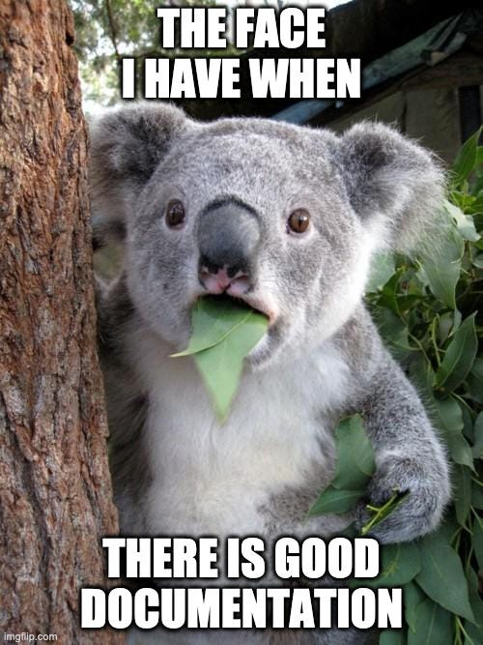
Importance of data documentation
For reusing research data, it must be described in a meaningful way and in as much detail as possible:
for other researchers
for other team members
for your future self
It is good to document how, when and for what purpose the data was created as soon as it is created.
Source: forschungsdaten.info, Illustration: image from imgflip.com - free to use acc. to copyright exeptions
Notes:
slide content:
Why is data documentation important for data re-use? → reproducibility, comprehensibility
How to document? → in a meaningful way, in as much detail as possible
For whom? → other researchers or team members and you future self
The documentation of the “how”, “when” and “for what purpose” is a lot easier to do as soon as data is created instead of waiting until the end of the project
This slide highlights the importance of documentation for data re-use.

Slide 3
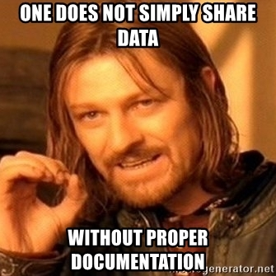
Importance of data documentation
Without documentation, you risk:
Not being able to find data again
No longer being able to trace the origin of data
No longer being able to interpret data due to missing context information
Mixing up files (outdated or competing versions)
Not being able to exchange data with other people or merge it with data from other sources
<Foliennummer>
Source: forschungsdaten.info, Illustration: image from Meme Generator- free to use acc. to copyright exeptions
Notes:
silde content:
Why is data documentation important? What do you loose without it? Some of the risks are listed on this slide.

