Slide 1
Data Documentation

Slide 2
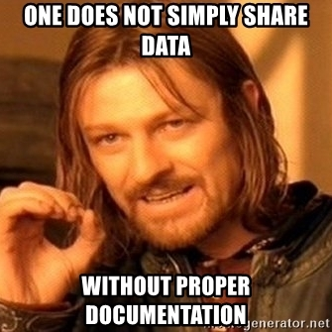
Benefits of Documentation
Making data:
  understandable
  reusable
Guarantee the reproducibility of research
!! Adequate documentation is part of
good scientific practice!
(Guideline 12, Guidelines for Safeguarding Good Research Practice, DFG)
Source: Modified from Engelhardt et al. 2022 and KU Leuven 2022 by ZB MED 2023,; Illustration: image from Meme Generator - free to use acc. to copyright exeptions
Notes:
Slide Content:
Without documentation, you run the risk of not being able to retrieve data:
no longer being able to trace the origin of data,
no longer being able to interpret data due to a lack of contextual information,
confusing files (outdated or competing versions),
not being able to exchange data with other people or merge it with data from other sources
🡪🡪Adequate documentation is part of good scientific practice!

