Slide 1
Data Documentation

Slide 2
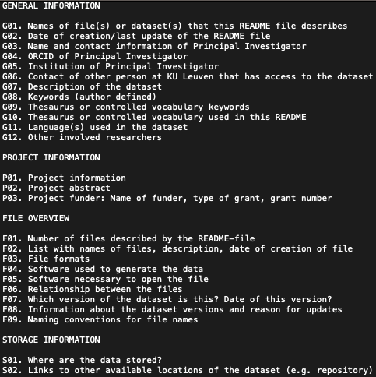
Data-level Documentation
1
Information on the data files:
  Data & file type, format, size, data processing scripts ...
Explanation of variables, labels and codes:
  Names, labels, values …
Tools to use:
  README file
  Data dictionary
  Codebooks
  Commented Code
  Lab/ Field Notebooks
2
3
Source: UK Data Service and CESSDA Training Team (2017 - 2022) modified by FAIRagro 2024,; Illustration: Screenshot template from KU Leuven 2024 (public domain)
Notes:
Note: The upper illustration refers to the overview of the level of data documentation (06-02-02).
Slide content:
Data-level documentation provides information about individual databases or data files. This could be, for example, interview transcripts or pictures, as well as documentation for elements within the files, for example describing variables within an SPSS file.
Source: https://ukdataservice.ac.uk/learning-hub/research-data-management/document-your-data/data-level/
Information about the data file: Data type, file type, and format, size, data processing scripts.
Information about the variables in the file: The names, labels and descriptions of variables, their values, a description of derived variables or, if applicable, frequencies, basic contingencies etc.
Source: https://dmeg.cessda.eu/Data-Management-Expert-Guide/2.-Organise-Document/Documentation-and-metadata

