Slide 1
Data Documentation

Slide 2
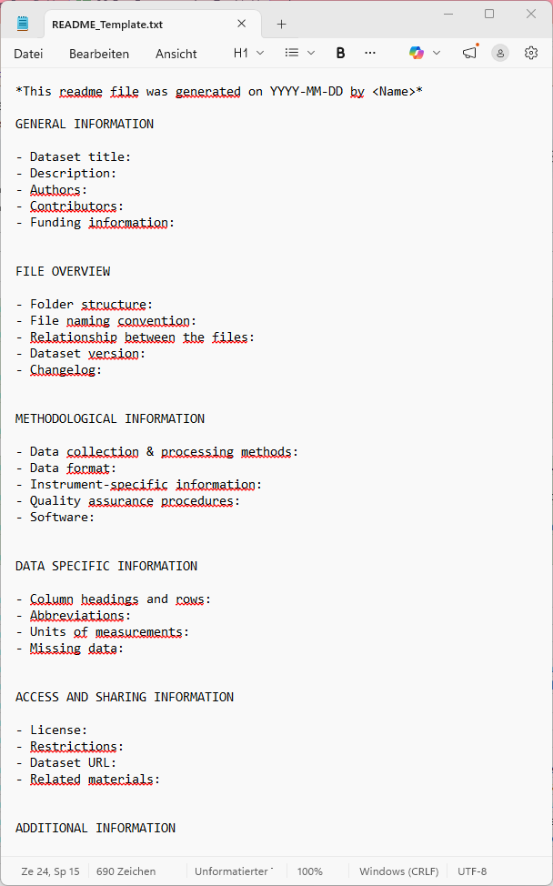
How to do a README file?
*.txt or *.md file
Some Templates:
  Cornell University
  KU Leuven
  RDM kit
Store at the same location as the data
Provide multiple README files for complex datasets
Source: KU Leuven 2024, Illustration: Screenshot README Template by KU Leuven 2024 taken on 23.04.2026, public domain
Notes:
Slide content:
README.txt files are a simple way to create documentation for a dataset.
It makes your data understandable and usable.
It provides the context of the data, to which research project the data belongs, and how the data should be interpreted.
It allows to understand how a dataset is related to other datasets.
How to clarify the relationship between the README file and the data?
The README file must be accessible at the same location as the data.
The name of the README file must make clear which file or dataset it describes.
The location of the README file in the folder structure can also show which dataset it belongs to.
You can provide one README file for an entire research project. If the dataset is complex, it is advisable to provide multiple README files (per work package / file) with attention to the structure of the project and/or the dataset.

Slide 3

Content of a README file
Information relevant to all files in the folder:
Context in which the data is gathered
Origin of the data
Content
Information on data confidentiality
Licenses and (legal) conditions for reuse
Source: Modified from KU Leuven 2022 by ZB MED 2023,; Illustration: icon from Kücklich 2020 is licensed under CC0
Notes:
Slide content:
A README file should contain information that are relevant for all files in the folder. You can have one README in every folder of your folder structure.

