Slide 1
Data Documentation

Slide 2
Metadata

Slide 3
What is it?
5 min
Work in three Groups.
Each group gets an object.
Describe the object with a maximum of 10 metadata elements!
Choose one person to present your results
Notes:
Note: This is the version for in-person trainings, plan 10 min for that. The participants should work in groups - make sure they bring at least one sheet of paper and a pen.
Bring different small objects, that are not too different from each other. Give each group one object to describe it.
Schedule more time, if participants need time to find their group and e.g. change rooms for that.

Slide 4
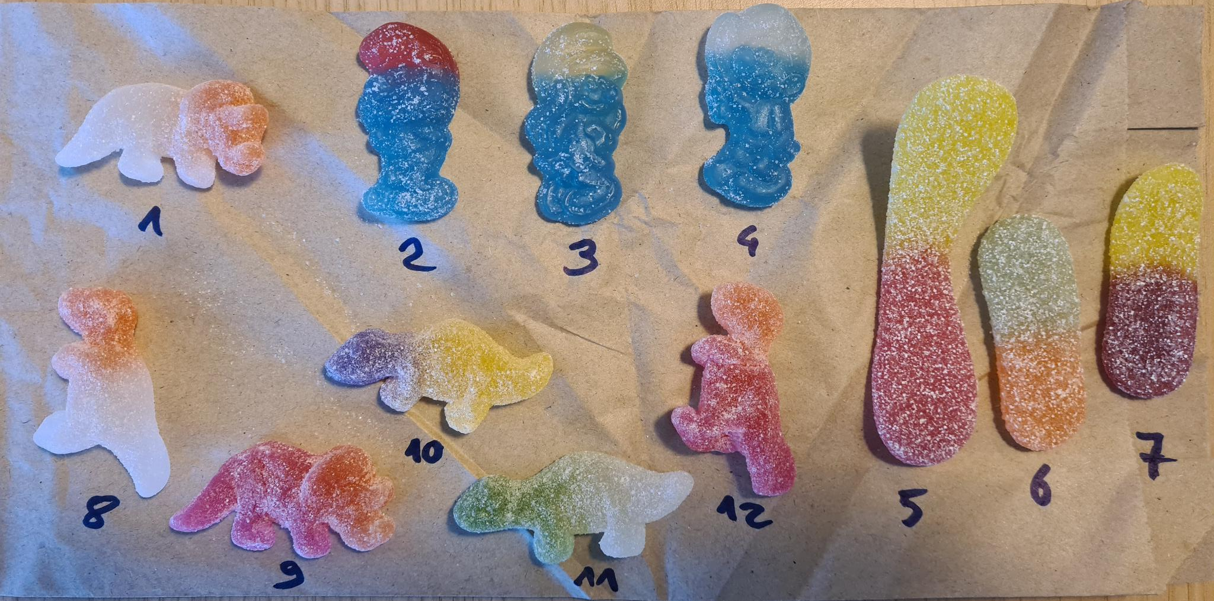
What is it?
Illustration: photo by Sophie Boße is licensed under CC0
Notes:
Note: Bring multiple small objects like these and prepare a numbered photo of them to include in this slide.

