Slide 1
Data Documentation

Slide 2
Metadata

Slide 3
What is it?
5 min
Work in three groups (in Break-out Rooms)
Each group gets a photo of an object
Describe the object with a maximum of 10 metadata elements!
Choose one person to present your results
Notes:
Note: This is the version for online training. Plan 10 minutes for it. Prepare the breakout rooms and worksheets as shared documents for the participants. If the trainers do not join the breakout rooms, make sure you share the links to the worksheets via chat before opening the breakout rooms, and ask the participants to open the respective worksheet before entering the breakout room. Remind participants to choose someone to present the group work afterwards.

Slide 4
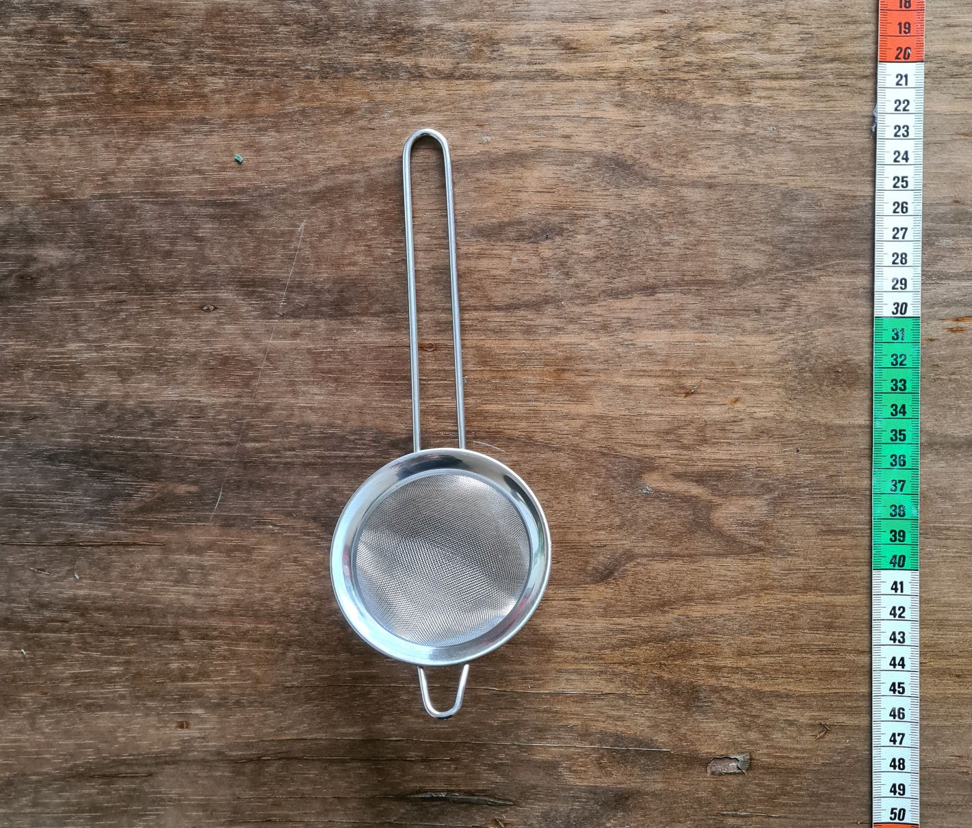
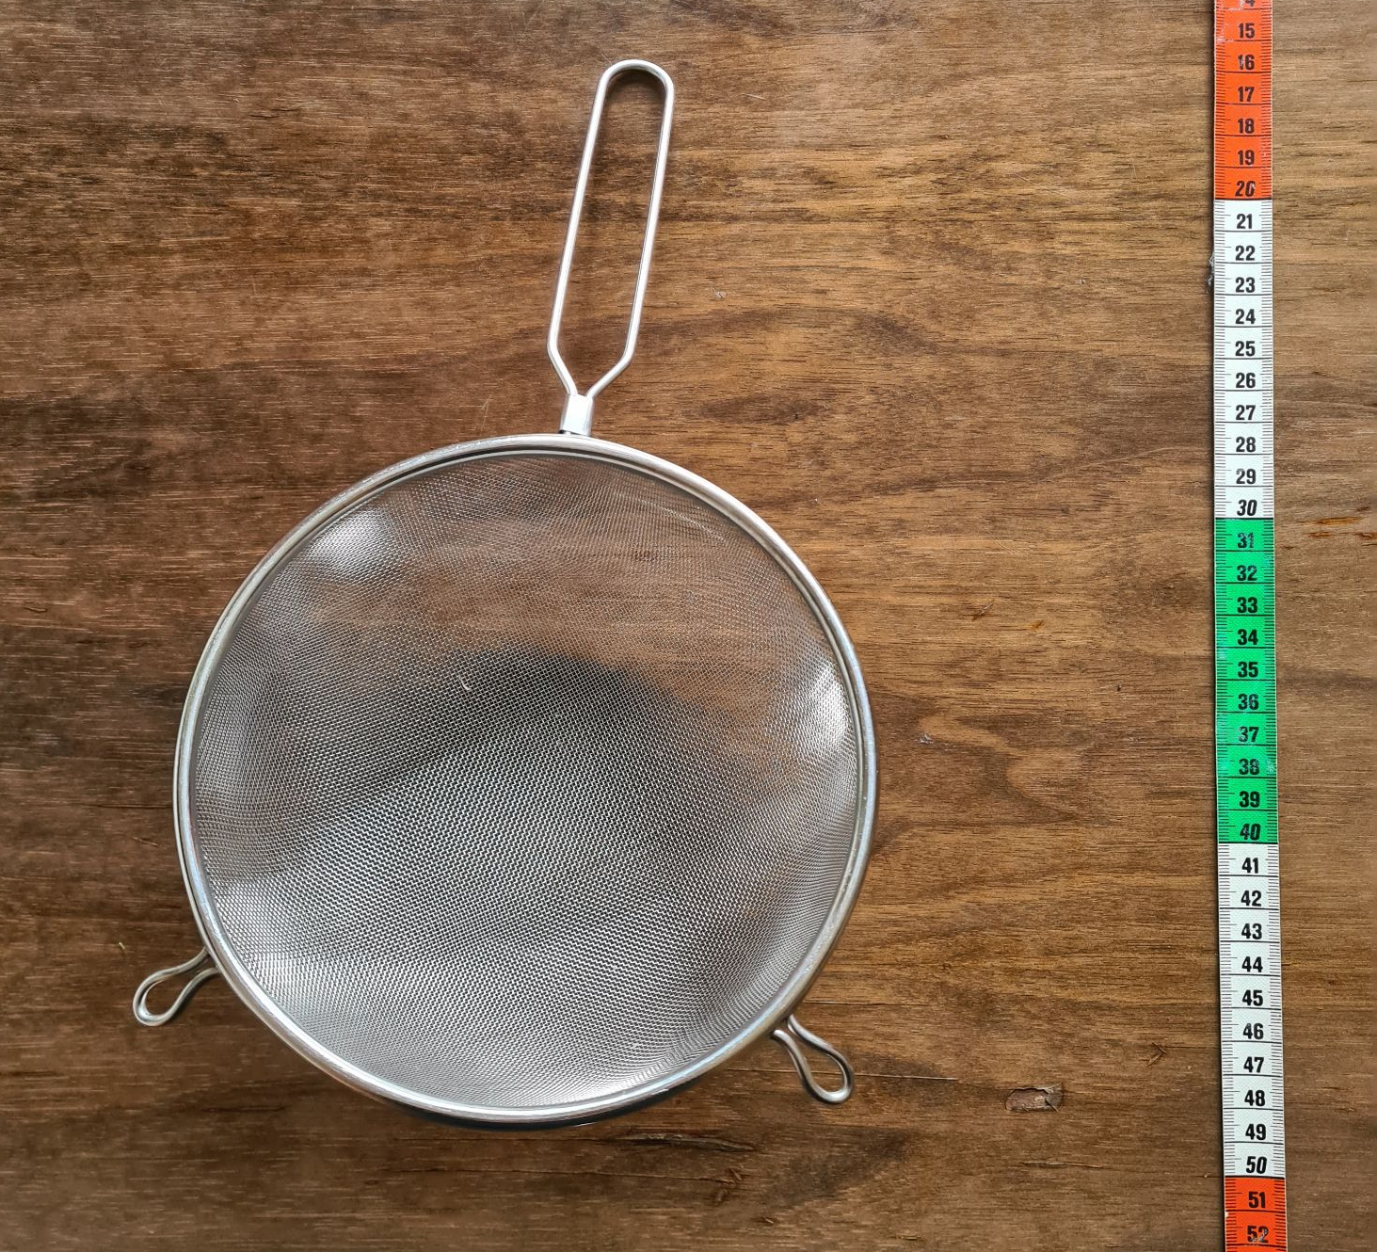
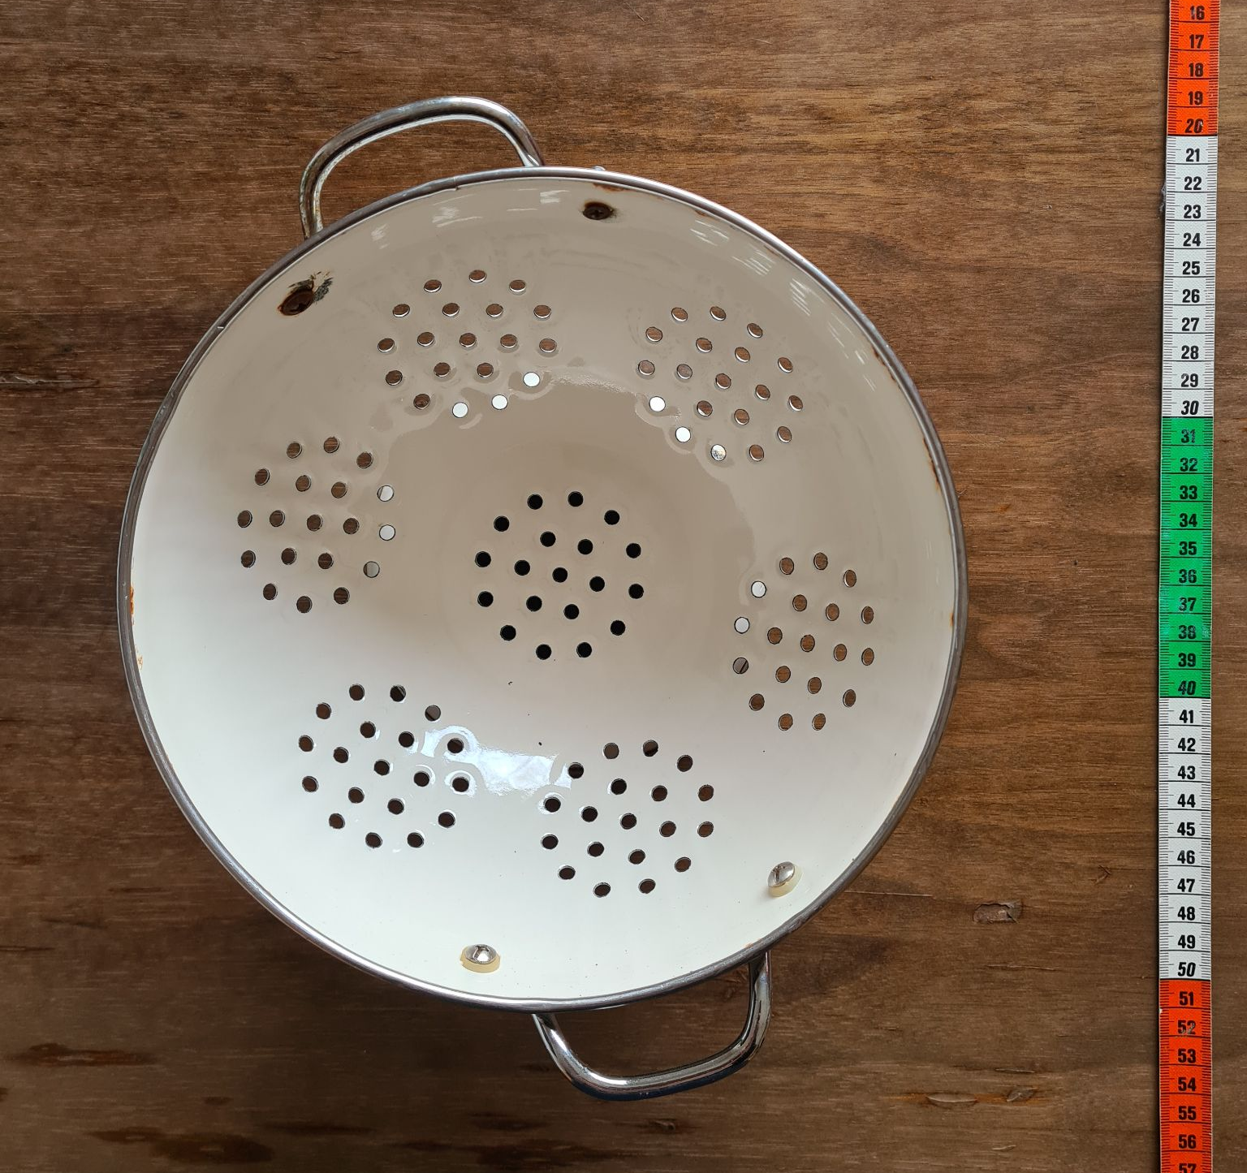
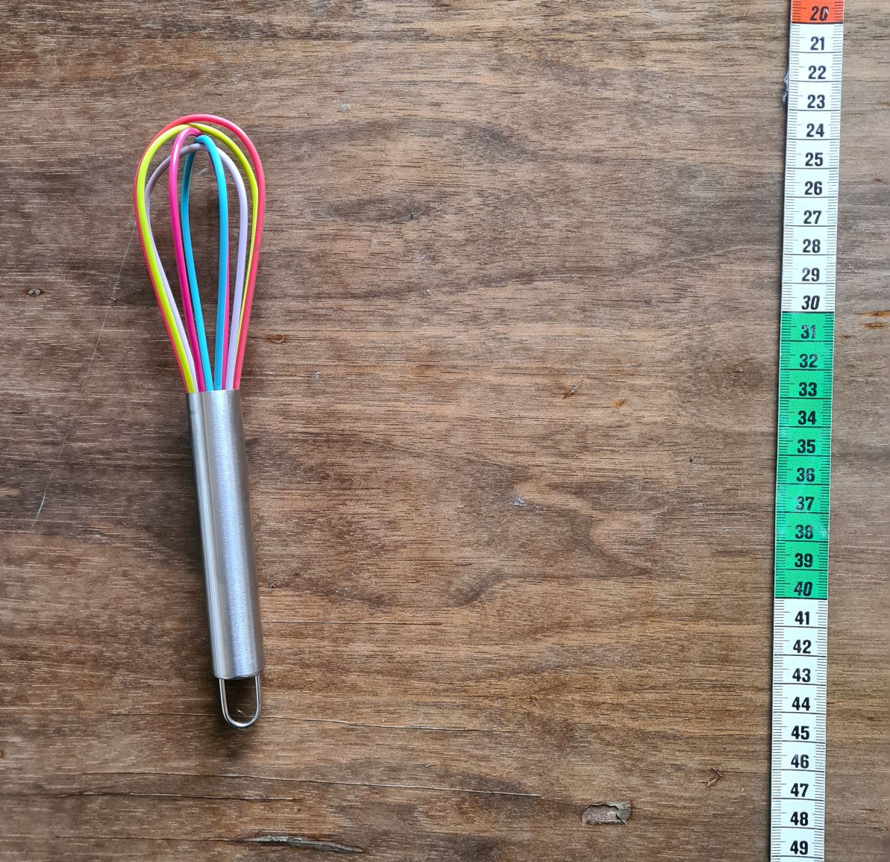
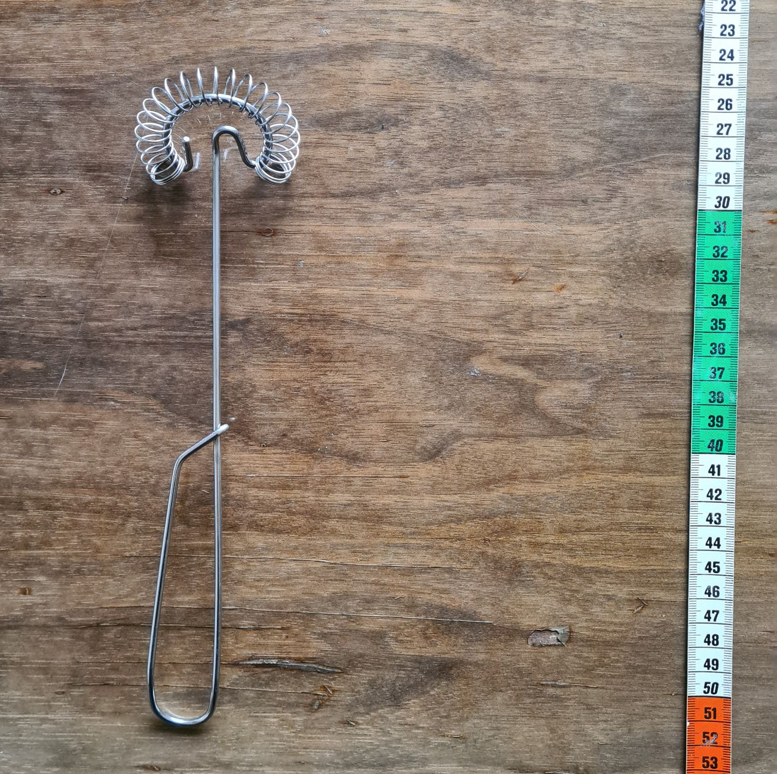
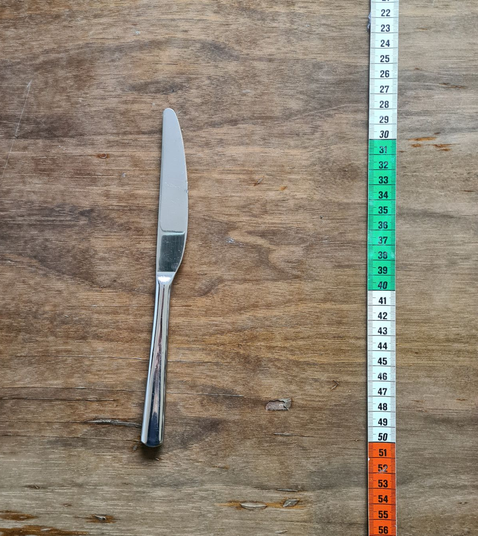
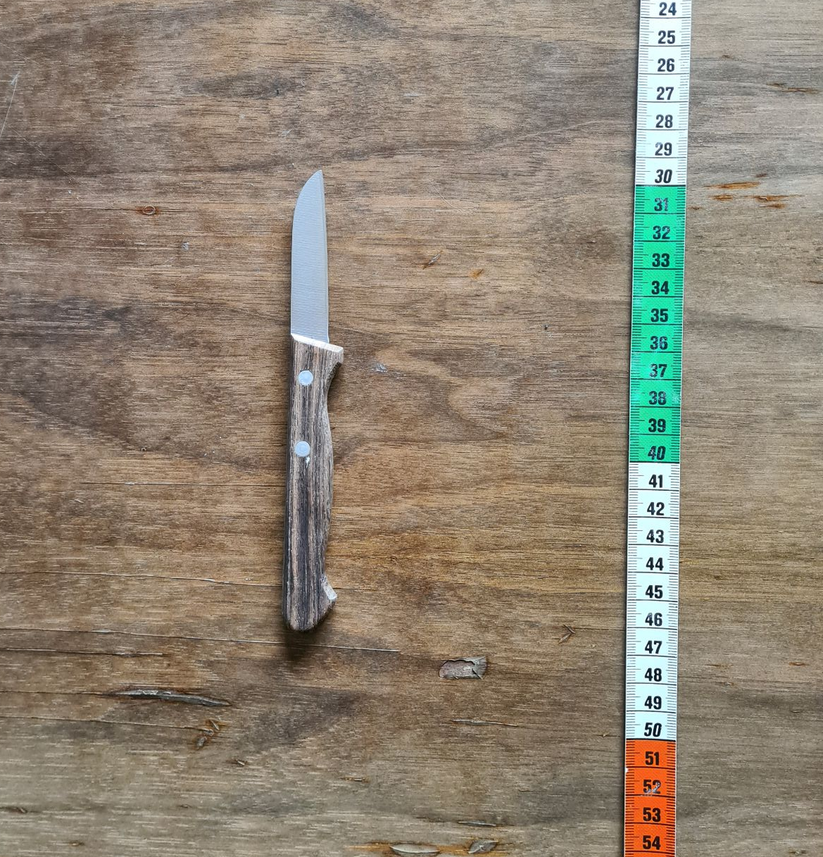
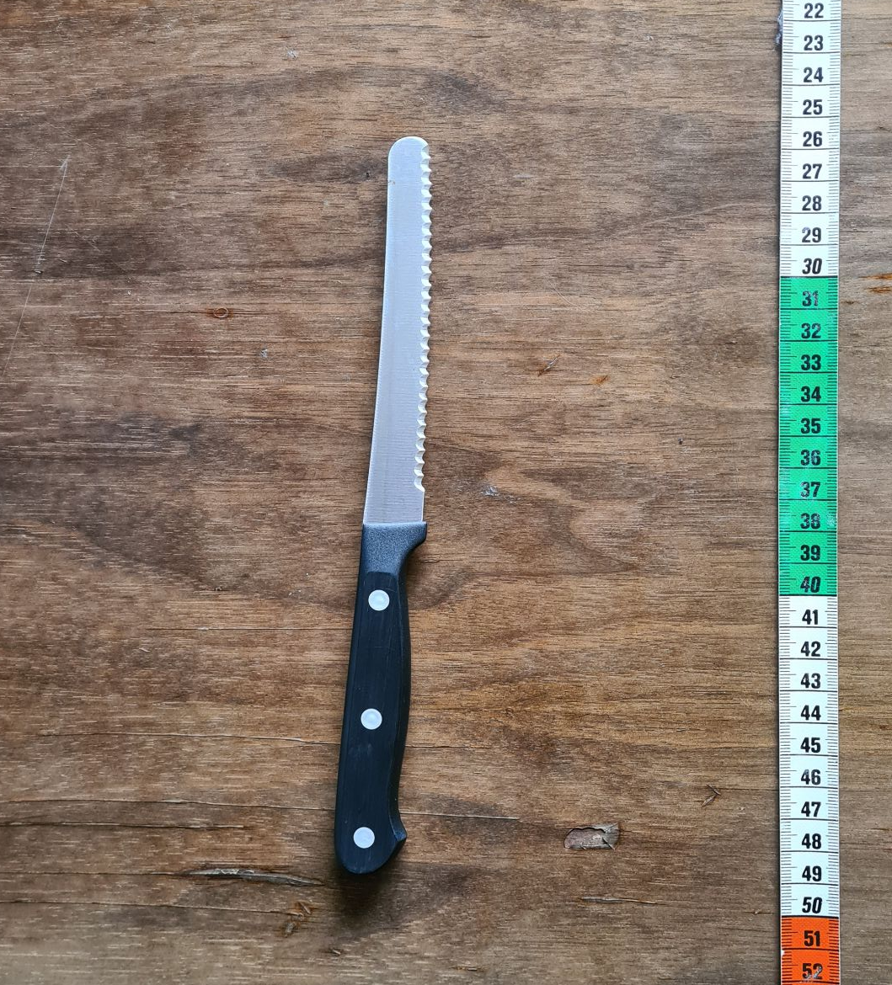
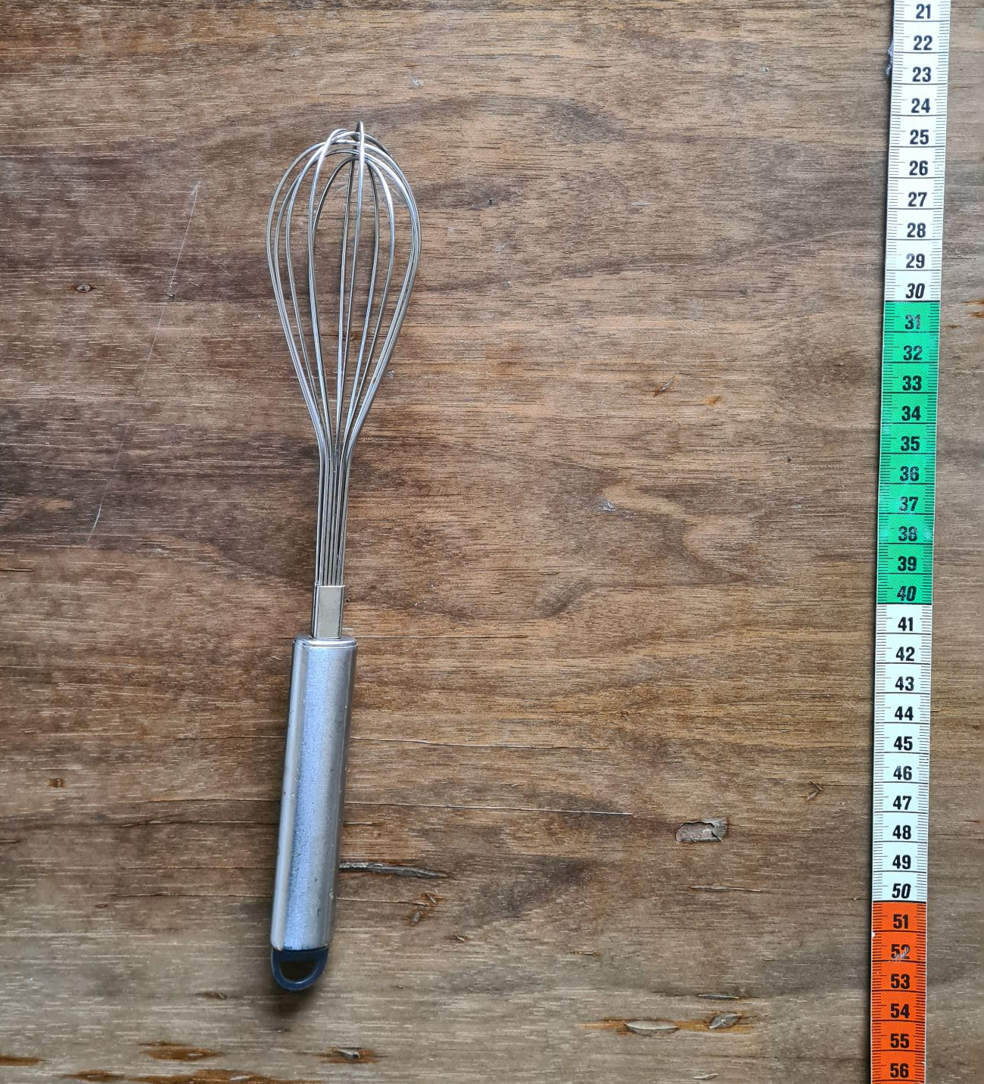
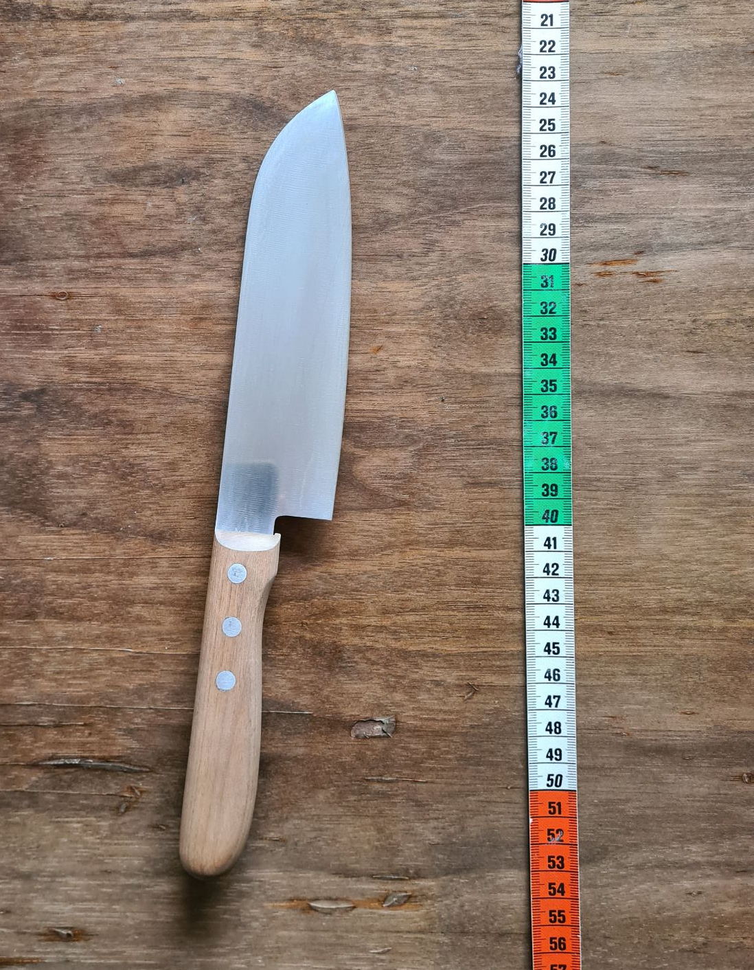
What was the object of group 1?
1
2
3
4
5
7
8
9
10
6
Illustration: photos by Sophie Boße are licensed under CC0
Notes:
Solution of group 1: sieve (object 2)
Which metadata elements where essential to distinguish between the objects 1, 2, and 3? (e.g. size)

Slide 5
What was the object of group 2?
1
2
3
4
5
7
8
9
10
6
Illustration: photos by Sophie Boße are licensed under CC0
Notes:
Solution of group 2: whisk (object 6)
Which metadata elements where essential to distinguish between the objects 4, 5, and 6? (e.g. size, color)

Slide 6
What was the object of group 3?
1
2
3
4
5
7
8
9
10
6
Illustration: photos by Sophie Boße are licensed under CC0
Notes:
Solution of group 3: paring knife (object 6)
Which metadata elements where essential to distinguish between the objects 7, 8, 9, and 10? (e.g. size, material)

