Slide 1
Data Documentation

Slide 2
Metadata

Slide 3
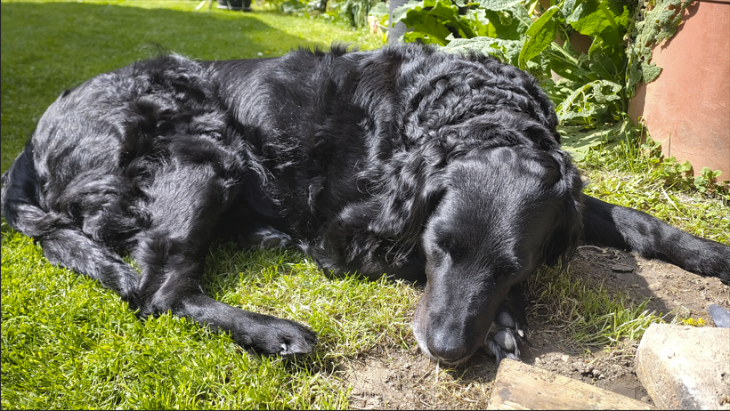
Exercise: Are these „good“ metadata?
Date 25 April 2026
Camera settings
Camera SHIFT
Camera modell SHIFTphone8
Aperture number F/1.8
Shutter speed 1/702 sec.
ISO speed ISO-100
Focal length 6 mm
Measurement mode multi- pattern
Flash light mode without flash
Kaja, 9 years old
Dog (Canis lupus familiaris)
Mixed-breed
Coat color black
Moderately obedient
Source: Modified from Jordan 2024;, Image: Lucia Vedder, licensed under CC0
Notes:
Slide content:
Now, we have a little exercise for you:
Imagine you find this image with this information, something about the camera setting and the dog itself.
Now, the question to you: Are these „good“ metadata?
Numerous questions arise: What is being researched here, the dog‘s behavior, the camera or the photographer?
Who is the researcher?
This example clearly illustrates that research data without meta(data) are worthless because they are no longer understable.

