Slide 1
Data Documentation

Slide 2
Metadata Standards

Slide 3

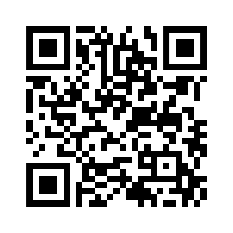
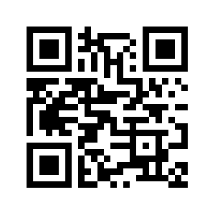
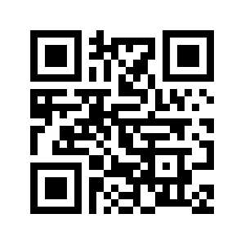
Exercise: Discipline-specific Metadata Standards
Search for suitable metadata schemas for agricultural and plant phenotyping research
Group 1:
Digital Curation Center
Group 2:
Research Data Alliance’s Catalog
Group 3:
FAIRsharing initiative
10 min
tinyurl.com/w8j9j5e5
rdamsc.bath.ac.uk
fairsharing.org
Notes:
Group 1: https://www.dcc.ac.uk/guidance/standards/metadata https://docs.google.com/document/d/1rNXimN0o5Q74Tm7YHXHscmJHKUqlgQ5OqwimhJosEcA/edit?usp=drive_link
Group 2: https://rdamsc.bath.ac.uk/ https://docs.google.com/document/d/1k7jVvNTez5gwTjcX-EQeFLo04eIcRKB9JByGvZoXWkE/edit?usp=drive_link
Group 3: https://fairsharing.org/
https://docs.google.com/document/d/1X2Kg4Qtu0yNXEK4e4zuDJ2p8iNHcujT3ymENpEJE_r0/edit?usp=drive_link

Slide 4

Discussion: Discipline-specific Metadata Standards
How did the research go? Did you get on well with your source?
What Metadata Standards did you find? What kind of data are they made for?
Notes:
Note: 5-7 min of discussion

