Slide 1
Data Documentation

Slide 2
Persistent Identifier

Slide 3
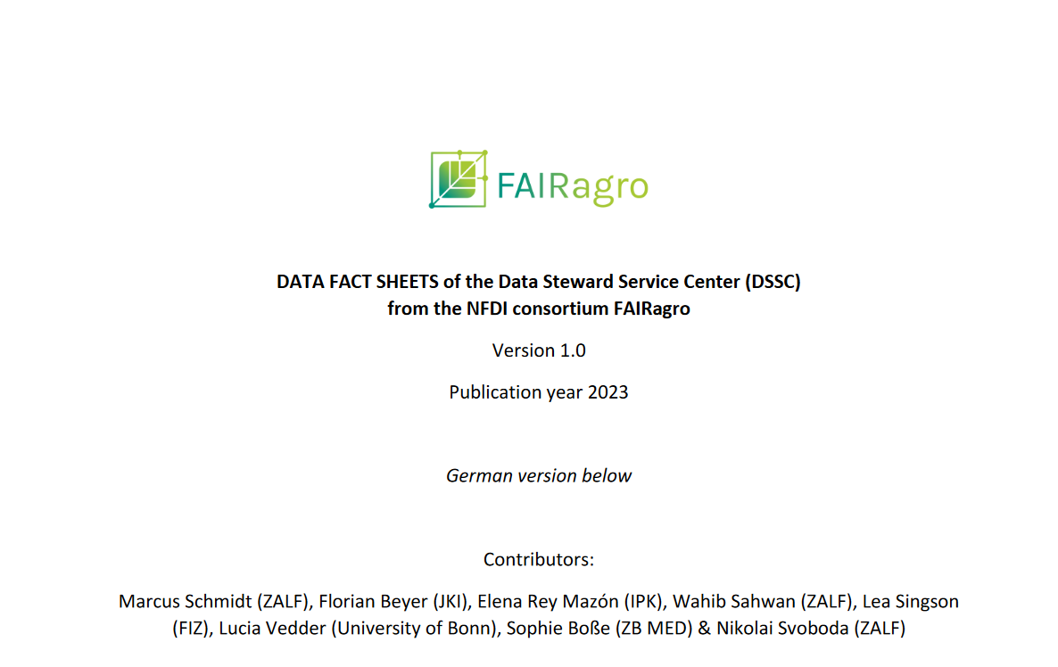
Digital Object Identifier (DOI): example of syntax
Prefix
(allocated):
PUBLISSO – Repository for Life Sciences (FRL)
URL of the DOI Foundation server for directing users to the DOI
Suffix
(chosen by the institution):
FRL01-006431467 document in the FRL
https://doi.org/10.4126/FRL01-006461782
DOI registry
Registrant
Source: Modified from forschungsdaten.info by ZB MED 2023, Illustration: Schmidt et al. (2023) is licensed under CC BY 4.0
Notes:
Slide content:
The repositories are responsible for assigning DOIs or URNs.
This slide shows how a DOI is built:
The URL of the DOI foundation, for directing the search to the DOI server
Prefix: the ID of the repository
10. → number of the DOI registry
4126 → number of the registrant
Suffix: unique combination of letters and numbers; chosen by the institution

