Slide 1
Data Documentation

Slide 2
Persistent Identifier

Slide 3
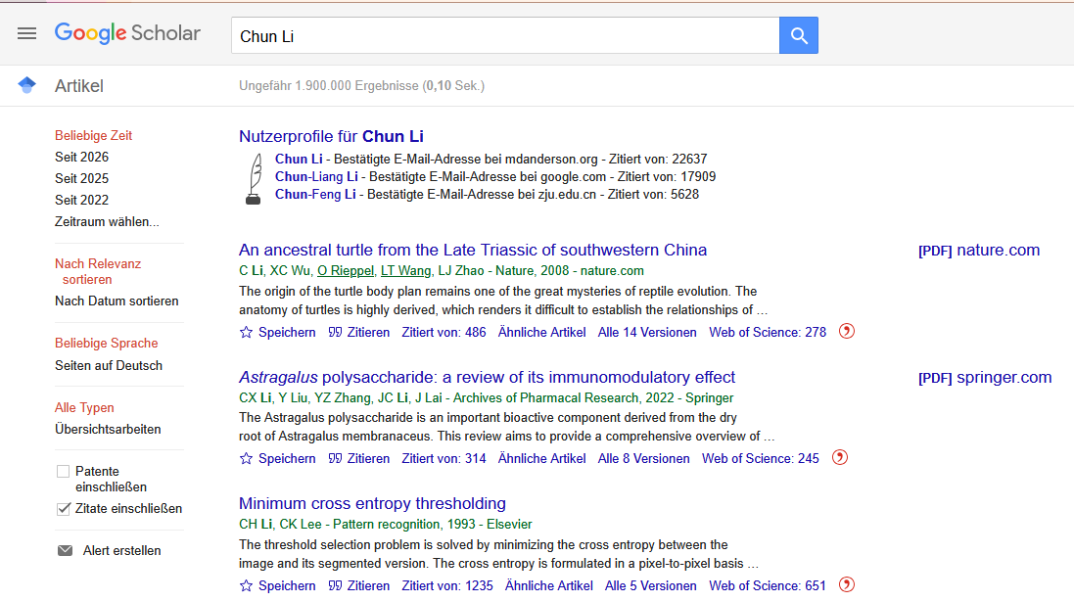
Exercise: Mister Chun Li
Mr Chun Li must be a busy man! You can find about 1.900.000 articles by him if you search in Google Scholar!
Take a look at six of them, and find out how he managed to have so many publications on such diverse topics…
Maybe the persistent identifiers can help!
10 min
Source: Screenshot from Google Scholar (2026) - Google and the Google logo are trademarks of Google LLC.
Notes:
Note:
Prepare as many Breakoutrooms (for online training) or Tables/Room (for in-person training) that are suitable for your groupsize. Prepared a shared document with the worksheet (06-06-06) for every goup and make sure being able to share it with your participants (via Chat for online training, via QR Code or tiny URL for in-person training)
Make sure to help your participants, of they don’t find out by themselves, that there could be more tahn one Chun Li, or what PID could help.
Schedule more time, for preparing groups/breakoutrooms if needed.
Slide content:
Mr Chun Li must be a busy man! You can find more than 1,9 mio articles by him if you just search in Google Scholar! Take a look at six of them, and find out how he managed to have so many publications on such diverse topics… Maybe a persistent identifier can help?
Work in Groups, you have 6 Minutes

Slide 4
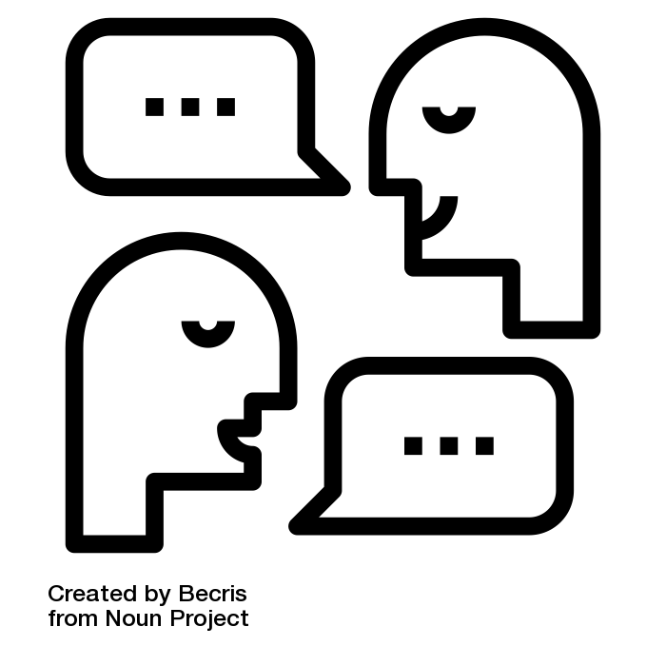
Exercise: Mister Chun Li
What did you find out?
What did help you?
What kind of PIDs did you use?
Notes:
Slide content:
Let’s discuss your experience and your findings!

Slide 5
Solution: Mister Chun Li
Paper 1: ORCID 0000-0002-8819-2443
Paper 2: ORCID 0000-0002-8031-3132
Paper 3: ORCID 0000-0002-9370-1775
Paper 4: ORCID 0000-0002-8819-2443
Paper 5: ORCID 0000-0002-9071-161X
Paper 6: ORCID 0000-0002-9370-1775
Notes:
Slide content:
Solution: These articles are written by multiple authors, all called Chun Li. The ORCID helps you to identify which articles are from the same person. In this case, there are four different people called Chun Li — all papers coloured the same belong to the same ORCID. ORCID is therefore a useful tool for clearly identifying scientists. This is important for properly differentiating between authors with the same name and recognising multiple articles from the same author if they have changed their name (e.g. due to marriage) or moved to another institute. It is also helpful to have a lasting ORCID where up-to-date contact information can be provided.
Here is the detailed information on the 6 articles:
Paper 1: “Efficacy of Abiraterone and Enzalutamide in Pre- and Postdocetaxel Castration-Resistant Prostate Cancer: A Trial-Level Meta-Analysis” https://doi.org/10.1155/2017/8560827 ORCID: 0000-0002-8819-2443
Paper 2: “Subtropical westerly jet waveguide and winter persistent heavy rainfall in south China” https://doi.org/10.1002/2017JD026530 ORCID: 0000-0002-8031-3132
Paper 3: “A SNP Mutation of SiCRC Regulates Seed Number Per Capsule and Capsule Length of cs1 Mutant in Sesame” https://doi.org/10.3390/ijms20164056 ORCID: 0000-0002-9370-1775
Paper 4: “Joint analyses of multi-tissue Hi-C and eQTL data demonstrate close spatial proximity between eQTLs and their target genes” https://doi.org/10.1186/s12863-019-0744-x ORCID: 0000-0002-8819-2443
Paper 5: “Antimicrobial Mechanism of pBD2 against Staphylococcus aureus” https://doi.org/10.3390/molecules25153513 ORCID: 0000-0002-9071-161X
Paper 6: “Identification of Candidate Genes Regulating the Seed Coat Color Trait in Sesame (Sesamum indicum L.) Using an Integrated Approach of QTL Mapping and Transcriptome Analysis” https://doi.org/10.3389/fgene.2021.700469 ORCID: 0000-0002-9370-1775

