Slide 1
Data Documentation

Slide 2
Computational Reproducibility

Slide 3
What is Narrative description?
Is a detailed, written description of computational analyses.
Benefits: enable others to reproduce a computational analysis
Content:
  Operating system(s)
  Software dependencies
  Analytical software and how to obtain them
  Software versions, order in which they were used and non-default parameters
When? Throughout the research process
Source: modified from Piccolo & Frampton 2016 by ZB MED 2023
Notes:
Slide content:
A narrative description is a detailed written description of a computational analysis. It is (often) the easies for other researchers to understand, but makes the most effort while programming.

Slide 4
Custom code & scripts
Text-based commands used via a command-line interface.
Benefits: automate research analyses
Content:
  Software program(s) to be executed
  Parameter(s) to be used
When? As needed, can be published alongside research papers
Source: modified from Piccolo & Frampton 2016 by ZB MED 2023
Notes:
Slide content:
Custom code and scripts are often parts of computational analyses as they may automate a lot. It is highly recommended to comment these scripts and code well to make it re-usable to others.
Note: see also 06-02-08_Types_CommentedCode

Slide 5
What are Software Frameworks?
“Concrete or conceptual platform where common code with generic functionality can be selectively specialized or overridden by developers or users” [Techopedia 2018].
Benefits of building on a pre-existing software framework:
  Easily accessing software libraries
  Easily downloading and installing software dependencies
  Easily ensuring that the versions are compatible with each other
Example of software framework in biology: Bioconductor
Source: modified from Piccolo & Frampton 2016 by ZB MED 2023
Notes:
Slide content:
A software framework may help to ensure the compatibility of dependencies or the accession of already existing libraries.

Slide 6
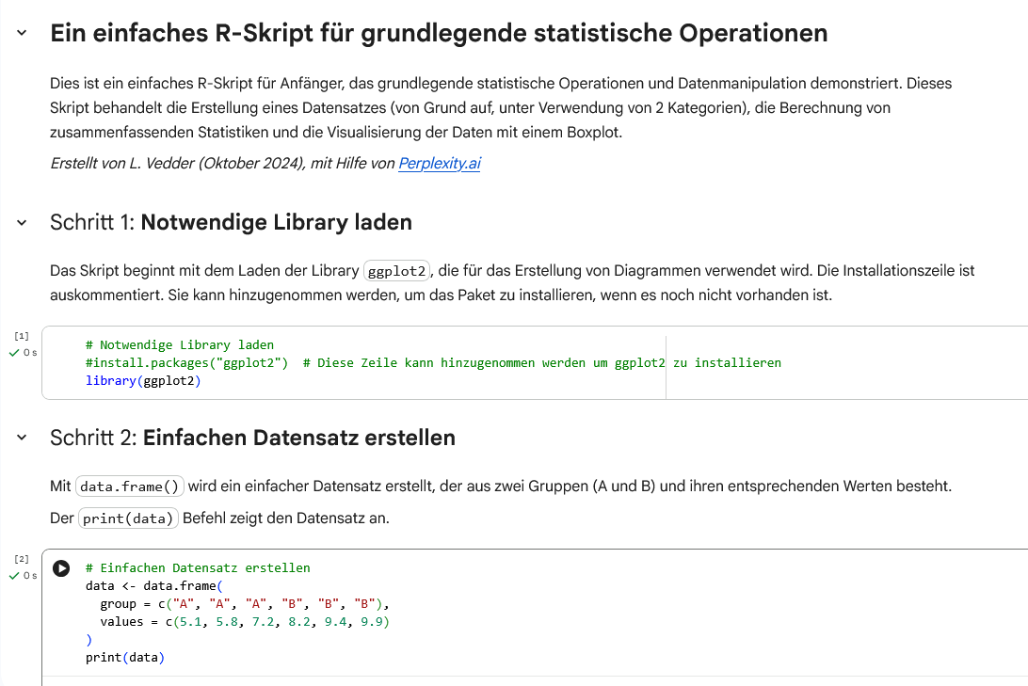
What is Literate Programming?
Code intermingled within a narrative of the scientific analysis.
Benefits: reduce barriers of understanding
Content:
  Code
  Narratives
  Output
Examples of tools:
  Jupyter
  knitr
Source: modified from Piccolo & Frampton 2016 by ZB MED 2023, Screenshot: Jupyter Notebook Example by Lucia Vedder licensed under CC0
Notes:
Slide content:
Literate programming (using e.g. Jupyter) combines the advantages of a narrative description with (short) parts of code: All analysis scripts, outputs, graphics and explanations are at the same place.

