Slide 1
Data Documentation

Slide 2
Computational Reproducibility

Slide 3
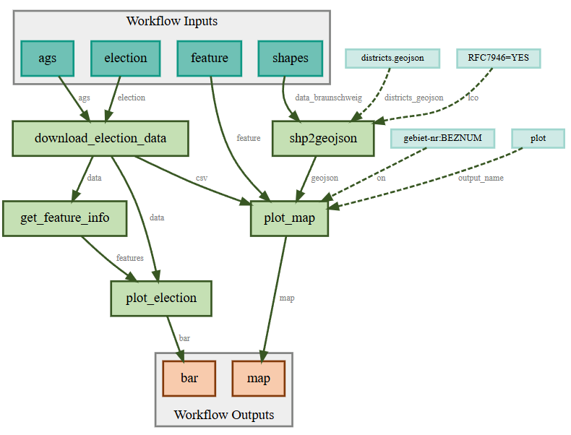
Why Workflows are Useful
You'll never forget a step again
You can automate repetitive tasks, e.g. for regular reports and rescheduling of tasks
You can share your work with others and they know how you got your results
You can easily repeat it even next year
A workflow saves you time and help you organize tasks
github.com/fairagro/m4.4_sciwin_client_demo
Source: Krumsiek, Leidel, Stiensmeier, von Waldow 2025; Illustration: SciWin Client Demo
Notes:
Slide content:
In the field of scientific programming workflows have several avantages, especially when you have multiple computing steps.

