Slide 1
Data Management Plan

Slide 2

Data management plan
Why Create a Data Management Plan (DMP)?
Required by many research funders
Helps avoid problems and unexpected costs
Enables re-use and reproducibility of your data
Increases the long-term impact of your research
Makes your work more efficient with FAIR principles and support tools
Source: Daniel Wibberg, Helena Schnitzer (de.NBi) modified by FAIRagro 2025; RDMkit by FAIRagro 2026; Illustration: from RDMkit is licensed under CC BY 4.0
Notes:
Slide content: Even though we’ve already looked at what a DMP is and how to write one, it’s worth asking: Why is it actually important?
First of all, many funders require a DMP. It’s simply expected.
But even more importantly, a good DMP helps you avoid surprises, manage your data better, and increase the long-term impact of your research.
It also makes your work more efficient, because you plan early how to use tools, services, and store or share your data in a FAIR way.

Slide 3
Why Data Management?
Goal: Reproducibility !!
Requirements
Good scientific practice
Institutional guidelines
Requirements from funding agencies
Legal and ethical frameworks
Benefits
Saves time and resources
Improves data security (less risk of data loss)
Enables reproducibility of experiments
Makes data reusable by others (and yourself!)
Source: by Daniel Wibberg, Helena Schnitzer (de.NBi) and RDMkit modified by FAIRagro 2026
Notes:
Slide content: There are two main reasons why good data management matters
First, the requirements: data management is part of good scientific practice, it's often required by your institution, your funder, and even by law, especially when personal or sensitive data is involved.
But the benefits go far beyond compliance:
A clear data strategy helps you save time, avoid data loss, and makes your research more reproducible and reusable (for others and for yourself later on).
So even if no one forces you to do it — it’s worth doing well.

Slide 4
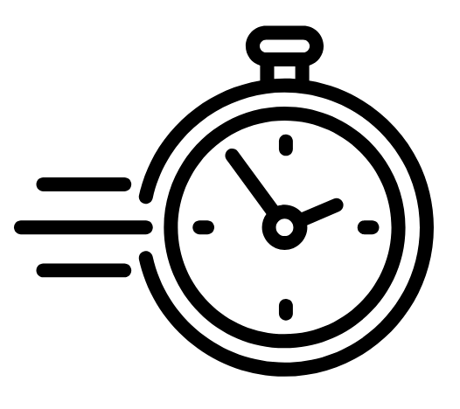
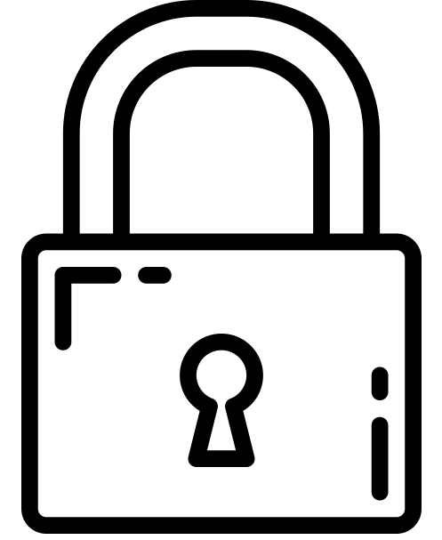

Importance of DMPs
Saving time for your future self.
Identifying time and money costs to be included in the proposal.
Regulate access rights and preventing security holes.
Facilitating data reuse.
Ensuring ethical and legal requirements are fulfilled.
Enabling verification and control.
Supporting research integrity.
Part of the funder requirements.
Source: Modified from ZB MED by FAIRagro 2026; Illustration: “Time” by Rena Putri, “Lock” by tulpahn, “legal” by Creative Mahira are licensed under CC BY 3.0
Notes:
Slide content: Here’s a summary of why DMPs really matter (not just for funders, but for your own research).
A good DMP can save your future self a lot of stress, help you plan costs and responsibilities, and ensure you're not overlooking ethical, legal, or security issues.
It also increases the impact and reusability of your data and supports transparency and scientific integrity (all essential aspects of good research).
And of course, in many cases, it’s a mandatory part of the funding process.

Slide 5
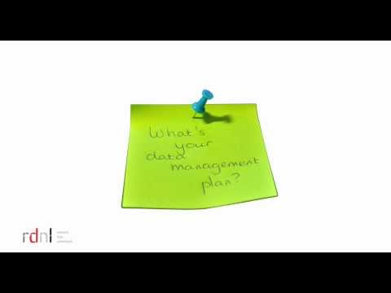
The what, why and how of data management planning
Video: research data netherlands is licensed under Youtube License
Notes:
Note:
If wanted, you can watch this short video with the participants. Plan 5 minutes more time for that.
Slide content: To wrap up this section, here’s a short video that nicely summarizes the what, why, and how of data management planning.
It’s part of an open course developed in the Netherlands and gives you a quick and practical overview, especially helpful if you're new to the topic.

